Slide 1
Drill: Tuesday, 9/6
Simplify.
1. 7 – (–3)
2. –1 – (–13)
3. |–7 – 1|
Solve each equation.
4. 2x + 3 = 9x – 11 5. 3x = 4x – 5
6. How many numbers are there between and ?
OBJ: SWBAT use the segment addition postulate in order to find segment lengths.

Slide 2
Honors Geometry Lesson A2

Slide 3
Find the length of…
Notes:
Compare lengths of different segments; vocab: length, distance, measure

Slide 5
The distance between any two points is the absolute value of the difference of the coordinates. If the coordinates of points A and B are a and b, then the distance between A and B is |a – b| or |b – a|. The distance between A and B is also called the length of AB, or AB.
A
B
AB = |a – b| or |b - a|
a
b

Slide 6
Example 1: Finding the Length of a Segment
Find each length.
A. BC
B. AC
BC = |1 – 3|
AC = |–2 – 3|
= |1 – 3|
= |– 5|
= 2
= 5

Slide 7
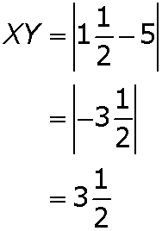
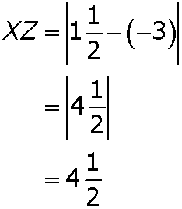
Check It Out! Example 1
Find each length.
a. XY
b. XZ

Slide 8
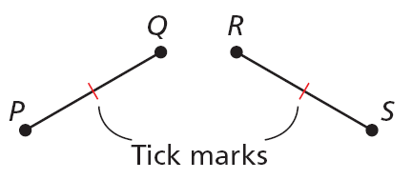
Congruent segments are segments that have the same length. In the diagram, PQ = RS, so you can write PQ ≅ RS. This is read as “segment PQ is congruent to segment RS.” Tick marks are used in a figure to show congruent segments.

Slide 9
In order for you to say that a point B is between two points A and C, all three points must lie on the same line, and AB + BC = AC.

Slide 10
Example 3A: Using the Segment Addition Postulate
G is between F and H, FG = 6, and FH = 11. Find GH.
FH = FG + GH
Seg. Add. Postulate
11 = 6 + GH
Substitute 6 for FG and 11 for FH.
Subtract 6 from both sides.
5 = GH
Simplify.

Slide 11
Example 3B: Using the Segment Addition Postulate
M is between N and O. Find NO.
NM + MO = NO
Seg. Add. Postulate
17 + (3x – 5) = 5x + 2
Substitute the given values
3x + 12 = 5x + 2
Simplify.
Subtract 2 from both sides.
3x + 10 = 5x
Simplify.
Subtract 3x from both sides.
10 = 2x
Divide both sides by 2.
5 = x

Slide 12
Example 3B Continued
M is between N and O. Find NO.
NO = 5x + 2
= 5(5) + 2
Substitute 5 for x.
= 27
Simplify.

Slide 13
Check It Out! Example 3a
Y is between X and Z, XZ = 3, and XY = . Find YZ.
XZ = XY + YZ
Seg. Add. Postulate
Substitute the given values.
Subtract from both sides.

Slide 14
Check It Out! Example 3b
E is between D and F. Find DF.
DE + EF = DF
Seg. Add. Postulate
(3x – 1) + 13 = 6x
Substitute the given values
3x + 12 = 6x
Subtract 3x from both sides.
12 = 3x
Simplify.
Divide both sides by 3.
4 = x

Slide 15
Check It Out! Example 3b Continued
E is between D and F. Find DF.
DF = 6x
= 6(4)
Substitute 4 for x.
= 24
Simplify.

Slide 16
The midpoint M of AB is the point that bisects, or divides, the segment into two congruent segments. If M is the midpoint of AB, then AM = MB.
So if AB = 6, then AM = 3 and MB = 3.

Slide 17
Example 4: Recreation Application
The map shows the route for a race. You are at X, 6000 ft from the first checkpoint C. The second checkpoint D is located at the midpoint between C and the end of the race Y. The total race is 3 miles. How far apart are the 2 checkpoints?
XY = 3(5280 ft)
Convert race distance to feet.
= 15,840 ft

Slide 18
Example 4 Continued
XC + CY = XY
Seg. Add. Post.
Substitute 6000 for XC and 15,840 for XY.
6000 + CY = 15,840
Subtract 6000 from both sides.
CY = 9840
Simplify.
D is the mdpt. of CY, so CD = CY.
= 4920 ft
The checkpoints are 4920 ft apart.

Slide 19
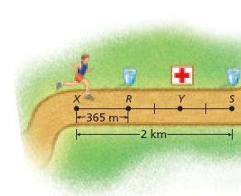
Check It Out! Example 4
You are 1182.5 m from the first-aid station. What is the distance to a drink station located at the midpoint between your current location and the first-aid station?
The distance XY is 1182.5 m. The midpoint would be
.

Slide 20
Example 5: Using Midpoints to Find Lengths
D is the midpoint of EF, ED = 4x + 6, and DF = 7x – 9. Find ED, DF, and EF.
E
4x + 6
D
7x – 9
F
Step 1 Solve for x.
ED = DF
D is the mdpt. of EF.
4x + 6 = 7x – 9
Substitute 4x + 6 for ED and 7x – 9 for DF.
Subtract 4x from both sides.
6 = 3x – 9
Simplify.
Add 9 to both sides.
15 = 3x
Simplify.

Slide 21
Example 5 Continued
D is the midpoint of EF, ED = 4x + 6, and DF = 7x – 9. Find ED, DF, and EF.
E
4x + 6
D
7x – 9
F
15 3x
=
Divide both sides by 3.
x = 5
Simplify.

Slide 22
Example 5 Continued
D is the midpoint of EF, ED = 4x + 6, and DF = 7x – 9. Find ED, DF, and EF.
E
4x + 6
D
7x – 9
F
Step 2 Find ED, DF, and EF.
ED = 4x + 6
DF = 7x – 9
EF = ED + DF
= 4(5) + 6
= 7(5) – 9
= 26 + 26
= 26
= 26
= 52

Slide 23
Check It Out! Example 5
S is the midpoint of RT, RS = –2x, and
ST = –3x – 2. Find RS, ST, and RT.
R
S
T
–2x
–3x – 2
Step 1 Solve for x.
RS = ST
S is the mdpt. of RT.
–2x = –3x – 2
Substitute –2x for RS and –3x – 2 for ST.
Add 3x to both sides.
x = –2
Simplify.

Slide 24
Check It Out! Example 5 Continued
S is the midpoint of RT, RS = –2x, and
ST = –3x – 2. Find RS, ST, and RT.
R
S
T
–2x
–3x – 2
Step 2 Find RS, ST, and RT.
RS = –2x
ST = –3x – 2
RT = RS + ST
= –2(–2)
= –3(–2) – 2
= 4 + 4
= 4
= 4
= 8

Slide 25
Lesson Quiz: Part I
1. M is between N and O. MO = 15, and MN = 7.6. Find NO.
22.6
2. S is the midpoint of TV, TS = 4x – 7, and
SV = 5x – 15. Find TS, SV, and TV.
25, 25, 50
3. Sketch, draw, and construct a segment congruent to CD.
Check students' constructions

Slide 26
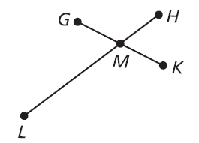
Lesson Quiz: Part II
4. LH bisects GK at M. GM = 2x + 6, and
GK = 24. Find x.
3
5. Tell whether the statement below is sometimes, always, or never true. Support your answer with a sketch.
If M is the midpoint of KL, then M, K, and L are collinear.
Always
K
M
L

