Slide 1
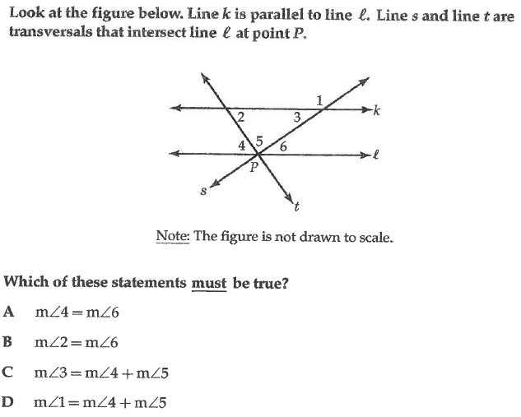
Drill: Tuesday, 11/8
OBJ: SWBAT analyze angle theorems in order to develop proofs.

Slide 8
Challenge Question

