Slide 1
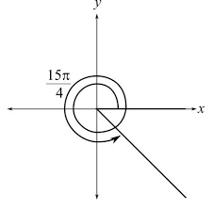
Sketching Angles and Coterminal Angles

Slide 2
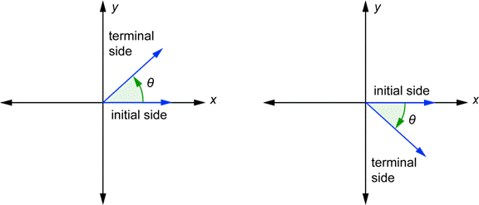
Angles in Standard Position
An angle is in standard position if its initial side is on the positive x-axis.
Positive Angle:
Rotates
counter-clockwise
Negative Angle:
Rotates
Clockwise
(Goes up from
the initial)
(Goes down from
the initial)

Slide 3
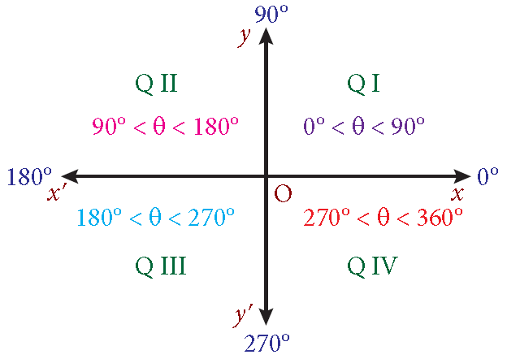
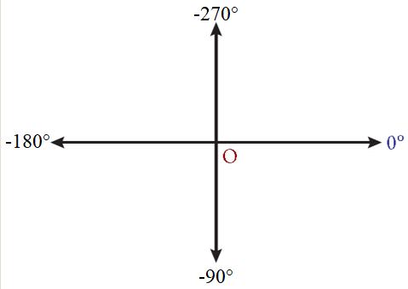
Sketching Degrees
The best way to go about sketching degrees is to label the quadrantal angles.

Slide 4
Sketching Degrees
Sketch 320° Sketch -150°

Slide 5
Sketching Radians
Sketching radians is a little more… complicated.
Take the denominator (L) and use that to break Q1 and Q2 into L equal slices.
Then, take the numerator and count that many slices.
Example: $\frac{5π}{6}$
Note: for odd denominators, it may be best to leave off the y-axis

Slide 6
Sketching Radians
Sketch $\frac{8π}{3}$
Sketch $−\frac{7π}{4}$

Slide 7
Sketching Radians
Sketch $\frac{4π}{5}$
Sketch $−\frac{5π}{2}$

Slide 8
Coterminal Angles
These are angles that have the same initial side and terminal side.
Degrees
- A multiple of 360° apart
$$θ±360n\text{°}$$
where $n$ is any integer
Radians
- A multiple of $2π$ apart
$$θ±2πn$$
where $n$ is any integer
When sketching very large angles, it is helpful to know the smallest positive coterminal angle!

Slide 9

Sketching Large Angles
Sketch 1150°
Sketch $\frac{27π}{4}$

