Slide 1
Drill
1) What is the vertex of the function f(x) = 2(x – 4)² + 8 ?
2) Write the equation of a quadratic function with an “a” value of -3 and a vertex of (-5, 12).

Slide 2
Objective
Students will be able to identify h and k of functions in order to determine how it transformed the parent function.

Slide 3
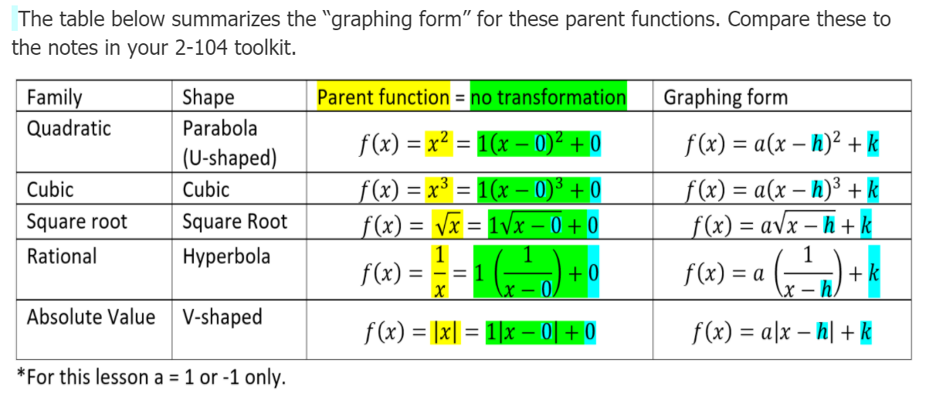

Slide 4
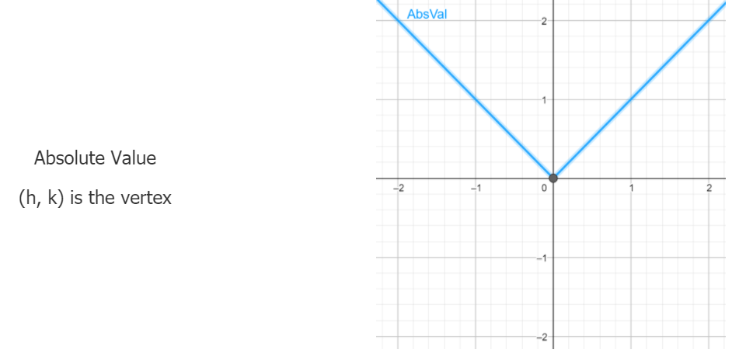

Slide 5

Identify the vertex of each absolute value function below.
$f\left(x\right)=\left|x+4\right|−1$
$f\left(x\right)=−\left|x−2\right|−6$
$y=\frac{1}{2}\left|x+6\right|−9$
*Type your answers in the chat

Slide 6
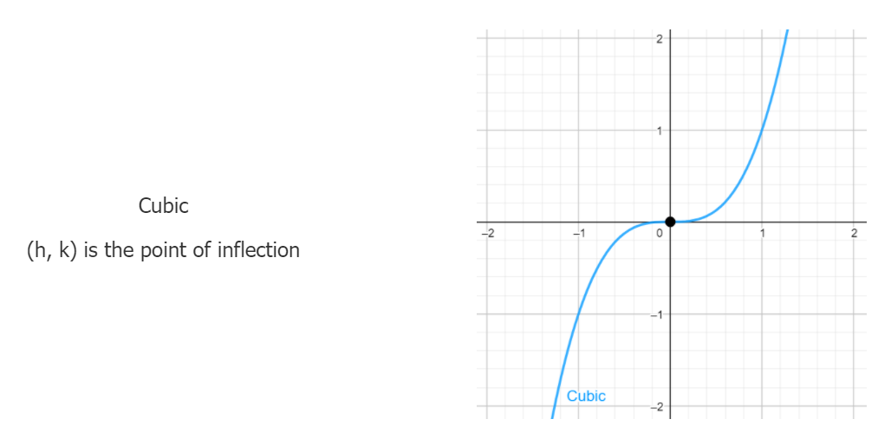

Slide 7

Identify the point of inflection for each cubic function below
$f\left(x\right)=(x+2)^{3}+4$
$f\left(x\right)=−(x)^{3}+6$
$f\left(x\right)=−.5(x−6)^{3}$
*Type your answers in the chat

Slide 8
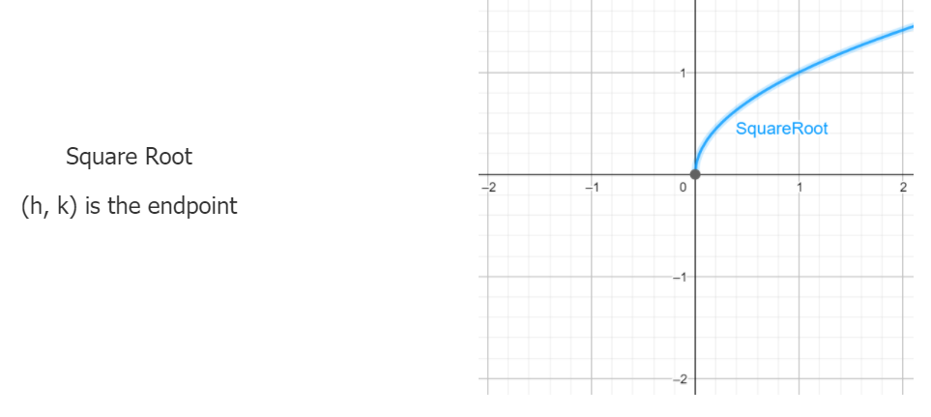

Slide 9

Determine the endpoint of each radical function
$f\left(x\right)=−\sqrt{x−2}+4$
$f\left(x\right)=\frac{2}{3}\sqrt{x+3}−9$
$f\left(x\right)=−\sqrt{x}+12$

Slide 10
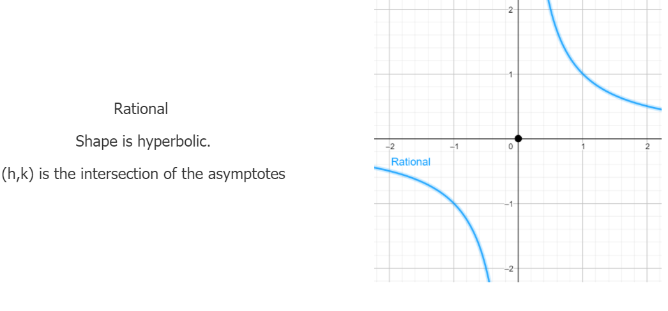

Slide 11

Determine the intersection of the asymptotes for the rationals below
$f\left(x\right)=\frac{1}{x−3}−11$
$f\left(x\right)=3\left(\frac{1}{x+2}\right)+13$

