Slide 1
Absolute Value Equations and Inequalities
Absolute Value Equations ▪ Absolute Value Inequalities ▪ Special Cases ▪ Absolute Value Models for Distance and Tolerance

Slide 2
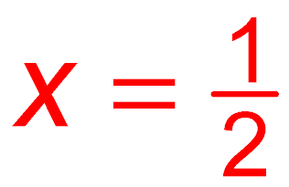
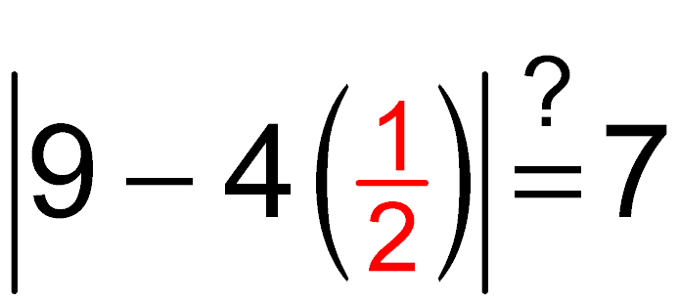
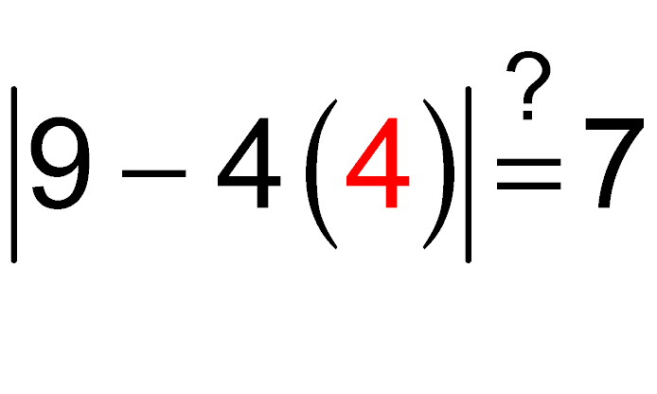
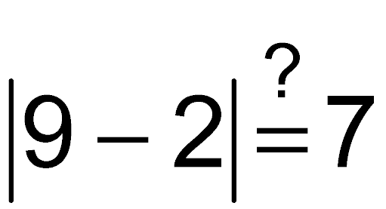
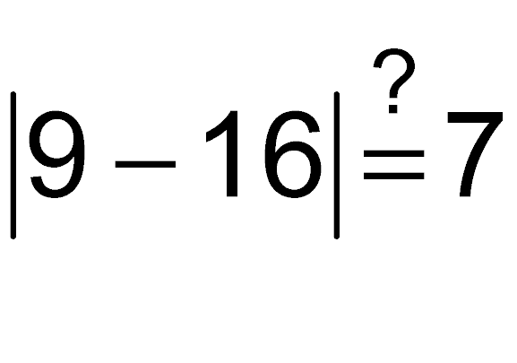
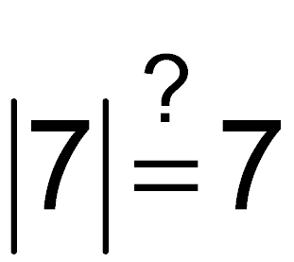
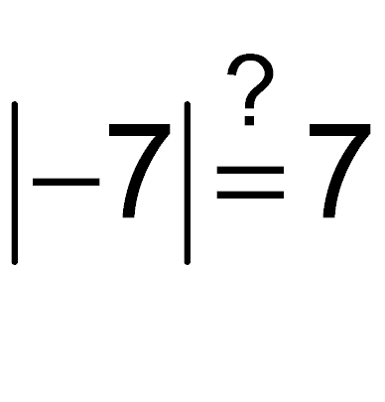
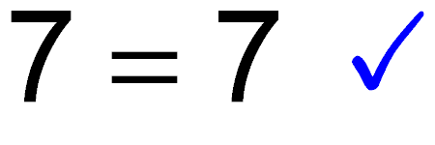
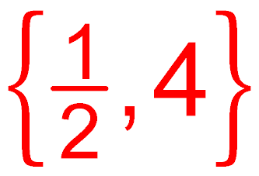
1.8 Example 1(a) Solving Absolute Value Equations (page 159)
or
Property 1
or
Subtract 9.
or
Divide by –4.
Now check.
Solution set:

Slide 3
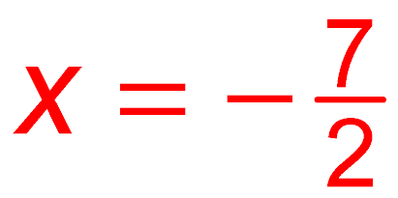
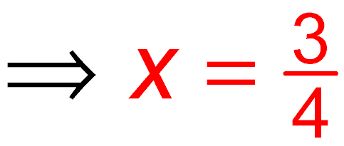
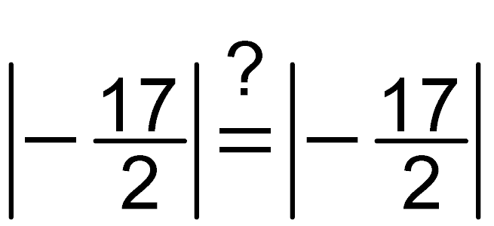
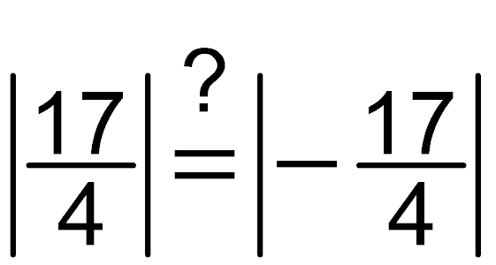
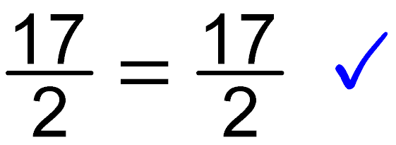
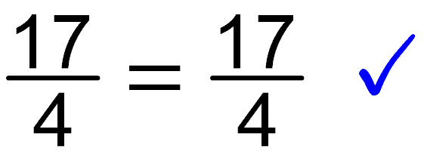
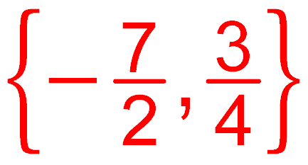
1.8 Example 1(b) Solving Absolute Value Equations (page 159)
or
Property 2
or
or
Now check.
Solution set:

Slide 4
1.8 Example 2(a) Solving Absolute Value Inequalities (page 160)
Property 3
Add 6.
Divide by 4.
Solution set: (–1, 4)

Slide 5
1.8 Example 2(b) Solving Absolute Value Inequalities (page 160)
or
Property 4
or
Add 6.
or
Divide by 4.
Solution set:

Slide 6
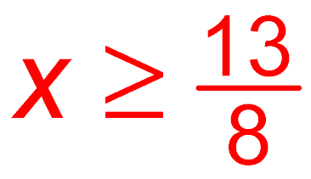
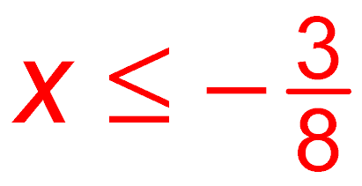
1.8 Example 3 Solving Absolute Value Inequalities Requiring a Transformation (page 161)
Subtract 6.
or
Property 4
or
Subtract 5.
or
Divide by –8. Reverse the direction of the inequality symbol.
Solution set:

Slide 7
1.8 Example 4(a) Solving Special Cases of Absolute Value Equations and Inequalities (page 161)
The absolute value of a number will be 0 if that number is 0.
Therefore, is equivalent to 7x + 28 = 0.
Solution set: {–4}

Slide 8
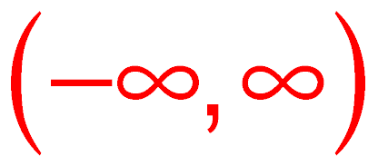
1.8 Example 4(b) Solving Special Cases of Absolute Value Equations and Inequalities (page 161)
The absolute value of a number is always nonnegative.
Therefore, is always true.
Solution set:

Slide 9
1.8 Example 4(c) Solving Special Cases of Absolute Value Equations and Inequalities (page 161)
There is no number whose absolute value is less than –5.
Therefore, is always false.
Solution set: ø

