Slide 1
Math 132 Day 2 (2/1/18)
CCBC Dundalk

Slide 2
Examples

Slide 3
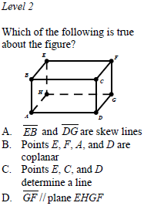

Slide 4
Examples

Slide 5
Homework #1: (Due 2/6)
Look through a magazine, newspaper, website, brochure, etc.. and cut out or label five examples of basic geometry vocabulary words in the real world.

Slide 6
Axioms About Points, Lines, and Planes
There is exactly one line that contains any two distinct points.
If two points lie in a plane, then the line containing the points lies in the plane.
If two distinct planes intersect, then their intersection is a line.
There is exactly one plane that contains any three distinct noncollinear points.

Slide 7
Theorems About Points, Lines, and Planes
A line and a point not on the line determine a plane.
Two parallel lines determine a plane.
Two intersecting lines determine a plane.

Slide 8
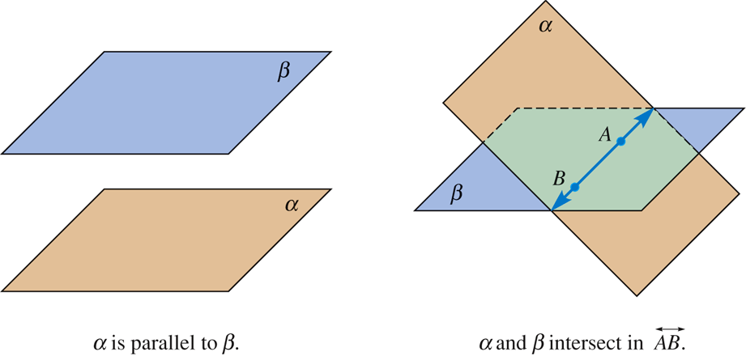
Other Planar Notions

Slide 9
Half plane
Line AB separates plane  into two half-planes.

Slide 10
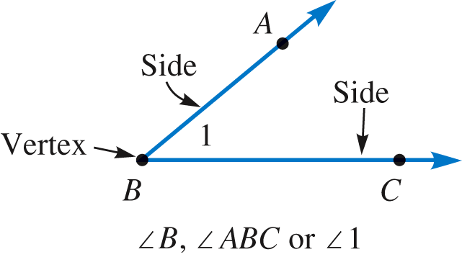
Angles
Angle – formed by two rays with the same endpoint.
Sides of an angle – the two rays that form an angle.
Vertex – the common endpoint of the two rays that form an angle.

Slide 11
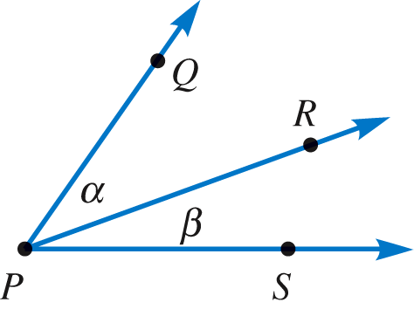
Angles
Adjacent angles – two angles with a common vertex and a common side, but without overlapping interiors.
QPR is adjacent to RPS.

Slide 12
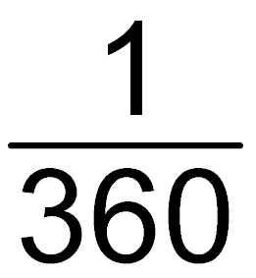
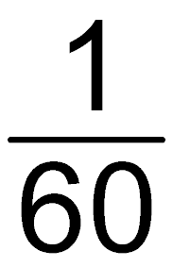
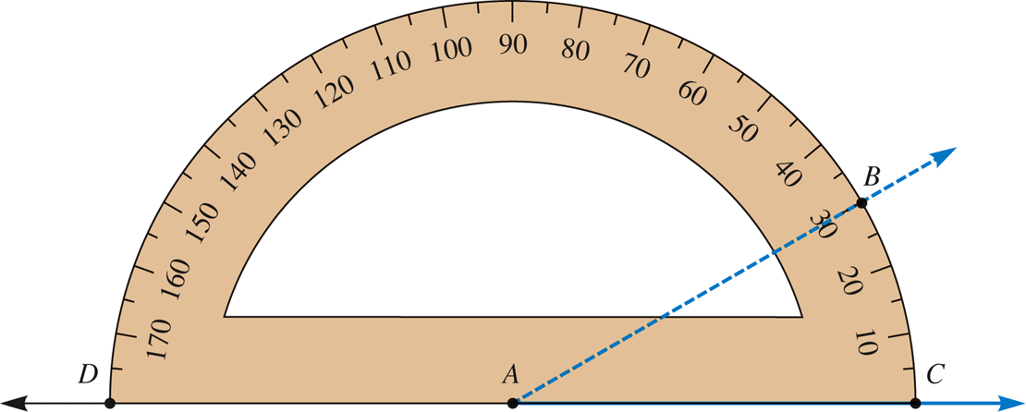
Angle Measurement
Degree : of a rotation about a point
Minute : of a degree
Second : of a minute
Protractor

Slide 13
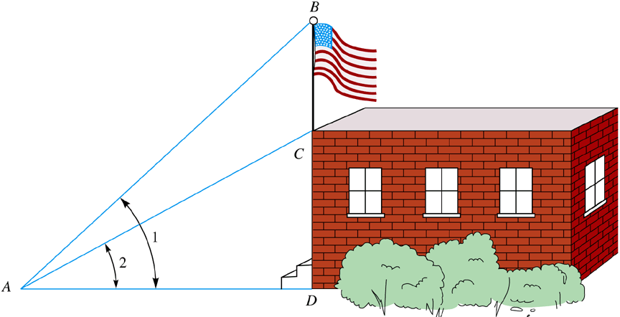
Example 11-1
a. Find the measure of BAC if m1 = 47°45′ and m2 = 29°58′ .
mBAC = 17°47′
b. Express 47°45′36″ as a number of degrees.
47°45′36″ = 47°+ 0.75° + 0.01° = 47.76°

Slide 14
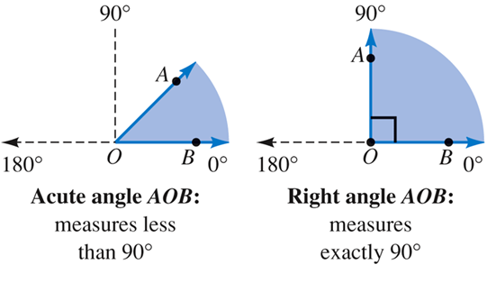
Types of Angles

Slide 15
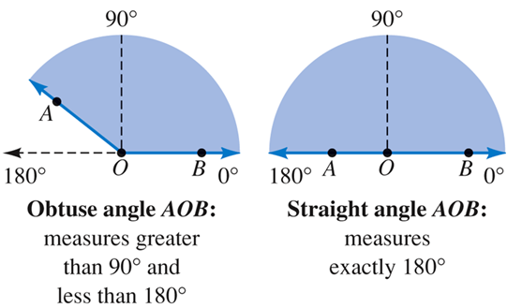
Types of Angles

Slide 16
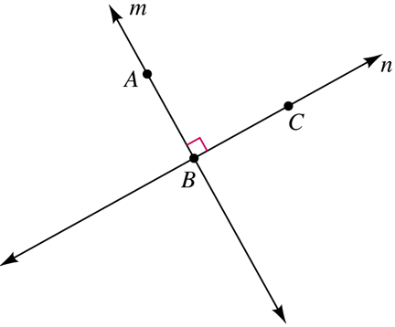
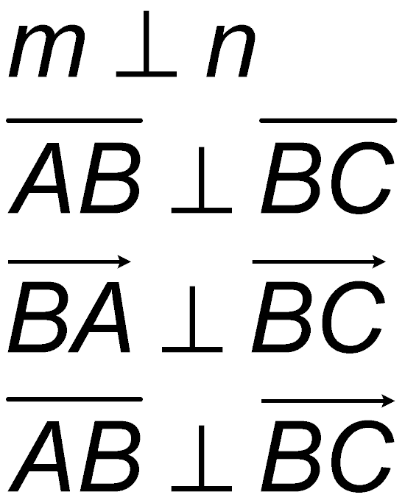
Perpendicular Lines

Slide 17
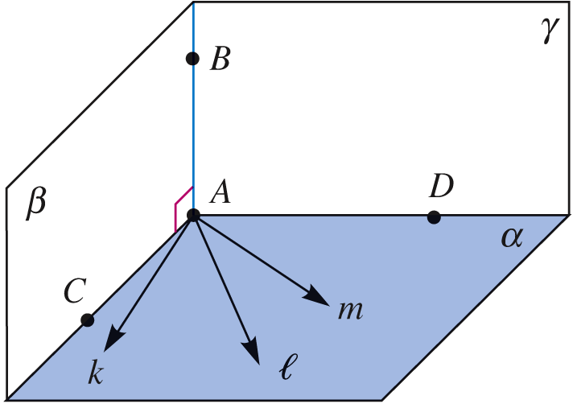
A Line Perpendicular to a Plane
A line perpendicular to a plane is a line that is perpendicular to every line in the plane through its intersection with the plane.

Slide 18
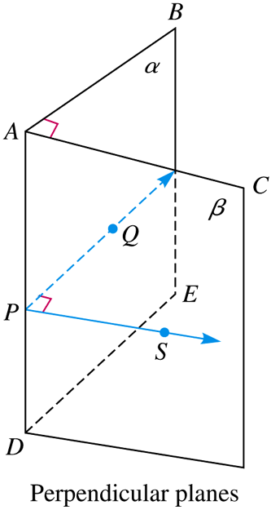
Perpendicular Planes
If P is any point on AD, Q in plane α, and S in plane β so that
PQ  AD and PS  AD, then QPS is also a right angle.
Since QPS measures 90°, the planes are perpendicular.

Slide 19
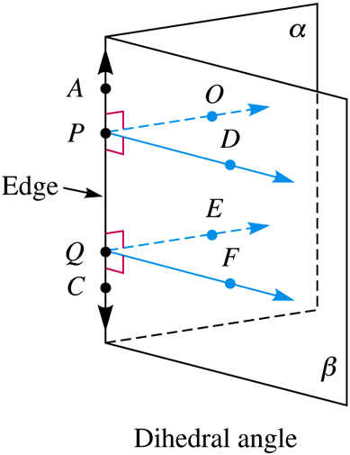
Dihedral Angles
A dihedral angle is formed by the union of two half-planes and the common line defining the half-planes.
A dihedral angle is measured by any of the associated planar angles such OPD, where PO  AC and PD  AC.

Slide 20
11-2 Linear Measure
The English System
Converting Units of Measure
Dimensional Analysis (Unit Analysis)
The Metric System
Distance Properties
Distance Around a Plane Figure
Circumference of a Circle
Arc Length

Slide 21
Distance Properties
1. The distance between any two points A and B is greater than or equal to 0 (AB  0).
2. The distance between any two points A and B is the same as the distance between B and A (AB = BA).
3. For any three points, A, B, and C, the distance between A and B plus the distance between B and C is greater than or equal to the distance between A and C (AB + BC  AC).

Slide 22
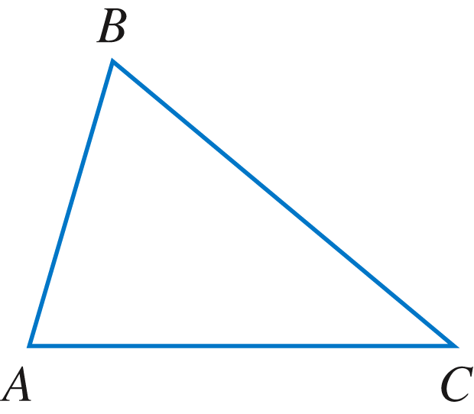
Triangle Inequality
The sum of the lengths of any two sides of a triangle is greater than the length of the third side.
AB + BC > AC
Can a triangle be made with sides that are 15 cm, 18 cm, and 37 cm?
no

Slide 23
Distance Around a Plane Figure
Perimeter
the length of a simple closed curve, or the sum of the lengths of the sides of a polygon.

Slide 24
Example 11-6
Find the perimeter of each of the shapes.
9 cm
2ℓ + 2w

Slide 25
Example 11-6 (continued)
4s
170 mm
What is the perimeter of a regular n-gon with side s?
ns

Slide 26
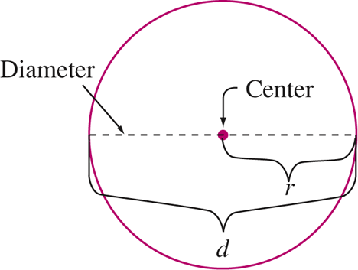
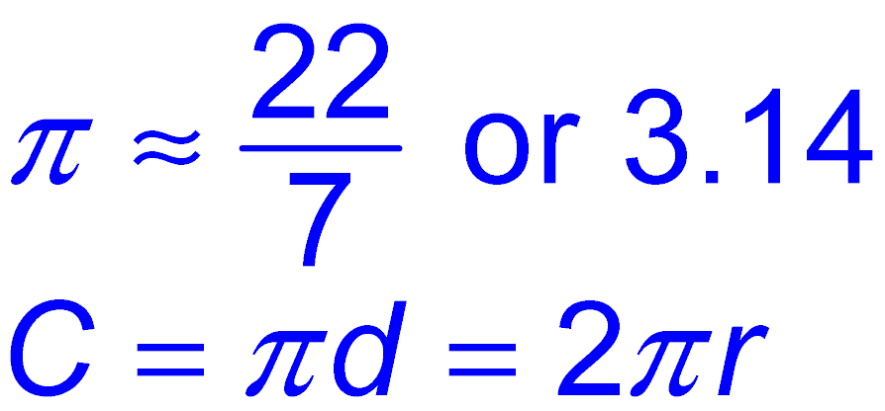
Circumference of a Circle
Circle – the set of all points in a plane that are the same distance from a given point, the center.
Circumference – the perimeter of a circle.
Pi – the ratio between the circumference of a circle and the length of its diameter.

Slide 27
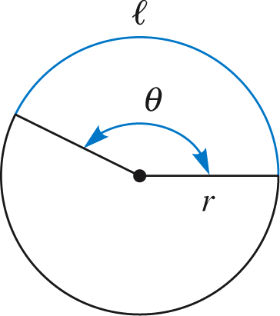
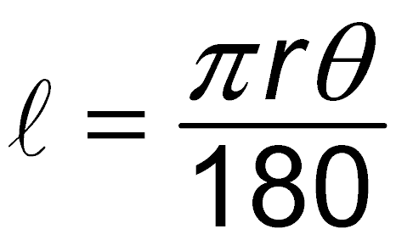
Arc Length

Slide 28
Example 11-7
Find each of the following:
The circumference of a circle with radius 2 m
The radius of a circle with circumference 15π m
The length of a 25° arc of a circle with diameter 10 cm.
The radius of an arc whose central angle is 87° and whose arc length is 154 cm.
4π m
7.5 m
≈ 101.4 cm

Slide 29
11-3 Curves, Polygons, and Symmetry
More About Polygons
Congruent Segments and Angles
Regular Polygons
Triangles and Quadrilaterals
Hierarchy Among Polygons
Line Symmetries
Rotational (Turn) Symmetries
Point Symmetry
Classification of Figures by Their Symmetries

Slide 30
Curves and Polygons
Simple curve
a curve that does not cross itself; starting and stopping points may be the same.
Closed curve
a curve that starts and stops at the same point.
Polygon
a simple, closed curve with sides that are line segments.

Slide 31
Curves and Polygons
Convex curve
a simple, closed curve with no indentations; the segment connecting any two points in the interior of the curve is wholly contained in the interior of the curve.
Concave curve
a simple, closed curve that is not convex; it has an indentation.

Slide 32
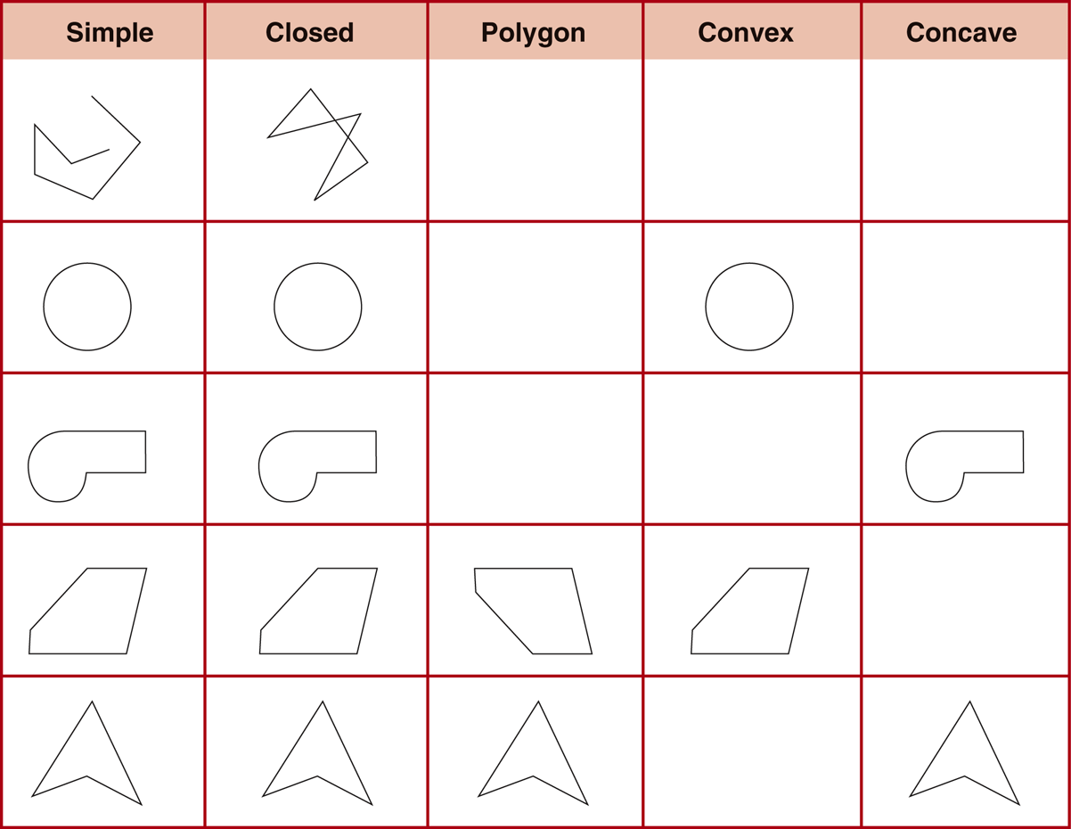

Slide 33
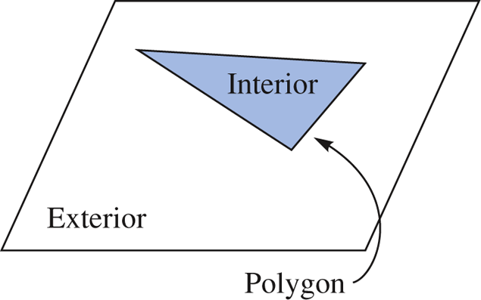
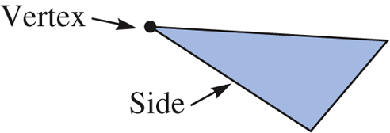
Polygonal Regions
Every simple closed curve separates the plane into three disjoint subsets: the interior of the curve, the exterior of the curve, and the curve itself.

Slide 34
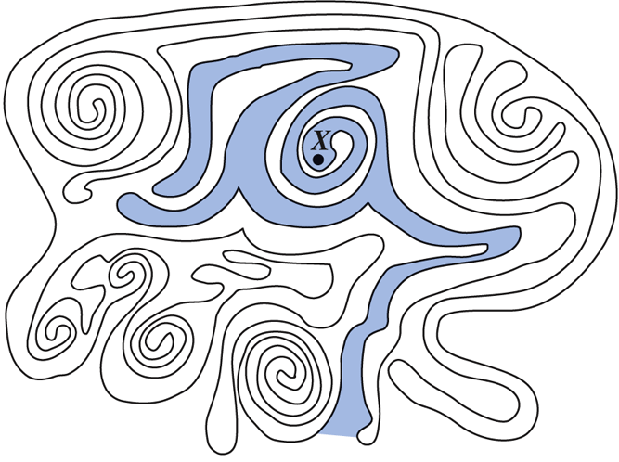
Polygonal Regions
Is point X inside or outside the simple closed curve?
outside

Slide 35
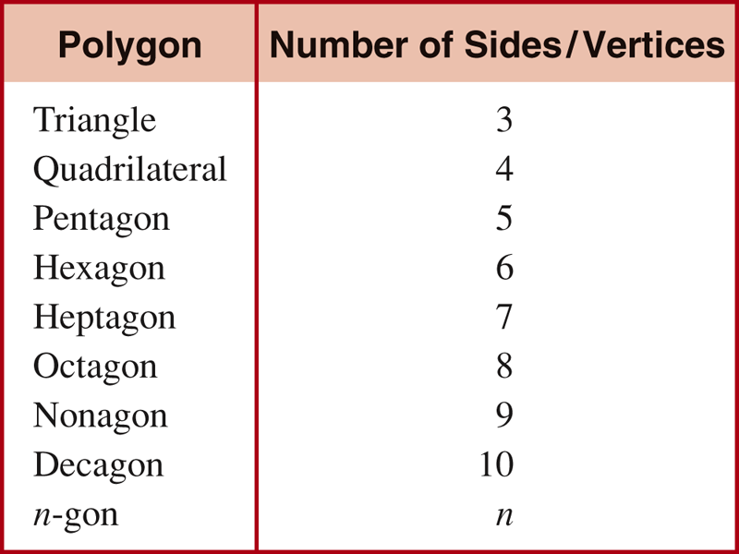
More About Polygons

Slide 36
More About Polygons
Interior angle
an angle formed by two sides of a polygon with a common vertex.
Exterior angle of a convex polygon
an angle formed by a side of a polygon and the extension of a contiguous side of the polygon.
Diagonal
a line segment connecting nonconsecutive vertices of a polygon.

Slide 37
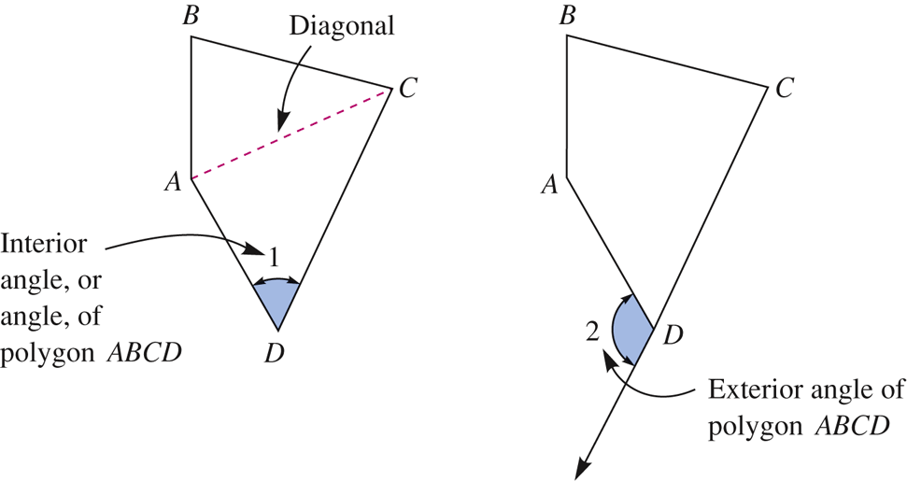
More About Polygons

Slide 38
Congruent Segments and Angles
Congruent parts
parts with the same size and shape
Two line segments are congruent (≅) if a tracing of one line segment can be fitted exactly on top of the other line segment.
Two angles are congruent (≅) if they have the same measure.

Slide 39
Congruent Segments and Angles

Slide 40
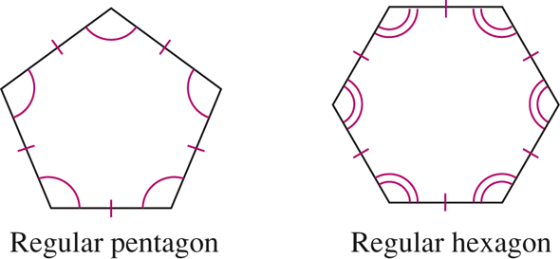
Regular Polygons
All sides are congruent and all angles are congruent.
A regular polygon is equilateral and equiangular.

Slide 41
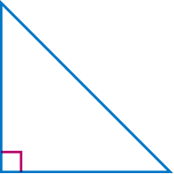
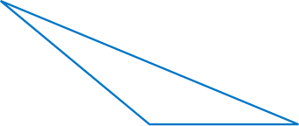
Triangles and Quadrilaterals
Right triangle
a triangle containing one right angle
Acute triangle
a triangle in which all the angles are acute
Obtuse triangle
a triangle containing one obtuse angle

Slide 42
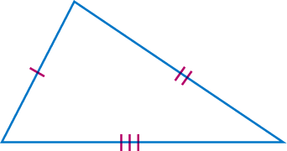
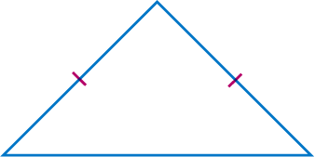
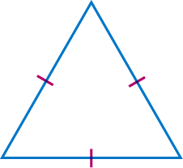
Triangles and Quadrilaterals
Scalene triangle
a triangle with no congruent sides
Isosceles triangle
a triangle with at least two congruent sides
Equilateral triangle
a triangle with three congruent sides

Slide 43
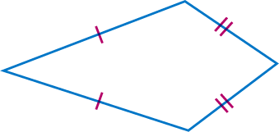
Triangles and Quadrilaterals
Trapezoid
a quadrilateral with at least one pair of parallel sides
Kite
a quadrilateral with two adjacent sides congruent and the other two sides also congruent

Slide 44
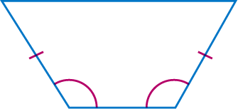
Triangles and Quadrilaterals
Isosceles trapezoid
a trapezoid with congruent base angles
Parallelogram
a quadrilateral in which each pair of opposite sides is parallel
Rectangle
a parallelogram with a right angle.

Slide 45
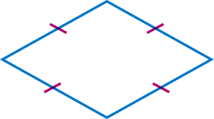
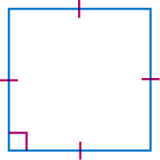
Triangles and Quadrilaterals
Rhombus
a parallelogram with two adjacent sides congruent
Square
a rectangle with two adjacent sides congruent

Slide 46
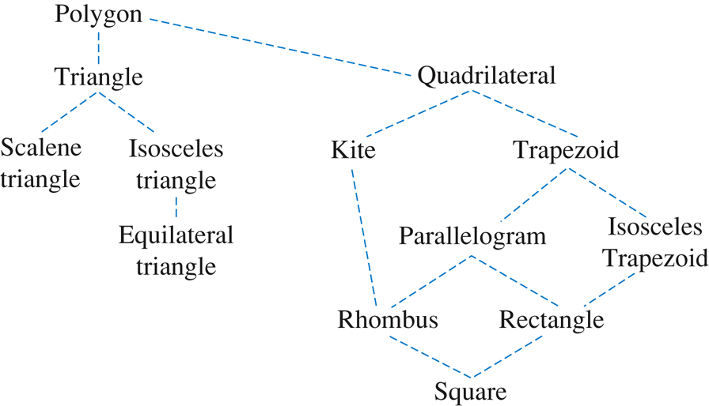
Hierarchy Among Polygons

Slide 47
Line Symmetries
Mathematically, a geometric figure has a line of symmetry ℓ if it is its own image under a reflection in ℓ.

Slide 48
Example 11-8
How many lines of symmetry does each drawing have?
6
1
2
0

Slide 49
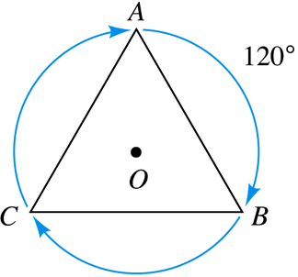
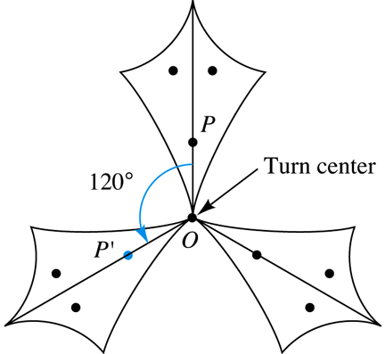
Rotational (Turn) Symmetries
A figure has rotational symmetry, or turn symmetry, when the traced figure can be rotated less than 360° about some point, the turn center, so that it matches the original figure.

Slide 50
Similar Example 11-9
Determine the amount of the turn for the rotational symmetries of each figure.
a.
b.
72°, 144°, 216°, 288°
c.
60°, 120°, 180°, 240°, 300°
180°

Slide 51
Point Symmetry
Any figure that has rotational symmetry 180° is said to have point symmetry about the turn center.

Slide 52
Classification of Figures by Their Symmetries
Geometric figures in a plane can be classified according to the number of symmetries they have.
We can use lines of symmetry and turn symmetries to define various types of quadrilaterals normally used in geometry.

Slide 53
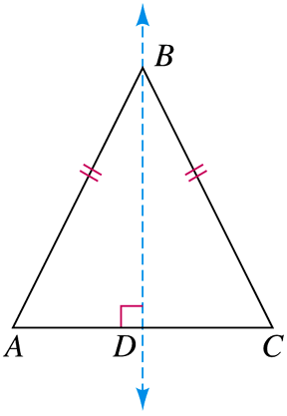
Classification of Figures by Their Symmetries
Consider a triangle described as having exactly one line of symmetry and no turn symmetries. What could the triangle look like?

