Slide 1
Summary (Week 1)
Categorical vs. Quantitative Variables
Types of Graphs for Categorical and Quantitative Data
Describe a Distribution: (Shape, Center, Spread)
Shape: Symmetric vs. Skewed
Center: Mean vs. Median
Spread: IQR vs. Standard Deviation (not covered)

Slide 2
Spread: The Interquartile Range
Quartiles divide the data into four equal sections.
One quarter of the data lies below the lower quartile, Q1
One quarter of the data lies above the upper quartile, Q3.
The difference between the quartiles is the interquartile range (IQR), so
IQR = upper quartile – lower quartile
IQR = Q3 – Q1

Slide 3
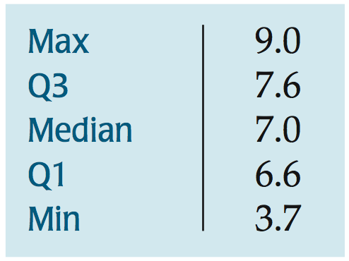
5-Number Summary
The 5-number summary of a distribution reports its median, quartiles, and extremes (maximum and minimum)
The 5-number summary for the recent tsunami earthquake Magnitudes looks like this:
We will use the 5-Number
summary later on to create
a box plot.

Slide 4
Summary: Shape, Center, and Spread
Mean and Standard Deviation always go together
Median and IQR always go together.
Use MEAN and STANDARD DEVIATION when the distribution is symmetric and there are NO Outliers!
Otherwise use Median and IQR.

Slide 5
What About Spread? The Standard Deviation
A more powerful measure of spread than the IQR is the standard deviation, which takes into account how far each data value is from the mean.
A deviation is the distance that a data value is from the mean.
Since adding all deviations together would total zero, we square each deviation and find an average of sorts for the deviations.

Slide 6
What About Spread? The Standard Deviation
The variance, notated by s², is found by summing the squared deviations and (almost) averaging them:
The variance will play a role later in our study, but it is problematic as a measure of spread—it is measured in squared units!

Slide 7
What About Spread? The Standard Deviation
The standard deviation, s, is just the square root of the variance and is measured in the same units as the original data.

Slide 8
Thinking About Variation
Since Statistics is about variation, spread is an important fundamental concept of Statistics.
Measures of spread help us talk about what we don’t know.
When the data values are tightly clustered around the center of the distribution, the IQR and standard deviation will be small.
When the data values are scattered far from the center, the IQR and standard deviation will be large.

Slide 9
Chapter 6
The Standard Deviation as a Ruler and the Normal Model

Slide 10
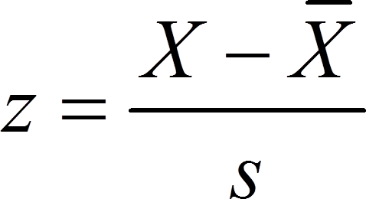
Standardizing with z-scores
We compare individual data values to their mean, relative to their standard deviation using the following formula:
We call the resulting values standardized values, denoted as z. They can also be called z-scores.

Slide 11
Standardizing with z-scores (cont.)
Standardized values have no units.
z-scores measure the distance of each data value from the mean in standard deviations.
A negative z-score tells us that the data value is below the mean, while a positive z-score tells us that the data value is above the mean.

Slide 12
Benefits of Standardizing
Standardized values have been converted from their original units to the standard statistical unit of standard deviations from the mean.
Thus, we can compare values that are measured on different scales, with different units, or from different populations.

Slide 13
Shifting Data
Adding or subtracting a constant to every data value adds or subtracts the same constant to measures of position: center, percentiles, max/min.
Its shape and spread - range, IQR, standard deviation - remain unchanged.

Slide 14
Rescaling Data
* When we multiply (or divide) all the data values by any constant, all measures of position (such as the mean, median, and percentiles) and measures of spread (such as the range, the IQR, and the standard deviation) are multiplied (or divided) by that same constant.

Slide 15
Back to z-scores
Standardizing data into z-scores shifts the data by subtracting the mean and rescales the values by dividing by their standard deviation.
Standardizing into z-scores does not change the shape of the distribution.
Standardizing into z-scores changes the center by making the mean 0.
Standardizing into z-scores changes the spread by making the standard deviation 1.

Slide 16
When Is a z-score BIG?
A z-score gives us an indication of how unusual a value is because it tells us how far it is from the mean.
Remember that a negative z-score tells us that the data value is below the mean, while a positive z-score tells us that the data value is above the mean.
The larger a z-score is (negative or positive), the more unusual it is.

Slide 17
When Is a z-score Big? (cont.)
There is no universal standard for z-scores, but there is a model that shows up over and over in Statistics.
This model is called the Normal model (You may have heard of “bell-shaped curves.”).
Normal models are appropriate for distributions whose shapes are unimodal and roughly symmetric.
These distributions provide a measure of how extreme a z-score is.

Slide 18
When Is a z-score Big? (cont.)
There is a Normal model for every possible combination of mean and standard deviation.
We write N(μ,σ) to represent a Normal model with a mean of μ and a standard deviation of σ.
We use Greek letters because this mean and standard deviation do not come from data—they are numbers (called parameters) that specify the model.

Slide 19
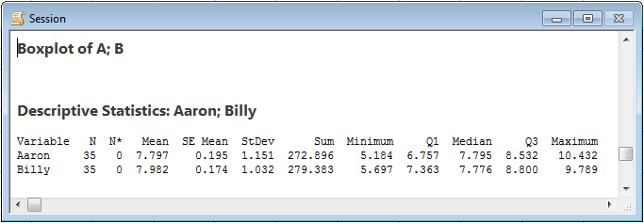
Calculating Statistics on Minitab
Type all values in C1. (You can name the column by typing in the grey box under C1)
Select → Stat
Select → Basic Statistics
Select → Display Descriptive Statistics
The print out gives you the mean, standard deviation, sample size, the 5 number summary as well as other values we will use later in the course.

Slide 20
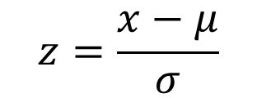
When Is a z-score Big? (cont.)
Summaries of data, like the sample mean and standard deviation, are written with Latin letters. Such summaries of data are called statistics.
When we standardize Normal data, we still call the standardized value a z-score, and we write

Slide 21
When Is a z-score Big? (cont.)
When we use the Normal model, we are assuming the distribution is Normal.
We cannot check this assumption in practice, so we check the following condition:
Nearly Normal Condition: The shape of the data’s distribution is unimodal and symmetric.
This condition can be checked by making a histogram or a Normal probability plot (to be explained later!).

Slide 22
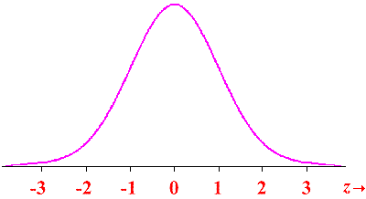
1. A normal distribution of scores has a standard deviation of 10. Find the z-scores corresponding to each of the following values:
a) A score of 60, where the mean score of the sample data values is 40.
b) A score that is 30 points below the mean.
c) A score of 55, where the mean score of the sample data values is 30.
d) A score of 28, where the mean score of the sample data values is 40.

Slide 23
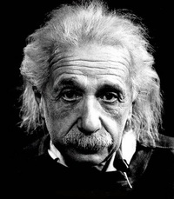
2. IQ scores have a mean of 100 and a standard deviation of 16. Albert Einstein reportedly had an IQ of 160.
a. What is the difference between Einstein's IQ and the mean?
b. How many standard deviations is that?
c. Convert Einstein’s IQ score to a z score.
d. If we consider “usual IQ scores to be those that convert z scores between -2 and 2, is Einstein’s IQ usual or unusual?

Slide 24
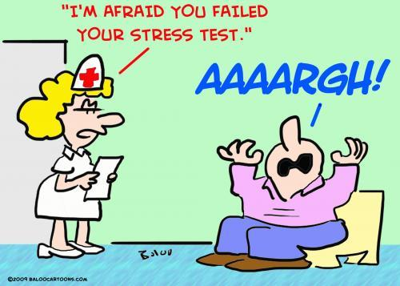
3. Three students take equivalent stress tests. Which is the highest relative score (meaning which has the largest z score value)?
a. A score of 144 on a test with a mean of 128 and a standard deviation of 34.
b. A score of 90 on a test with a mean of 86 and a standard deviation of 18.
c. A score of 18 on a test with a mean of 15 and a standard deviation of 5.

Slide 25
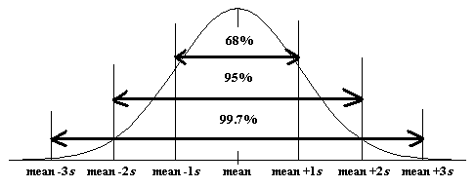
The 68-95-99.7 Rule (Empirical Rule)
Normal models give us an idea of how extreme a value is by telling us how likely it is to find one that far from the mean.
We can find these numbers precisely, but until then we will use a simple rule that tells us a lot about the Normal model…

Slide 26
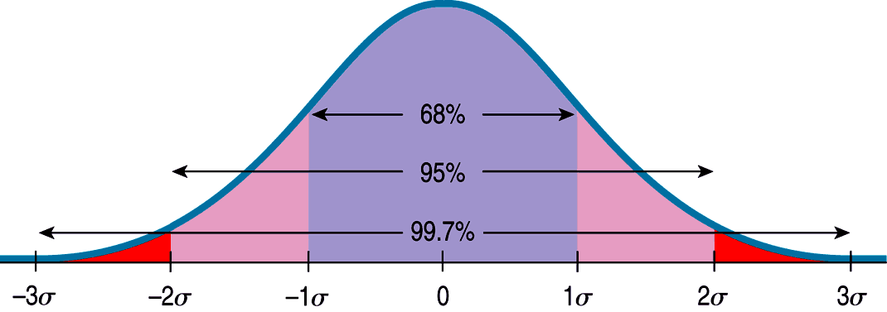
The 68-95-99.7 Rule (cont.)
The following shows what the 68-95-99.7 Rule tells us:

Slide 27
The 68-95-99.7 Rule (cont.)
It turns out that in a Normal model:
about 68% of the values fall within one standard deviation of the mean;
about 95% of the values fall within two standard deviations of the mean; and,
about 99.7% of the values fall within three standard deviations of the mean.

Slide 28
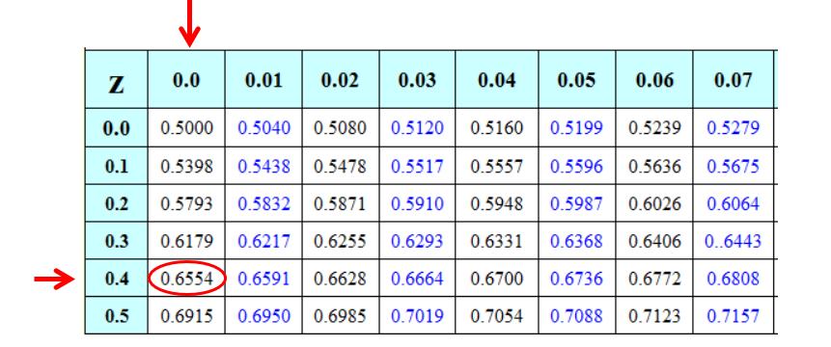
Finding Normal Percentiles by Hand
When a data value doesn’t fall exactly 1, 2, or 3 standard deviations from the mean, we can look it up in a table of Normal percentiles.
(Extra Z-Score Charts are on my website!)

Slide 29
Finding Normal Percentiles by Hand (cont.)
Table Z is the standard Normal table. We have to convert our data to z-scores before using the table.
The figure shows us how to find the area to the left when we have a z-score of 1.80:

Slide 30
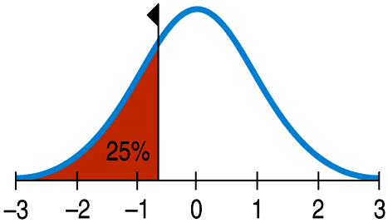
From Percentiles to Scores: z in Reverse
Sometimes we start with areas and need to find the corresponding z-score or even the original data value.
Example: What z-score represents the first quartile in a Normal model?

Slide 31
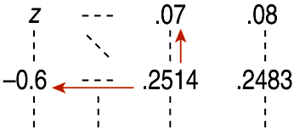
From Percentiles to Scores: z in Reverse
Look in Table Z for an area of 0.2500.
The exact area is not there, but 0.2514 is pretty close.
This figure is associated with z = -0.67, so the first quartile is 0.67 standard deviations below the mean.

Slide 32
What Can Go Wrong? (cont.)
Don’t use the mean and standard deviation when outliers are present—the mean and standard deviation can both be distorted by outliers.
Don’t round your results in the middle of a calculation.
Don’t worry about minor differences in results.

Slide 33
4. Women's heights have a mean of 63.6 in. and a standard deviation of 2.5 inches.
Find the z score corresponding to a woman with a height of 70 inches and determine whether the height is unusual.
What percent of women have a height higher than 70 inches?

Slide 34
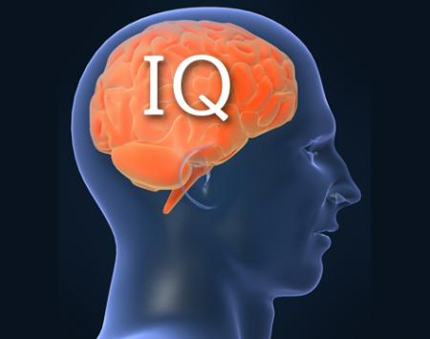
5. As mentioned above, IQ scores are normally distributed with mean 100 and std deviation of 16.
What percent of people have an IQ of less than 100?
What percent of people have an IQ between 84 and 100?
What percent of people have an IQ higher than 140?
What percent of people have an IQ less than 80?

