Slide 1
Drill: Monday, 10/31
Write the converse, inverse and contrapositive of “If today is Monday, then today is Halloween”
Write the validity for each statement.
OBJ: SWBAT complete Unit C exam.

Slide 2
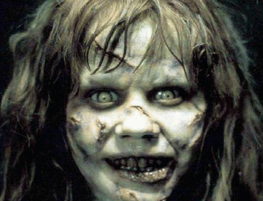

Slide 3
Review / Exam
Chapter 2 Sections 1 – 6

Slide 4
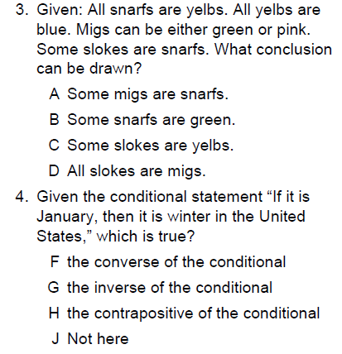

Slide 5
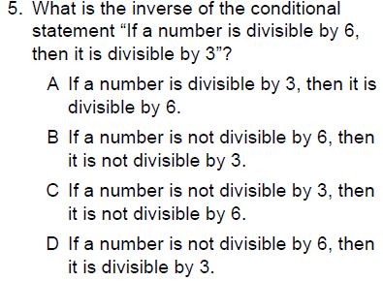
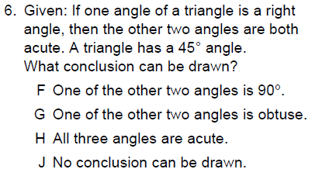

Slide 7
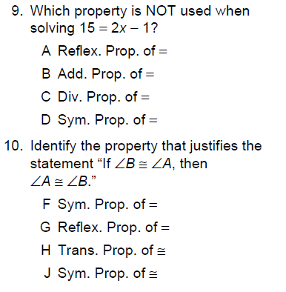

Slide 11
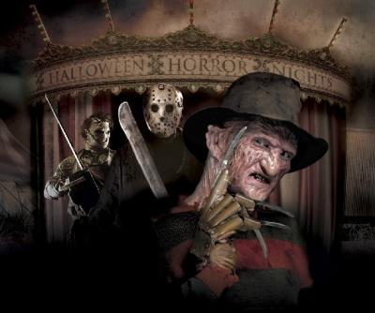

Slide 12
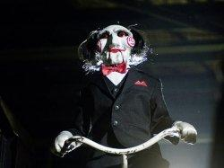

Slide 13
Review Day
Skim chapter 2 focusing on vocabulary and examples
Complete pg 134 – 135
If time, pg 138 – 139

Slide 14
