Slide 1
WELCOME BACK TO OMHS & WELCOME TO HONORS TRIGONOMETRY
Mr. Calise
www.mrcalise.weebly.com

Slide 2
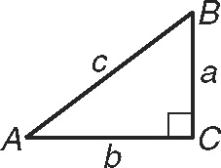
Drill
1) If side a has a length of 12 cm. and side c has a length of 24 cm.
Find the length of b.
2) What is the longest side in triangle ABC?

Slide 3
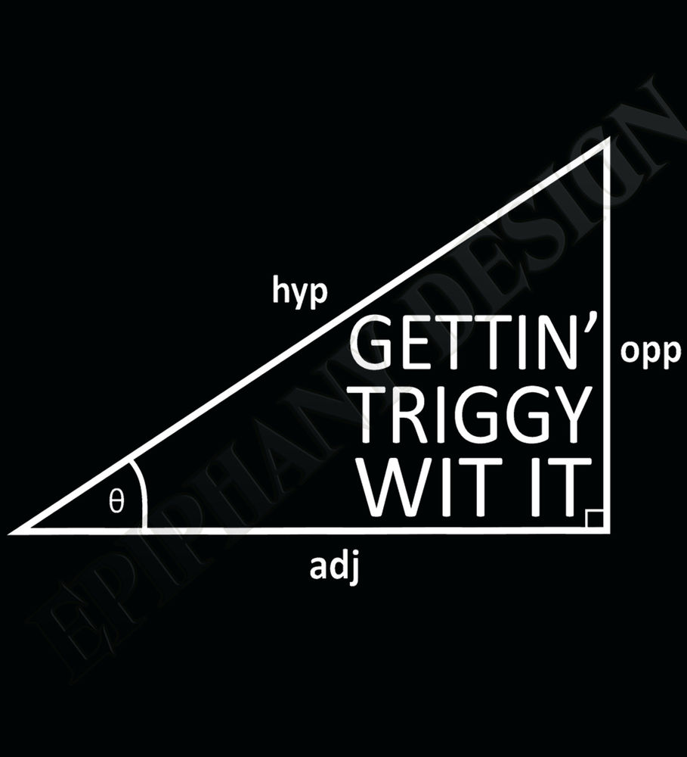
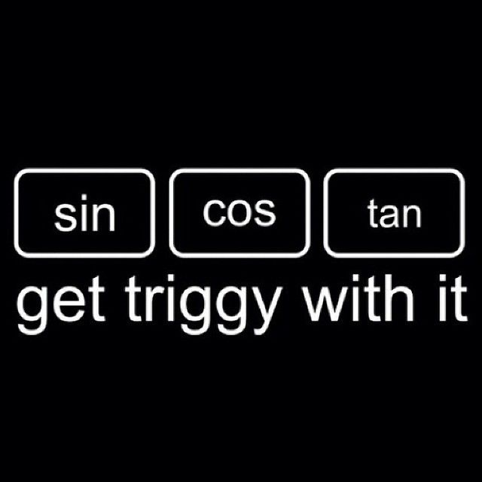
“Getting Triggy With It”
WSHS RAP SONG (Math Remix)

Slide 4
Discovery (3,4,5 & 6,8,10)

Slide 5
Scale Factor of 3!

Slide 6
Discovery Questions
How are the triangles #1, #2 and #3 related?
Label the shortest side “a”, middle side “b” and the longest side “c” for each triangle.
Fill in the chart shown for each triangle.
Answer the questions on the question sheet.

Slide 7
Introduction to Trigonometry
In this section we define the three basic trigonometric ratios, sine, cosine and tangent.
opp is the side opposite angle A
adj is the side adjacent to angle A
hyp is the hypotenuse of the right triangle
hyp ….OpP
adj A

Slide 8
Definitions
Sine is abbreviated sin, cosine is abbreviated cos and tangent is abbreviated tan.
The sin(A) = opp/hyp
The cos(A) = adj/hyp
The tan(A) = opp/adj
Just remember SOHCAHTOA!
Sin Opp Hyp Cos Adj Hyp Tan Opp Adj

