Slide 1
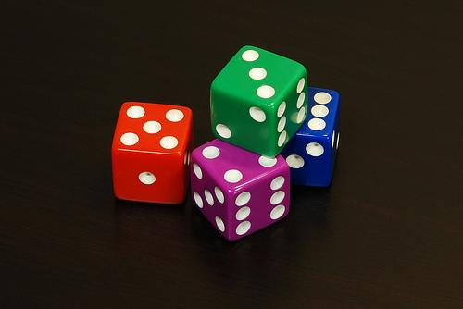
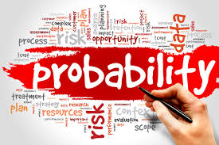
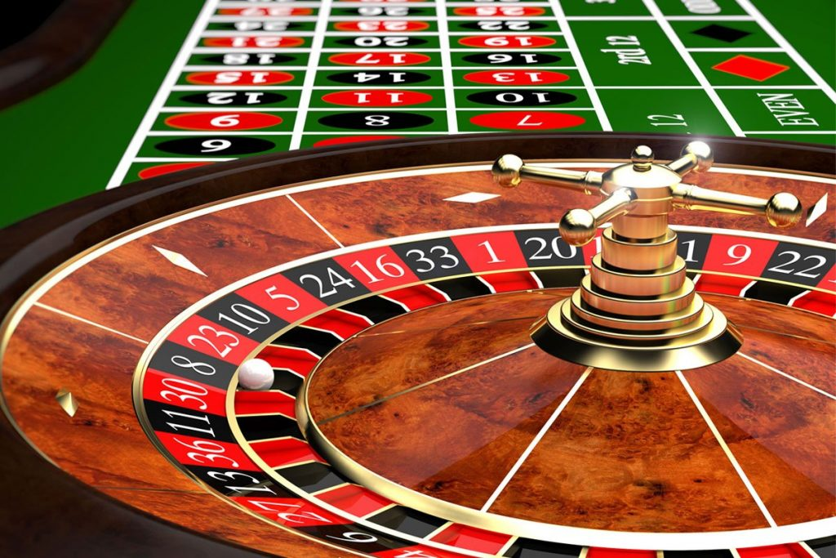
STAT 110
Continue Probability

Slide 2
Practice Problem
If we randomly select a whole number from #’s 1 – 50, then what is the probability that we select a number either less than 18 or odd?
These events are NOT Disjoint because a number in this set can be odd and less than 18.
P(A or B) = P(A) + P(B) – P(A and B)
P(# < 18 OR Odd) = 17/50 + 25/50 – 9/50
= 33/50 = 0.66

Slide 3
The General Multiplication Rule
When two events A and B are independent, we can use the multiplication rule for independent events:
P(A and B) = P(A) x P(B)
However, when our events are not independent, this earlier multiplication rule does not work. Thus, we need the General Multiplication Rule.

Slide 4
Example #4

Slide 5
Drawing Without Replacement
Sampling without replacement means that once one object is drawn it doesn’t go back into the pool.
We often sample without replacement, which doesn’t matter too much when we are dealing with a large population.
However, when drawing from a small population, we need to take note and adjust probabilities accordingly.
Drawing without replacement is just another instance of working with conditional probabilities.

Slide 6
Example #7 (w/o replacement)

Slide 7
Example (Three Circle Venn Diagram)
A survey of 88 faculty and graduate students at the University of Florida's film school revealed the following information:
51 admire Moe
49 admire Larry
60 admire Curly
34 admire Moe and Larry
32 admire Larry and Curly
36 admire Moe and Curly
24 admire all three of the Stooges

Slide 8
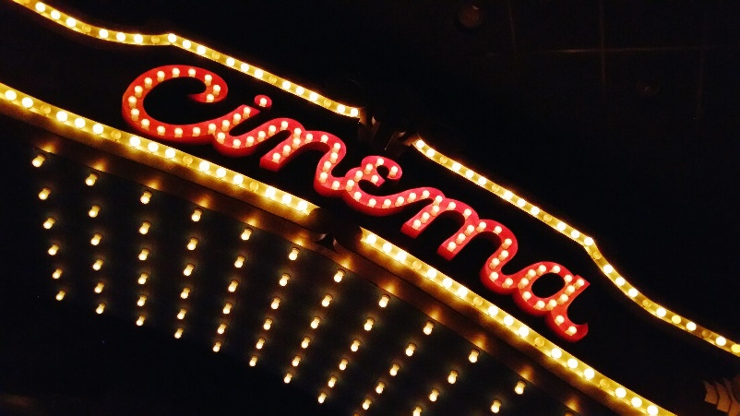
Practice (Three Circle Venn Diagram)
A survey of 140 seniors at a local high school revealed the following information about their movie preferences.
104 enjoy Comedies
81 enjoy Action
73 enjoy Drama
64 enjoy Comedies and Action
53 enjoy Comedies and Drama
48 enjoy Action and Drama
39 enjoy all three of the movie genres

Slide 9
Practice Questions:
What is the probability of selecting one person from this survey and they do NOT enjoy any of these movie genres?
What is the probability of selecting one person and they enjoy EXACTLY one type of movie genre of these three choices?
What is the probability of selecting two people from this survey and they BOTH enjoy EXACTLY two of these movie genres?

Slide 10
Practice Problem
What is the probability that you reach into a bag and select two of the same color marbles if the bag contains 8 green marbles and 14 red marbles?
P(Green and Green OR Red and Red)
(8/22)(7/21) + (14/22)(13/21)
56/462 + 182/462
238/462

