Slide 1
Sampling Distributions

Slide 2
Definitions
parameter:
a number that describes the population
a parameter is a fixed number
in practice, we do not know its value because we cannot examine the entire population

Slide 3
Definitions
statistic:
a number that describes a sample
the value of a statistic is known when we have taken a sample, but it can change from sample to sample
we often use a statistic to estimate an unknown parameter

Slide 4
Compare
parameter
mean: μ
standard deviation: σ
proportion: p
Sometimes we call the parameters “true”; true mean, true proportion, etc.
statistic
mean: x-bar
standard deviation: s
proportion: p-hat
Sometimes we call the statistics “sample”; sample mean, sample proportion, etc.

Slide 5
Sampling variability
Given the same population, we may have multiple samples.
Should we expect that the statistics for each sample be the same?
While sample means or sample proportions are similar, they do vary. We call this sampling variability.

Slide 6
Sampling Distributions
The sampling distribution of a statistic is the distribution of values taken by the statistic in all possible samples of the same size from the same population.

Slide 7
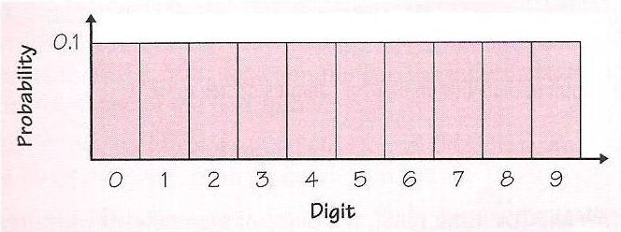

Slide 9
Example
Television executives and companies who advertise on TV are interested in how many viewers watch particular television shows. According to 2001 Nielsen ratings, Survivor II was one of the most watched television shows in the US during every week that is aired.
Suppose that true proportion of US adults who watched Survivor II is p=.37.
Suppose we did a survey with n=100.
Suppose we did this survey 1000 times.

Slide 10
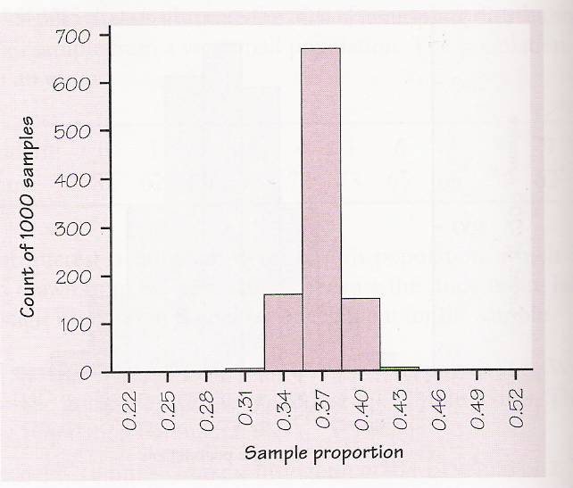
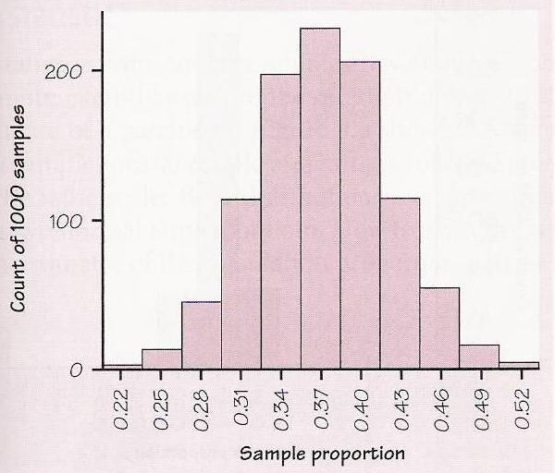

Slide 12
Variability of a Statistic
The variability of a statistic is described by the spread of its sampling distribution. This spread is determined by the sampling design and the size of the sample. Larger samples give smaller spread.
As long as the population is much larger than the sample (say, at least 10 times as large), the spread of the sampling distribution is approximately the same for any population size.

Slide 13
Unbiased Statistic
A statistic used to estimate a parameter is unbiased if the mean of its sampling distribution is equal to the true value of the parameter being estimated.

Slide 16
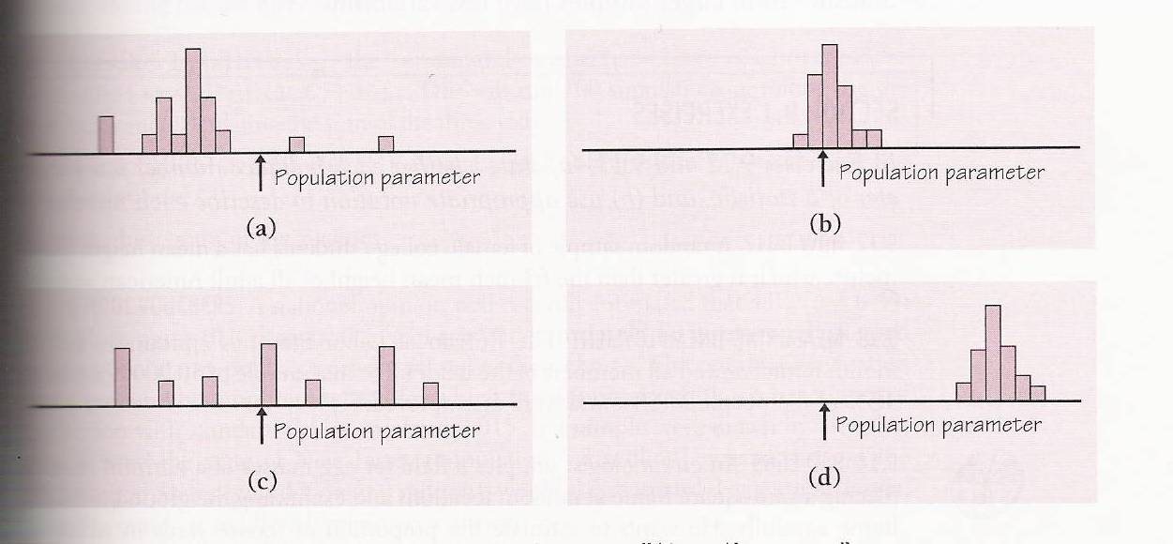

Slide 17
Sampling Proportions

Slide 18
Example
A Gallup Poll found that 210 out of a random sample of 501 American teens age 13 to 17 knew the answer to this question:
“What year did Columbus ‘discover’ America?”

Slide 19
Interpretation
210/501 =.42
Is .42 a parameter or a statistic?
Does this mean that only 42% of American teens know this fact?
What is the proper notation for this statistic?
p-hat = .42

Slide 20
New Formulas

Slide 21
Rules of Thumb
Use the previous formula for standard deviation only when the population is at least 10 times as large as the sample.
You may use the normal approximation to the sampling distribution of p-hat for the values n and p that satisfy np>10 and nq>10

Slide 22
Do we meet the rules of thumb
Do we believe the population is bigger than 10*501?
Do we believe np>10 and nq>10?

Slide 23
Draw the distribution…

Slide 24
Different question
An SRS of 1500 first-year college students were asked whether they applied for admission to any other college. In fact, 35% of all first-year students applied to colleges beside the one they are attending.
What is the probability that the poll will be within 2 percentage points of the true p?

Slide 26
Conclusion
About 90% of the samples fall within 2% of the real p.

Slide 27
Another example
One way of checking the effect of undercoverage, nonresponse, and other sources of error in a sample survey is to compare the sample with known facts about the population.
About 11% of American adults have Type B blood. The proportion p-hat in an SRS should be about .11.
If a national sample contains only 9.2% of people with Type B blood, should we suspect nonresponse bias?

Slide 29
Distribution of Sample Means

Slide 30
Sampling from a Normal Distribution
If you sample from a population that is normal, the resulting distribution of sample means is also normal.
If the population distribution is N(μ,σ), the distribution of sample means is N(μ,σ/n^.5)
Restrictions: population size at least 10 times sample size.

Slide 31
Central Limit Theorem
Draw an SRS of size n from any population whatsoever with mean μ and finite standard deviation σ. When n is large, the sampling distribution of the sample mean x-bar is close to the normal distribution N(μ,σ/n^.5), with mean μ and standard deviation σ/n^.5.

Slide 32
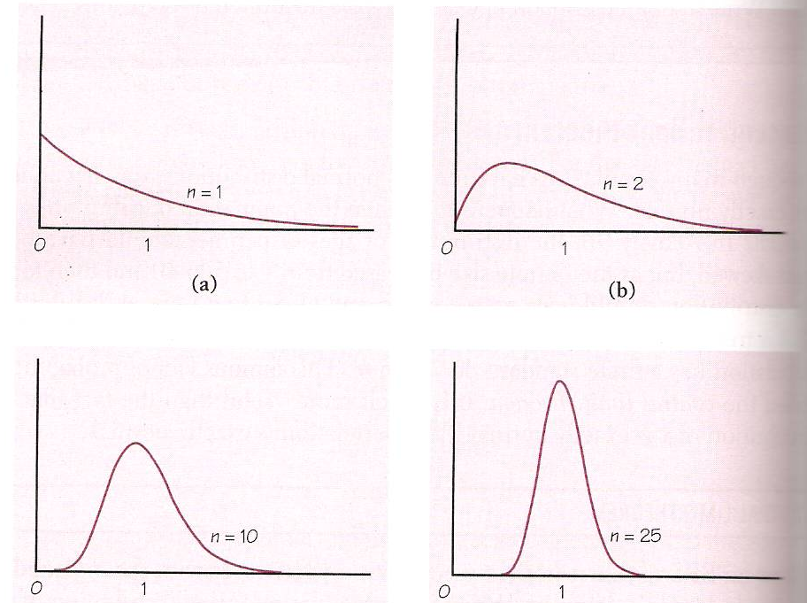

Slide 33
Example
The time that a technician requires to perform preventive maintenance on an air-conditioning unit is governed by the exponential distribution whose density curve has mean 1 hour and standard deviation 1 hour.
Your company operates 70 of these units.
What is the probability that their average maintenance exceeds 50 minutes?

Slide 34
Example:
Are the restrictions of sampling fulfilled?
Sampling size of 70 is less than one tenth of the infinite number of the “maintenances” that could be done.
The population distribution is not normal, but the sample of 70 is large enough for the distribution of sample means to be approximately normal with mean 1 and standard deviation 1/70^.5.

Slide 35
