Slide 1
Chapter 1
Data Analysis
Section 1.2
Displaying Quantitative Data with Graphs

Slide 2
Displaying Quantitative Data with Graphs
MAKE and INTERPRET dotplots, stemplots, and histograms of quantitative data.
IDENTIFY the shape of a distribution from a graph.
DESCRIBE the overall pattern (shape, center, and variability) of a distribution and IDENTIFY any major departures from the pattern (outliers).
COMPARE distributions of quantitative data using dotplots, stemplots, and histograms.

Slide 3
Dotplots
A dotplot shows each data value as a dot above its location on a number line.
How to make a dotplot:

Slide 4
Dotplots
A dotplot shows each data value as a dot above its location on a number line.
How to make a dotplot:
Draw a horizontal axis (a number line) and label it with the quantitative variable.

Slide 5
Dotplots
A dotplot shows each data value as a dot above its location on a number line.
How to make a dotplot:
Draw a horizontal axis (a number line) and label it with the quantitative variable.
Scale the axis from the minimum to the maximum value.

Slide 6
Dotplots
A dotplot shows each data value as a dot above its location on a number line.
How to make a dotplot:
Draw a horizontal axis (a number line) and label it with the quantitative variable.
Scale the axis from the minimum to the maximum value.
Mark a dot above the location on the horizontal axis corresponding to each data value.

Slide 7
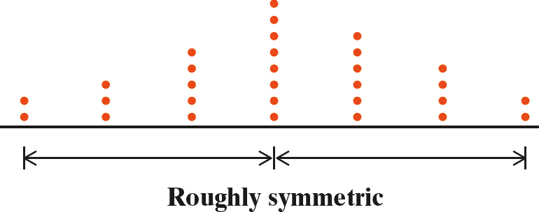
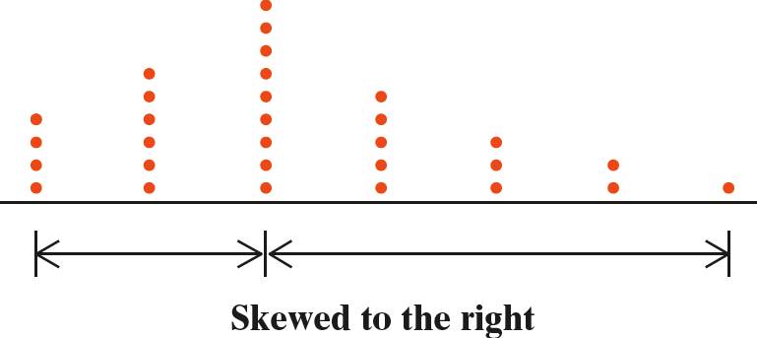
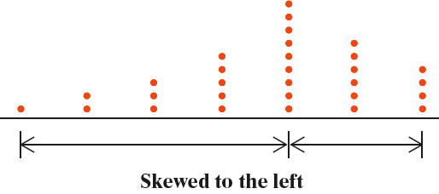
Describing Shape
A distribution is roughly symmetric if the right side of the graph (containing the half of observations with the largest values) is approximately a mirror image of the left side.
A distribution is skewed to the right if the right side of the graph is much longer than the left side.
A distribution is skewed to the left if the left side of the graph is much longer than the right side.

Slide 8
Describing Shape
A distribution is roughly symmetric if the right side of the graph (containing the half of observations with the largest values) is approximately a mirror image of the left side.
CAUTION:
The direction of skewness is toward the long tail, not the direction where most observations are clustered.
A distribution is skewed to the right if the right side of the graph is much longer than the left side.
A distribution is skewed to the left if the left side of the graph is much longer than the right side.

Slide 9
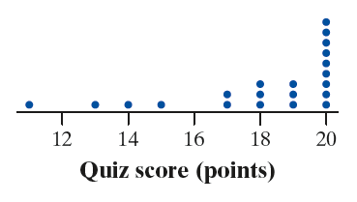
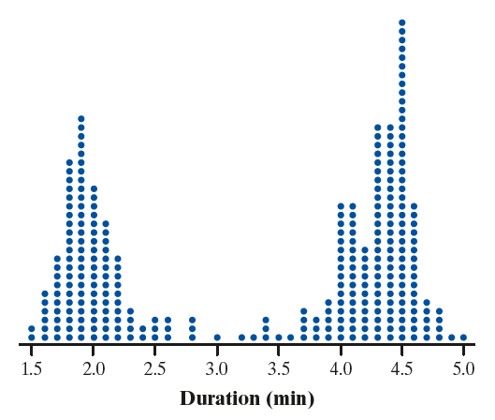
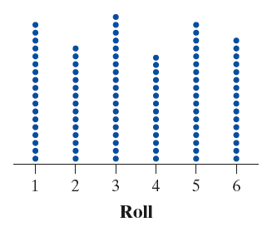
Describing Shape
The distribution of a quantitative variable is unimodal if it has a single peak.
The distribution of a quantitative variable is bimodal if it has two distinct clusters and peaks.
The distribution of a quantitative variable is approximately symmetric if the frequencies are about the same for all values.

Slide 10
Describing Distributions
AP® Exam Tip
Always be sure to include context when you are asked to describe a distribution. This means using the variable name, not just the units the variable is measured in.

Slide 11
Describing Distributions
Describe the distribution of goals scored in 20 games played by the 2016 U.S. women’s soccer team.
Did we include context?
Shape: The distribution of goals scored is skewed to the right, with a single peak at 1 goal. There is a gap between 5 and 9 goals.
Outliers: The games when the team scored 9 and 10 goals appear to be outliers.
Center: The median is 2 goals scored.
Variability: The number of goals varies from 1 to 10 goals scored.

Slide 12
Describing Distributions
Describe the distribution of goals scored in 20 games played by the 2016 U.S. women’s soccer team.
Did we include context?
YES!
Shape: The distribution of goals scored is skewed to the right, with a single peak at 1 goal. There is a gap between 5 and 9 goals.
Outliers: The games when the team scored 9 and 10 goals appear to be outliers.
Center: The median is 2 goals scored.
Variability: The number of goals varies from 1 to 10 goals scored.

Slide 13
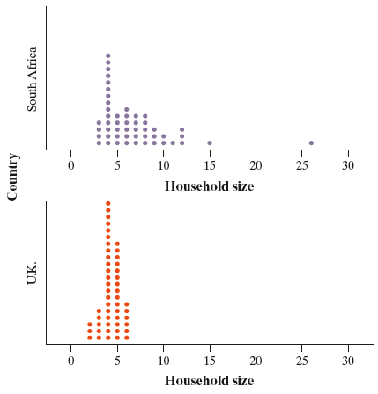
Comparing Distributions
We used Census At School’s “Random Data Selector” to choose 50 students from each country. Here are dotplots of the household sizes reported by the survey respondents. Compare the distributions of household size for these two countries.
AP® Exam Tip
When comparing distributions of quantitative data, it’s not enough just to list values for the center and variability of each distribution. You must explicitly compare these values, using words like “greater than,” “less than,” or “about the same as.”

Slide 14
Comparing Distributions
Shape: The distribution of household size for the U.K. sample is roughly symmetric, with a single peak at 4 people. The distribution of
household size for the South Africa sample is skewed to the right, with a single peak at 4 people and a clear gap between 15 and 26.

Slide 15
Comparing Distributions
Shape: The distribution of household size for the U.K. sample is roughly symmetric, with a single peak at 4 people. The distribution of
household size for the South Africa sample is skewed to the right, with a single peak at 4 people and a clear gap between 15 and 26.
Outliers: There don’t appear to be any outliers in the U.K. distribution. The South African distribution seems to have two outliers: the households with 15 and 26 people.

Slide 16
Comparing Distributions
Shape: The distribution of household size for the U.K. sample is roughly symmetric, with a single peak at 4 people. The distribution of
household size for the South Africa sample is skewed to the right, with a single peak at 4 people and a clear gap between 15 and 26.
Outliers: There don’t appear to be any outliers in the U.K. distribution. The South African distribution seems to have two outliers: the households with 15 and 26 people.
Center: Household sizes for the South African students tend to be larger (median 6 people) than for the U.K. students (median 4 people).

Slide 17
Comparing Distributions
Shape: The distribution of household size for the U.K. sample is roughly symmetric, with a single peak at 4 people. The distribution of
household size for the South Africa sample is skewed to the right, with a single peak at 4 people and a clear gap between 15 and 26.
Outliers: There don’t appear to be any outliers in the U.K. distribution. The South African distribution seems to have two outliers: the households with 15 and 26 people.
Center: Household sizes for the South African students tend to be larger (median 6 people) than for the U.K. students (median 4 people).
Variability: The household sizes for the South African students vary more (from 3 to 26 people) than for the U.K. students (from 2 to 6 people).

Slide 18
Comparing Distributions
Shape: The distribution of household size for the U.K. sample is roughly symmetric, with a single peak at 4 people. The distribution of
household size for the South Africa sample is skewed to the right, with a single peak at 4 people and a clear gap between 15 and 26.
Outliers: There don’t appear to be any outliers in the U.K. distribution. The South African distribution seems to have two outliers: the households with 15 and 26 people.
Center: Household sizes for the South African students tend to be larger (median 6 people) than for the U.K. students (median 4 people).
Variability: The household sizes for the South African students vary more (from 3 to 26 people) than for the U.K. students (from 2 to 6 people).
Context
Comparative language

Slide 19
Stemplots
A stemplot shows each data value separated into two parts: a stem, which consists of all but the final digit, and a leaf, the final digit. The stems are ordered from lowest to highest and arranged in a vertical column. The leaves are arranged in increasing order out from the appropriate stems.
How to make a stemplot:
Separate each observation into a stem, consisting of all but the final digit, and a leaf, the final digit. Write the stems in a vertical column with the smallest at the top. Draw a vertical line at the right of this column.
Write each leaf in the row to the right of its stem.
Arrange the leaves in increasing order out from the stem.
Provide a key that identifies the variable and explains what the stems and leaves represent.

Slide 20
Stemplots
These data represent the responses of 20 female AP Statistics students to the question, “How many pairs of shoes do you have?” Construct a stemplot.
50 | 26 | 26 | 31 | 57 | 19 | 24 | 22 | 23 | 38
13 | 50 | 13 | 34 | 23 | 30 | 49 | 13 | 15 | 51
1
2
3
4
5
1 93335
2 664233
3 1840
4 9
5 0701
1 33359
2 233466
3 0148
4 9
5 0017
Key: 4|9 represents a female student who reported having 49 pairs of shoes.
Stems
Add leaves
Order leaves
Add a key

Slide 21
Stemplots
When data values are “bunched up”, we can get a better picture of the distribution by splitting stems.
Two distributions of the same quantitative variable can be compared using a back-to-back stemplot with common stems.
Females
Males
50 | 26 | 26 | 31 | 57 | 19 | 24 | 22 | 23 | 38
13 | 50 | 13 | 34 | 23 | 30 | 49 | 13 | 15 | 51
14 | 7 | 6 | 5 | 12 | 38 | 8 | 7 | 10 | 10
10 | 11 | 4 | 5 | 22 | 7 | 5 | 10 | 35 | 7
Females
333
95
4332
66
410
8
9
100
7
Males
0 4
0 555677778
1 0000124
1
2 2
2
3
3 58
4
4
5
5
0
0
1
1
2
2
3
3
4
4
5
5
“split stems”
Key: 4|9 represents a student who reported having 49 pairs of shoes.

Slide 22
Histograms
A histogram shows each interval of values as a bar. The heights of the bars show the frequencies or relative frequencies of values in each interval.
Dotplot

Slide 23
Histograms
A histogram shows each interval of values as a bar. The heights of the bars show the frequencies or relative frequencies of values in each interval.
Dotplot
Histogram

Slide 24
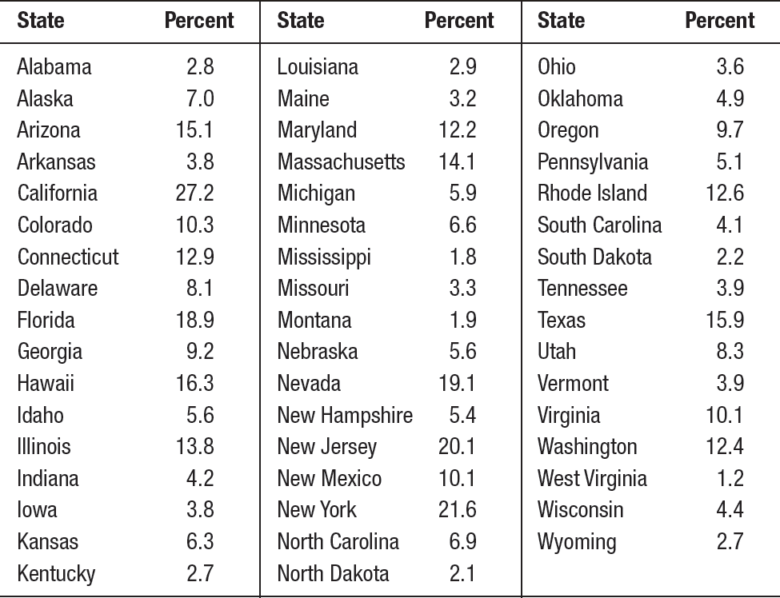
Histograms
How to make a histogram:

Slide 25
Histograms
How to make a histogram:
Choose equal-width intervals that span the data.
Frequency Table
Class
0 to <5
5 to <10
10 to <15
15 to <20
20 to <25
25 to <30
Total

Slide 26
Histograms
How to make a histogram:
Choose equal-width intervals that span the data.
Make a table that shows the frequency or relative frequency of individuals in each interval.
Frequency Table
Class | Count
0 to <5 | 20
5 to <10 | 13
10 to <15 | 9
15 to <20 | 5
20 to <25 | 2
25 to <30 | 1
Total | 50

Slide 27
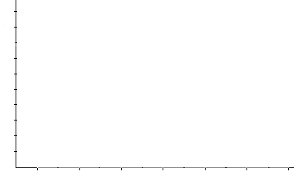
Histograms
How to make a histogram:
Choose equal-width intervals that span the data.
Make a table that shows the frequency or relative frequency of individuals in each interval.
Draw horizontal and vertical axes. Label the axes.
Frequency Table
Class | Count
0 to <5 | 20
5 to <10 | 13
10 to <15 | 9
15 to <20 | 5
20 to <25 | 2
25 to <30 | 1
Total | 50
Number of States
Percent of foreign-born residents

Slide 28
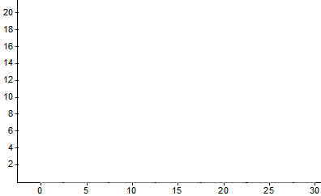
Histograms
How to make a histogram:
Choose equal-width intervals that span the data.
Make a table that shows the frequency or relative frequency of individuals in each interval.
Draw horizontal and vertical axes. Label the axes.
Scale the axes.
Frequency Table
Class | Count
0 to <5 | 20
5 to <10 | 13
10 to <15 | 9
15 to <20 | 5
20 to <25 | 2
25 to <30 | 1
Total | 50
Number of States
Percent of foreign-born residents

Slide 29
Histograms
How to make a histogram:
Choose equal-width intervals that span the data.
Make a table that shows the frequency or relative frequency of individuals in each interval.
Draw horizontal and vertical axes. Label the axes.
Scale the axes.
Draw bars above the intervals. The bar heights correspond to the frequency or relative frequency of individuals in that interval.
Frequency Table
Class | Count
0 to <5 | 20
5 to <10 | 13
10 to <15 | 9
15 to <20 | 5
20 to <25 | 2
25 to <30 | 1
Total | 50
Number of States
Percent of foreign-born residents

Slide 30
Histograms
CAUTION:
Don’t confuse histograms and bar graphs.
Use percents or proportions instead of counts on the vertical axis when comparing distributions with different numbers of observations.
Just because a graph looks nice doesn’t make it a meaningful display of data.

Slide 31
Section Summary
MAKE and INTERPRET dotplots, stemplots, and histograms of quantitative data.
IDENTIFY the shape of a distribution from a graph.
DESCRIBE the overall pattern (shape, center, and variability) of a distribution and IDENTIFY any major departures from the pattern (outliers).
COMPARE distributions of quantitative data using dotplots, stemplots, and histograms.

