Slide 1
Chapter 1
Data Analysis
Section 1.3
Describing Quantitative Data with Numbers

Slide 2
Displaying Quantitative Data with Numbers
CALCULATE measures of center (mean, median) for a distribution of quantitative data.
CALCULATE and INTERPRET measures of variability (range, standard deviation, IQR) for a distribution of quantitative data.
EXPLAIN how outliers and skewness affect measures of center and variability.
IDENTIFY outliers using the 1.5 × IQR rule.
MAKE and INTERPRET boxplots of quantitative data.
Use boxplots and numerical summaries to COMPARE distributions of quantitative data.

Slide 3
Measuring Center: The Mean
The mean of a distribution of quantitative data is the average of all the individual data values. To find the mean, add all the values and divide by the total number of observations.
If the n observations are x₁, x₂ , …, x_{n}, the sample mean $\overline{x}$ (pronounced “ x-bar ”) is given by the following formula:

Slide 4
Measuring Center: The Mean
Here are the data on the number of goals scored in 20 games played by the 2016 U.S. women’s soccer team:
5 5 1 10 5 2 1 1 2 3 3 2 1 4 2 1 2 1 9 3

Slide 5
Measuring Center: The Mean
Here are the data on the number of goals scored in 20 games played by the 2016 U.S. women’s soccer team:
5 5 1 10 5 2 1 1 2 3 3 2 1 4 2 1 2 1 9 3
$$\overline{x}=\frac{1 +1+1 +1+ 1+ 1 +2 +2 +2 +2+ 2 +3 +3 +3+ 4 +5 +5 +5+ 9 +10 }{20}$$
$$\overline{x}=3.15 goals$$

Slide 6
Measuring Center: The Mean
Here are the data on the number of goals scored in 20 games played by the 2016 U.S. women’s soccer team:
5 5 1 10 5 2 1 1 2 3 3 2 1 4 2 1 2 1 9 3
$$\overline{x}=\frac{1 +1+1 +1+ 1+ 1 +2 +2 +2 +2+ 2 +3 +3 +3+ 4 +5 +5 +5+ 9 +10 }{20}$$
$$\overline{x}=3.15 goals$$

Slide 7
Measuring Center: The Mean
The symbol $\overline{x}$ refers to the mean of a sample.
Statistic
The notation µ refers to the mean of a population.
Parameter
A statistic is a number that describes some characteristic of a sample.
A statistic is a number that describes some characteristic of a sample.
A parameter is a number that describes some characteristic of a population.

Slide 8
Measuring Center: The Mean
Here is the mean number of goals scored by the 2016 U.S. women’s soccer team, if we exclude the games that are possible outliers (when they scored 9 and 10 goals).
$$\overline{x}=\frac{1 +1+1 +1+ 1+ 1 +2 +2 +2 +2+ 2 +3 +3 +3+ 4 +5 +5 +5}{18}$$
$$\overline{x}=2.44 goals$$
A statistical measure is resistant if it isn’t sensitive to extreme values.

Slide 9
Measuring Center: The Mean
Here is the mean number of goals scored by the 2016 U.S. women’s soccer team, if we exclude the games that are possible outliers (when they scored 9 and 10 goals).
CAUTION:
$$\overline{x}=\frac{1 +1+1 +1+ 1+ 1 +2 +2 +2 +2+ 2 +3 +3 +3+ 4 +5 +5 +5}{18}$$
$$\overline{x}=2.44 goals$$
The mean is sensitive to extreme values in a distribution. The mean is not a resistant measure of center.
A statistical measure is resistant if it isn’t sensitive to extreme values.

Slide 10
Measuring Center: The Median
The median is the midpoint of a distribution, the number such that about half the observations are smaller and about half are larger.
To find the median, arrange the data values from smallest to largest.
If the number n of data values is odd, the median is the middle value in the ordered list.
If the number n of data values is even, the median is the average of the two middle values in the ordered list.

Slide 11
Measuring Center: The Median
Here are the highway fuel economy ratings for a sample of 25 model year 2018 Toyota 4Runners tested by the EPA:
Raw data
22.4 22.4 22.3 23.3 22.3 22.3 22.5 22.4 22.1 21.5 22.0 22.2 22.7
22.8 22.4 22.6 22.9 22.5 22.1 22.4 22.2 22.9 22.6 21.9 22.4
Sorted data
21.5 21.9 22.0 22.1 22.1 22.2 22.2 22.3 22.3 22.3 22.4 22.4 22.4
22.4 22.4 22.4 22.5 22.5 22.6 22.6 22.7 22.8 22.9 22.9 23.3
Median

Slide 12
Measuring Center: The Median
Here are the data on the number of goals scored in
20 games played by the 2016 U.S. women’s soccer team:
Raw data
5 5 1 10 5 2 1 1 2 3 3 2 1 4 2 1 2 1 9 3
Sorted data
1 1 1 1 1 1 2 2 2 2 2 3 3 3 4 5 5 5 9 10
Median = $\frac{2+2}{2}=2$

Slide 13
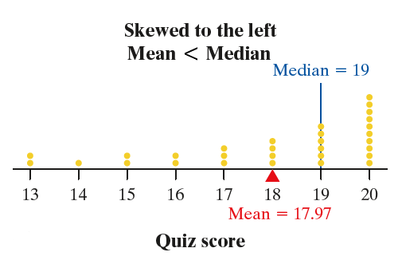
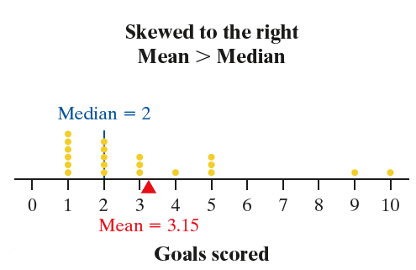
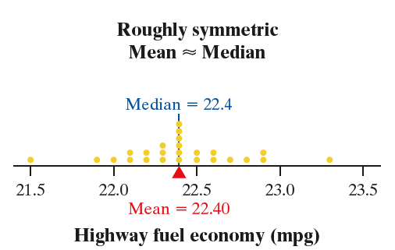
Comparing the Mean and the Median

Slide 14
Comparing the Mean and the Median
Effect of Skewness and Outliers
on Measures of Center
If a distribution of quantitative data is roughly symmetric and has no outliers, the mean and median will be similar.
If the distribution is strongly skewed, the mean will be pulled in the direction of the skewness but the median won’t. For a right-skewed distribution, we expect the mean to be greater than the median. For a left-skewed distribution, we expect the mean to be less than the median.
The median is resistant to outliers but the mean isn’t.

Slide 15
Measuring Variability: The Range
The range of a distribution is the distance between the minimum value and the
maximum value. That is,
Range = Maximum – Minimum
Here are the data on the number of goals scored in 20 games played by the 2016 U.S. women’s soccer team:
5 5 1 10 5 2 1 1 2 3 3 2 1 4 2 1 2 1 9 3
$$Range=10 −1=9 goals$$
CAUTION:
The range of a data set is a single number.
The range is not a resistant measure of variability.

Slide 16
Measuring Variability: The Standard Deviation
How to calculate standard deviation and variance:
Find the mean of the distribution.
Calculate the deviation (value – mean) of each value from the mean.
Square each of the deviations.
Add all the squared deviations, divide by n – 1. This is the sample variance.
Take the square root. This is the sample standard deviation.
The standard deviation measures the typical distance of the values in a distribution from the mean.

Slide 17
Measuring Variability: The Standard Deviation
Eleven high school students were asked how many “close” friends they have. Here are their responses: 1 2 2 2 3 3 3 3 4 4 6
How to calculate standard deviation, s_{x}:
Find the mean of the distribution.

Slide 18
Measuring Variability: The Standard Deviation
Eleven high school students were asked how many “close” friends they have. Here are their responses: 1 2 2 2 3 3 3 3 4 4 6
How to calculate standard deviation, s_{x}:
Find the mean of the distribution.
Calculate the deviation of each value from the mean.

Slide 19
Measuring Variability: The Standard Deviation
Eleven high school students were asked how many “close” friends they have. Here are their responses: 1 2 2 2 3 3 3 3 4 4 6
How to calculate standard deviation, s_{x}:
Find the mean of the distribution.
Calculate the deviation of each value from the mean.
Square each of the deviations.

Slide 20
Measuring Variability: The Standard Deviation
Eleven high school students were asked how many “close” friends they have. Here are their responses: 1 2 2 2 3 3 3 3 4 4 6
How to calculate standard deviation, s_{x}:
Find the mean of the distribution.
Calculate the deviation of each value from the mean.
Square each of the deviations.
Add all the squared deviations, divide by n – 1.
This value is known as the sample variance. (In this case, the units would be “squared close friends.”)

Slide 21
Measuring Variability: The Standard Deviation
Eleven high school students were asked how many “close” friends they have. Here are their responses: 1 2 2 2 3 3 3 3 4 4 6
How to calculate standard deviation, s_{x}:
Find the mean of the distribution.
Calculate the deviation of each value from the mean.
Square each of the deviations.
Add all the squared deviations, divide by n – 1.
Take the square root.
This value is known as the sample standard deviation.

Slide 22
Measuring Variability: The Standard Deviation
Properties of Standard Deviation
s_{x} is always greater than or equal to 0.
Larger values of s_{x} indicate greater variation.
s_{x} is not a resistant measure of variability.
s_{x} measures variation about the mean.

Slide 23
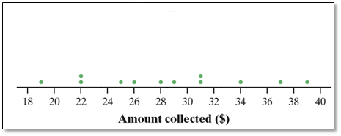
Measuring Variability: The Interquartile Range (IQR )
The quartiles of a distribution divide the ordered data set into four groups having roughly the same number of values. To find the quartiles, arrange the data values from smallest to largest and find the median.

Slide 24
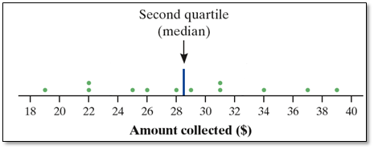
Measuring Variability: The Interquartile Range (IQR )
The quartiles of a distribution divide the ordered data set into four groups having roughly the same number of values. To find the quartiles, arrange the data values from smallest to largest and find the median.

Slide 25
Measuring Variability: The Interquartile Range (IQR )
The quartiles of a distribution divide the ordered data set into four groups having roughly the same number of values. To find the quartiles, arrange the data values from smallest to largest and find the median.
The first quartile Q₁ is the median of the data values that are to the left of the median in the ordered list.
The third quartile Q₃ is the median of the data values that are to the right of the median in the ordered list.

Slide 26
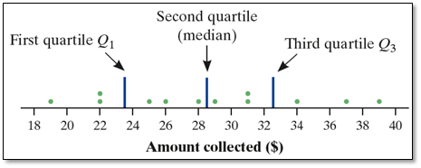
Measuring Variability: The Interquartile Range (IQR )
The quartiles of a distribution divide the ordered data set into four groups having roughly the same number of values. To find the quartiles, arrange the data values from smallest to largest and find the median.
The first quartile Q₁ is the median of the data values that are to the left of the median in the ordered list.
The third quartile Q₃ is the median of the data values that are to the right of the median in the ordered list.

Slide 27
Measuring Variability: The Interquartile Range (IQR )
The quartiles of a distribution divide the ordered data set into four groups having roughly the same number of values. To find the quartiles, arrange the data values from smallest to largest and find the median.
The first quartile Q₁ is the median of the data values that are to the left of the median in the ordered list.
The third quartile Q₃ is the median of the data values that are to the right of the median in the ordered list.
The interquartile range (IQR) is the distance between the first and third quartiles of a distribution. In symbols:
IQR = Q₃ − Q₁

Slide 28
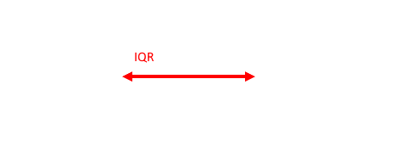
Measuring Variability: The Interquartile Range (IQR )
The quartiles of a distribution divide the ordered data set into four groups having roughly the same number of values. To find the quartiles, arrange the data values from smallest to largest and find the median.
The first quartile Q₁ is the median of the data values that are to the left of the median in the ordered list.
The third quartile Q₃ is the median of the data values that are to the right of the median in the ordered list.
The interquartile range (IQR) is the distance between the first and third quartiles of a distribution. In symbols:
IQR = Q₃ − Q₁

Slide 29
Measuring Variability: The Interquartile Range (IQR )
Travel times for 20 New Yorkers:
10 | 30 | 5 | 25 | 40 | 20 | 10 | 15 | 30 | 20 | 15 | 20 | 85 | 15 | 65 | 15 | 60 | 60 | 40 | 45

Slide 30
Measuring Variability: The Interquartile Range (IQR )
Travel times for 20 New Yorkers:
10 | 30 | 5 | 25 | 40 | 20 | 10 | 15 | 30 | 20 | 15 | 20 | 85 | 15 | 65 | 15 | 60 | 60 | 40 | 45
5 | 10 | 10 | 15 | 15 | 15 | 15 | 20 | 20 | 20 | 25 | 30 | 30 | 40 | 40 | 45 | 60 | 60 | 65 | 85

Slide 31
Measuring Variability: The Interquartile Range (IQR )
Travel times for 20 New Yorkers:
10 | 30 | 5 | 25 | 40 | 20 | 10 | 15 | 30 | 20 | 15 | 20 | 85 | 15 | 65 | 15 | 60 | 60 | 40 | 45
5 | 10 | 10 | 15 | 15 | 15 | 15 | 20 | 20 | 20 | 25 | 30 | 30 | 40 | 40 | 45 | 60 | 60 | 65 | 85

Slide 32
Measuring Variability: The Interquartile Range (IQR )
Travel times for 20 New Yorkers:
10 | 30 | 5 | 25 | 40 | 20 | 10 | 15 | 30 | 20 | 15 | 20 | 85 | 15 | 65 | 15 | 60 | 60 | 40 | 45
5 | 10 | 10 | 15 | 15 | 15 | 15 | 20 | 20 | 20 | 25 | 30 | 30 | 40 | 40 | 45 | 60 | 60 | 65 | 85
Q₁ = 15
Median = 22.5
Q₃= 42.5

Slide 33
Measuring Variability: The Interquartile Range (IQR )
Travel times for 20 New Yorkers:
10 | 30 | 5 | 25 | 40 | 20 | 10 | 15 | 30 | 20 | 15 | 20 | 85 | 15 | 65 | 15 | 60 | 60 | 40 | 45
5 | 10 | 10 | 15 | 15 | 15 | 15 | 20 | 20 | 20 | 25 | 30 | 30 | 40 | 40 | 45 | 60 | 60 | 65 | 85
Q₁ = 15
Median = 22.5
Q₃= 42.5
IQR = Q₃ – Q₁
= 42.5 – 15
= 27.5 minutes

Slide 34
Measuring Variability: The Interquartile Range (IQR )
Travel times for 20 New Yorkers:
10 | 30 | 5 | 25 | 40 | 20 | 10 | 15 | 30 | 20 | 15 | 20 | 85 | 15 | 65 | 15 | 60 | 60 | 40 | 45
5 | 10 | 10 | 15 | 15 | 15 | 15 | 20 | 20 | 20 | 25 | 30 | 30 | 40 | 40 | 45 | 60 | 60 | 65 | 85
Q₁ = 15
Median = 22.5
Q₃= 42.5
IQR = Q₃ – Q₁
= 42.5 – 15
= 27.5 minutes
Interpretation: The range of the middle half of travel times for the New Yorkers in the sample is 27.5 minutes.

Slide 35
Identifying Outliers
Although there are several rules for outliers, one of the most common rules is the 1.5 × IQR rule.

Slide 36
Identifying Outliers
Highway fuel economy ratings for twenty-five 2018 Toyota 4Runners tested by the EPA:
21.5 21.9 22.0 22.1 22.1 22.2 22.2 22.3 22.3 22.3 22.4 22.4 22.4
22.4 22.4 22.4 22.5 22.5 22.6 22.6 22.7 22.8 22.9 22.9 23.3
Q₁ = 22.2 mpg
Q₃ = 22.6 mpg
IQR = 0.4 mpg

Slide 37
Identifying Outliers
Highway fuel economy ratings for twenty-five 2018 Toyota 4Runners tested by the EPA:
21.5 21.9 22.0 22.1 22.1 22.2 22.2 22.3 22.3 22.3 22.4 22.4 22.4
22.4 22.4 22.4 22.5 22.5 22.6 22.6 22.7 22.8 22.9 22.9 23.3
Q₁ = 22.2 mpg
Q₃ = 22.6 mpg
IQR = 0.4 mpg
Low outliers < Q₁ – 1.5 × IQR = 22.2 – 1.5 × 0.4 = 21.6

Slide 38
Identifying Outliers
Highway fuel economy ratings for twenty-five 2018 Toyota 4Runners tested by the EPA:
21.5 21.9 22.0 22.1 22.1 22.2 22.2 22.3 22.3 22.3 22.4 22.4 22.4
22.4 22.4 22.4 22.5 22.5 22.6 22.6 22.7 22.8 22.9 22.9 23.3
Q₁ = 22.2 mpg
Q₃ = 22.6 mpg
IQR = 0.4 mpg
Low outliers < Q₁ – 1.5 × IQR = 22.2 – 1.5 × 0.4 = 21.6

Slide 39
Identifying Outliers
Highway fuel economy ratings for twenty-five 2018 Toyota 4Runners tested by the EPA:
21.5 21.9 22.0 22.1 22.1 22.2 22.2 22.3 22.3 22.3 22.4 22.4 22.4
22.4 22.4 22.4 22.5 22.5 22.6 22.6 22.7 22.8 22.9 22.9 23.3
Q₁ = 22.2 mpg
Q₃ = 22.6 mpg
IQR = 0.4 mpg
Low outliers < Q₁ – 1.5 × IQR = 22.2 – 1.5 × 0.4 = 21.6
High outiers > Q₃ + 1.5 × IQR = 22.6 + 1.5 × 0.4 = 23.2

Slide 40
Identifying Outliers
Highway fuel economy ratings for twenty-five 2018 Toyota 4Runners tested by the EPA:
21.5 21.9 22.0 22.1 22.1 22.2 22.2 22.3 22.3 22.3 22.4 22.4 22.4
22.4 22.4 22.4 22.5 22.5 22.6 22.6 22.7 22.8 22.9 22.9 23.3
Q₁ = 22.2 mpg
Q₃ = 22.6 mpg
IQR = 0.4 mpg
Low outliers < Q₁ – 1.5 × IQR = 22.2 – 1.5 × 0.4 = 21.6
High outiers > Q₃ + 1.5 × IQR = 22.6 + 1.5 × 0.4 = 23.2

Slide 41
Identifying Outliers
Highway fuel economy ratings for twenty-five 2018 Toyota 4Runners tested by the EPA:
21.5 21.9 22.0 22.1 22.1 22.2 22.2 22.3 22.3 22.3 22.4 22.4 22.4
22.4 22.4 22.4 22.5 22.5 22.6 22.6 22.7 22.8 22.9 22.9 23.3
Q₁ = 22.2 mpg
Q₃ = 22.6 mpg
IQR = 0.4 mpg
Low outliers < Q₁ – 1.5 × IQR = 22.2 – 1.5 × 0.4 = 21.6
High outiers > Q₃ + 1.5 × IQR = 22.6 + 1.5 × 0.4 = 23.2
The cars with fuel economy ratings of 21.5 mpg and 23.3 mpg would be considered outliers by the 1.5 × IQR rule.

Slide 42
Identifying Outliers
Why look for outliers?

Slide 43
Identifying Outliers
Why look for outliers?
They might be inaccurate data values.

Slide 44
Identifying Outliers
Why look for outliers?
They might be inaccurate data values.
They can indicate a remarkable occurrence.

Slide 45
Identifying Outliers
Why look for outliers?
They might be inaccurate data values.
They can indicate a remarkable occurrence.
They can heavily influence the values of some summary statistics, like the mean, range, and standard deviation.

Slide 46
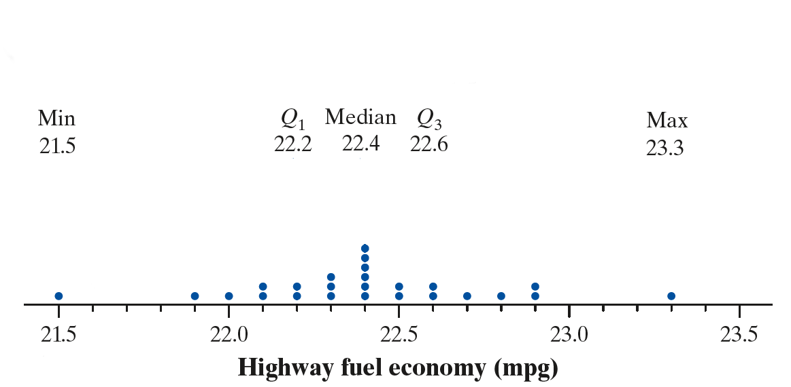
Making and Interpreting Boxplots
The five-number summary of a distribution of quantitative data consists of the minimum, the first quartile Q₁, the median, the third quartile Q₃, and the maximum.

Slide 47
Making and Interpreting Boxplots
The five-number summary of a distribution of quantitative data consists of the minimum, the first quartile Q₁, the median, the third quartile Q₃, and the maximum.

Slide 48
Making and Interpreting Boxplots
The five-number summary of a distribution of quantitative data consists of the minimum, the first quartile Q₁, the median, the third quartile Q₃, and the maximum.
A boxplot is a visual representation of the five-number summary.

Slide 49
Making and Interpreting Boxplots
How to Make a Boxplot
Find the five-number summary.
Identify outliers using the 1.5 × IQR rule.
Draw and label the horizontal axis.
Scale the axis.
Draw a box.
Mark the median.
Draw whiskers.

Slide 50
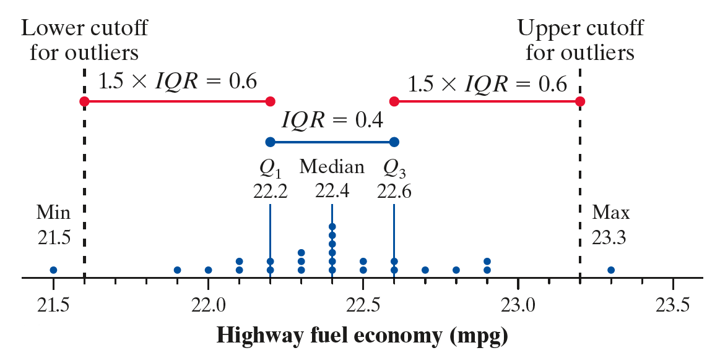
Making and Interpreting Boxplots
How to Make a Boxplot
Find the five-number summary.
Identify outliers using the 1.5 × IQR rule.
Draw and label the horizontal axis.
Scale the axis.
Draw a box.
Mark the median.
Draw whiskers.

Slide 51
Making and Interpreting Boxplots
How to Make a Boxplot
Find the five-number summary.
Identify outliers using the 1.5 × IQR rule.
Draw and label the horizontal axis.
Scale the axis.
Draw a box.
Mark the median.
Draw whiskers.
Outliers

Slide 52
Making and Interpreting Boxplots
How to Make a Boxplot
Find the five-number summary.
Identify outliers using the 1.5 × IQR rule.
Draw and label the horizontal axis.
Scale the axis.
Draw a box.
Mark the median.
Draw whiskers.

Slide 53
Making and Interpreting Boxplots
How to Make a Boxplot
Find the five-number summary.
Identify outliers using the 1.5 × IQR rule.
Draw and label the horizontal axis.
Scale the axis.
Draw a box.
Mark the median.
Draw whiskers.

Slide 54
Making and Interpreting Boxplots
How to Make a Boxplot
Find the five-number summary.
Identify outliers using the 1.5 × IQR rule.
Draw and label the horizontal axis.
Scale the axis.
Draw a box.
Mark the median.
Draw whiskers.

Slide 55
Making and Interpreting Boxplots
How to Make a Boxplot
Find the five-number summary.
Identify outliers using the 1.5 × IQR rule.
Draw and label the horizontal axis.
Scale the axis.
Draw a box.
Mark the median.
Draw whiskers.

Slide 56
Making and Interpreting Boxplots
How to Make a Boxplot
Whiskers extend to last data value that isn’t an outlier
Find the five-number summary.
Identify outliers using the 1.5 × IQR rule.
Draw and label the horizontal axis.
Scale the axis.
Draw a box.
Mark the median.
Draw whiskers.

Slide 57
Making and Interpreting Boxplots
How to Make a Boxplot
Find the five-number summary.
Identify outliers using the 1.5 × IQR rule.
Draw and label the horizontal axis.
Scale the axis.
Draw a box.
Mark the median.
Draw whiskers.
Mark outliers as separate points

Slide 58
Making and Interpreting Boxplots
How to Make a Boxplot
CAUTION:
Boxplots do not display each individual value in a distribution.
Boxplots don’t show gaps, clusters, or peaks.
Find the five-number summary.
Identify outliers using the 1.5 × IQR rule.
Draw and label the horizontal axis.
Scale the axis.
Draw a box.
Mark the median.
Draw whiskers.

Slide 59
Section Summary
CALCULATE measures of center (mean, median) for a distribution of quantitative data.
CALCULATE and INTERPRET measures of variability (range, standard deviation, IQR) for a distribution of quantitative data.
EXPLAIN how outliers and skewness affect measures of center and variability.
IDENTIFY outliers using the 1.5 × IQR rule.
MAKE and INTERPRET boxplots of quantitative data.
Use boxplots and numerical summaries to COMPARE distributions of quantitative data.

