Slide 1


Chapter 6
Random Variables and Probability Distributions
Section 6.1
Discrete and Continuous
Random Variables

Slide 2
Discrete and Continuous Random Variables
USE the probability distribution of a discrete random variable to CALCULATE the probability of an event.
MAKE a histogram to display the probability distribution of a discrete random variable and DESCRIBE its shape.
CALCULATE and INTERPRET the mean (expected value) of a discrete random variable.
CALCULATE and INTERPRET the standard deviation of a discrete random variable.
USE the probability distribution of a continuous random variable (uniform or Normal) to CALCULATE the probability of an event.

Slide 3
Discrete Random Variables
  A probability model describes the possible outcomes of a chance process and the likelihood that those outcomes will occur.

Slide 4
Discrete Random Variables
  A probability model describes the possible outcomes of a chance process and the likelihood that those outcomes will occur.
Consider tossing a fair coin 3 times.
Define the random variable X = the number of heads obtained

Slide 5
Discrete Random Variables
  A probability model describes the possible outcomes of a chance process and the likelihood that those outcomes will occur.
Consider tossing a fair coin 3 times.
Define the random variable X = the number of heads obtained
X = 0: TTT
X = 1: HTT THT TTH
X = 2: HHT HTH THH
X = 3: HHH
Value of X | 0 | 1 | 2 | 3
Probability | 1/8 | 3/8 | 3/8 | 1/8

Slide 6
Discrete Random Variables
  A probability model describes the possible outcomes of a chance process and the likelihood that those outcomes will occur.
Consider tossing a fair coin 3 times.
Define the random variable X = the number of heads obtained
X = 0: TTT
X = 1: HTT THT TTH
X = 2: HHT HTH THH
X = 3: HHH
Value of X | 0 | 1 | 2 | 3
Probability | 1/8 | 3/8 | 3/8 | 1/8
A random variable takes numerical values that describe the outcomes of a chance process.
The probability distribution of a random variable gives its possible values and their probabilities.

Slide 7
Discrete Random Variables
Probability Distribution for a Discrete Random Variable
The probability distribution of a discrete random variable X lists the values x_{i} and their probabilities p_{i}:
For the probability distribution to be valid, the probabilities p_{i} must satisfy two requirements:
Every probability p_{i} is a number between 0 and 1, inclusive.
The sum of the probabilities is 1: p₁ + p₂ + p₃ + . . . = 1.
Value | x₁ | x₂ | x₃ | …
Probability | p₁ | p₂ | p₃ | …

Slide 8
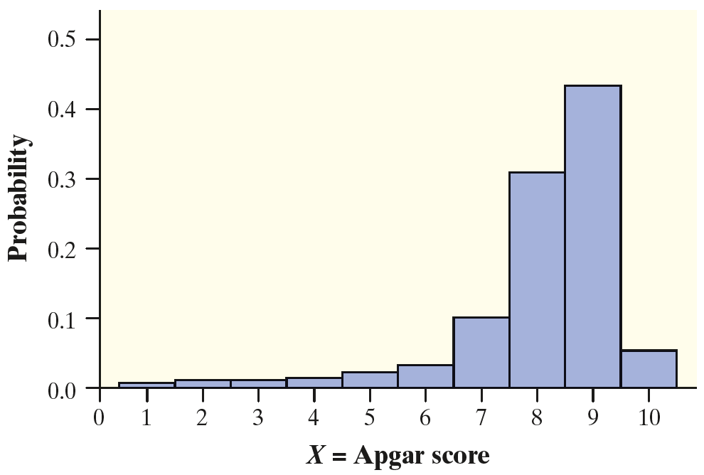
Analyzing Discrete Random Variables:
Describing Shape
When we analyzed distributions of quantitative data in Chapter 1, we made it a point to discuss their shape, center, and variability.

Slide 9
Analyzing Discrete Random Variables:
Describing Shape
When we analyzed distributions of quantitative data in Chapter 1, we made it a point to discuss their shape, center, and variability.
We’ll do the same with probability distributions of random variables.

Slide 10
Analyzing Discrete Random Variables:
Describing Shape
When we analyzed distributions of quantitative data in Chapter 1, we made it a point to discuss their shape, center, and variability.
We’ll do the same with probability distributions of random variables.
This distribution is skewed to the left
with a single peak at an Apgar score of 9.

Slide 11
Analyzing Discrete Random Variables:
Describing Shape
The probability distribution of the random variable X models the population distribution of the quantitative variable “Apgar score of a newborn baby.” So we can interpret our earlier result, P (X > 7) = 0.809 , as saying that about 81% of all newborn babies have Apgar scores greater than 7.

Slide 12
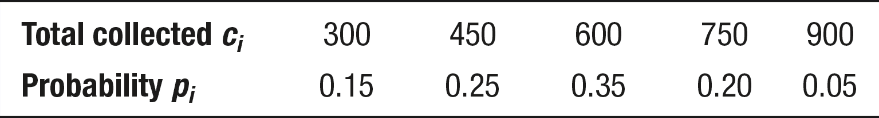
Analyzing Discrete Random Variables:
Describing Shape
Problem: Pete’s Jeep Tours offers a popular day trip in a tourist area.
There must be at least 2 passengers for the trip to run, and the vehicle
will hold up to 6 passengers. Pete charges $150 per passenger. Let C =
the total amount of money that Pete collects on a randomly selected
trip. The probability
distribution of C is
given in the table.
Make a histogram of the probability distribution. Describe its shape.
Judy M. Starnes

Slide 13
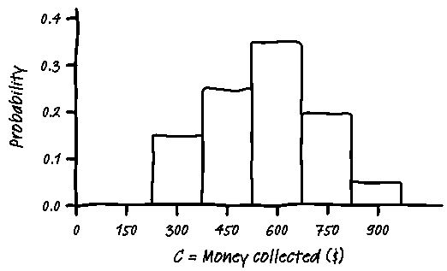
Analyzing Discrete Random Variables:
Describing Shape
Problem: Pete’s Jeep Tours offers a popular day trip in a tourist area.
There must be at least 2 passengers for the trip to run, and the vehicle
will hold up to 6 passengers. Pete charges $150 per passenger. Let C =
the total amount of money that Pete collects on a randomly selected
trip. The probability
distribution of C is
given in the table.
Make a histogram of the probability distribution. Describe its shape.
Judy M. Starnes

Slide 14
Analyzing Discrete Random Variables:
Describing Shape
Problem: Pete’s Jeep Tours offers a popular day trip in a tourist area.
There must be at least 2 passengers for the trip to run, and the vehicle
will hold up to 6 passengers. Pete charges $150 per passenger. Let C =
the total amount of money that Pete collects on a randomly selected
trip. The probability
distribution of C is
given in the table.
Make a histogram of the probability distribution. Describe its shape.
The graph is
roughly
symmetric
and has a
single peak
at $600.
Judy M. Starnes

Slide 15
Measuring Center: The Mean (Expected Value) of a Discrete Random Variable
The mean (expected value) of any discrete random variable is an average of the possible outcomes, but a weighted average in which each outcome is weighted by its probability.

Slide 16
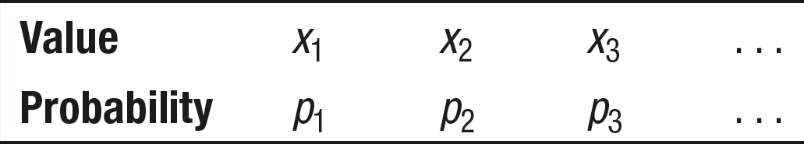
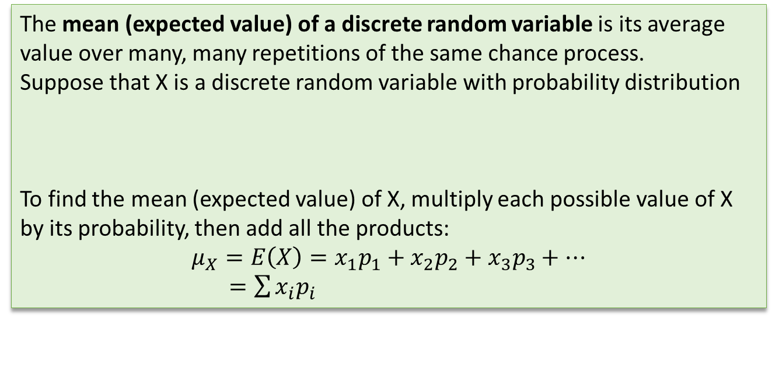
Measuring Center: The Mean (Expected Value) of a Discrete Random Variable
The mean (expected value) of any discrete random variable is an average of the possible outcomes, but a weighted average in which each outcome is weighted by its probability.
The mean (expected value) of a discrete random variable is its average value over many, many repetitions of the same chance process.
Suppose that X is a discrete random variable with probability distribution
To find the mean (expected value) of X, multiply each possible value of X by its probability, then add all the products:
$$μ_{X}=E\left(X\right)=x_{1}p_{1}+x_{2}p_{2}+x_{3}p_{3}+⋯$$
$=\sum{x_{i}p_{i}}$

Slide 17
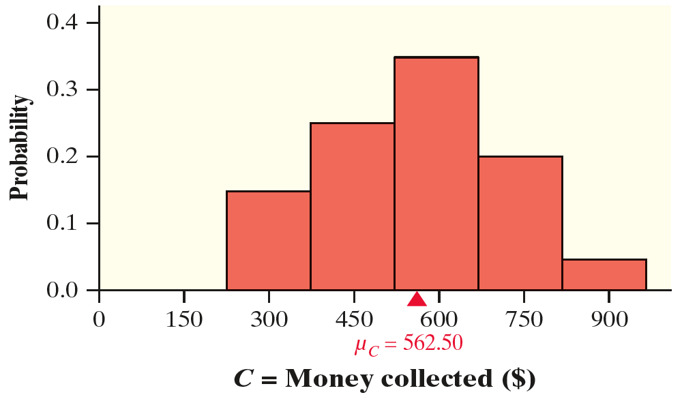
Measuring Center: The Mean (Expected Value) of a Discrete Random Variable
For Pete’s distribution,
µ_{C} = $562.50

Slide 18
Measuring Center: The Mean (Expected Value) of a Discrete Random Variable
For Pete’s distribution,
µ_{C} = $562.50
Recall that the mean is the balance point of a distribution.

Slide 19
Measuring Center: The Mean (Expected Value) of a Discrete Random Variable
For Pete’s distribution,
µ_{C} = $562.50
Recall that the mean is the balance point of a distribution.
How do we interpret this value?

Slide 20
Measuring Center: The Mean (Expected Value) of a Discrete Random Variable
For Pete’s distribution,
µ_{C} = $562.50
Recall that the mean is the balance point of a distribution.
How do we interpret this value?
If we randomly select many, many jeep tours, Pete will make about $562.50 per trip, on average.

Slide 21
Measuring Center: The Mean (Expected Value) of a Discrete Random Variable
Problem: Earlier, we defined the random variable X to be the Apgar score of a randomly selected newborn baby. The table gives the probability distribution of X once again.
Calculate and interpret the expected value of X.
susaro/iStock/Getty Images

Slide 22
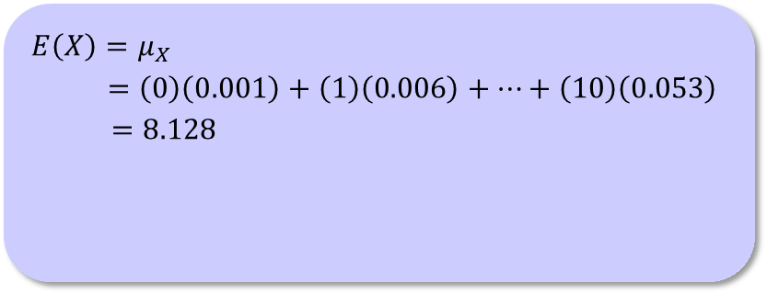
Measuring Center: The Mean (Expected Value) of a Discrete Random Variable
Problem: Earlier, we defined the random variable X to be the Apgar score of a randomly selected newborn baby. The table gives the probability distribution of X once again.
Calculate and interpret the expected value of X.
$$E\left(X\right)=μ_{X}$$
$=\left(0\right)\left(0.001\right)+\left(1\right)\left(0.006\right)+⋯+\left(10\right)\left(0.053\right)$
$=8.128$
susaro/iStock/Getty Images

Slide 23
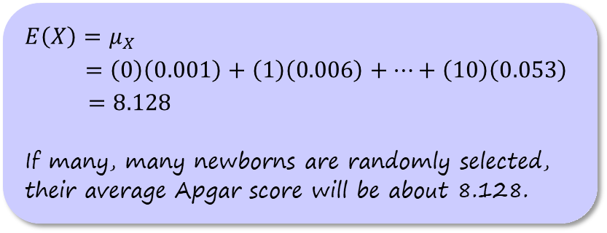
Measuring Center: The Mean (Expected Value) of a Discrete Random Variable
Problem: Earlier, we defined the random variable X to be the Apgar score of a randomly selected newborn baby. The table gives the probability distribution of X once again.
Calculate and interpret the expected value of X.
$$E\left(X\right)=μ_{X}$$
$=\left(0\right)\left(0.001\right)+\left(1\right)\left(0.006\right)+⋯+\left(10\right)\left(0.053\right)$
$=8.128$
If many, many newborns are randomly selected, their average Apgar score will be about 8.128.
susaro/iStock/Getty Images

Slide 24
Measuring Center: The Mean (Expected Value) of a Discrete Random Variable
How can we find the median of a discrete random variable?

Slide 25
Measuring Center: The Mean (Expected Value) of a Discrete Random Variable
How can we find the median of a discrete random variable?
We can find the median from a cumulative probability distribution. The median of a discrete random variable is the 50th percentile of its probability distribution.

Slide 26
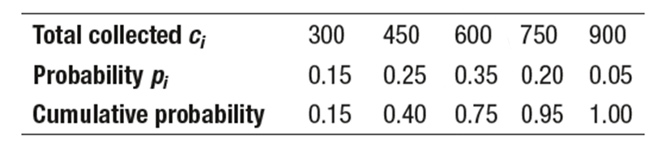
Measuring Center: The Mean (Expected Value) of a Discrete Random Variable
How can we find the median of a discrete random variable?
We can find the median from a cumulative probability distribution. The median of a discrete random variable is the 50th percentile of its probability distribution.

Slide 27
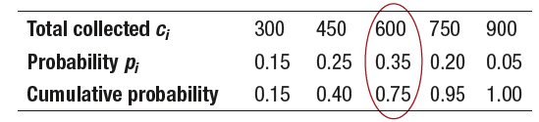
Measuring Center: The Mean (Expected Value) of a Discrete Random Variable
How can we find the median of a discrete random variable?
We can find the median from a cumulative probability distribution. The median of a discrete random variable is the 50th percentile of its probability distribution.
The median of a discrete random variable is the smallest value for which the cumulative probability equals or exceeds 0.5. So the median amount of money Pete collects on a randomly selected jeep tour is $600.

Slide 28
Measuring Variability: The Standard Deviation (and Variance) of a Discrete Random Variable
With the mean as our measure of center for a discrete random variable, it shouldn’t surprise you that we’ll use the standard deviation as our measure of variability.

Slide 29
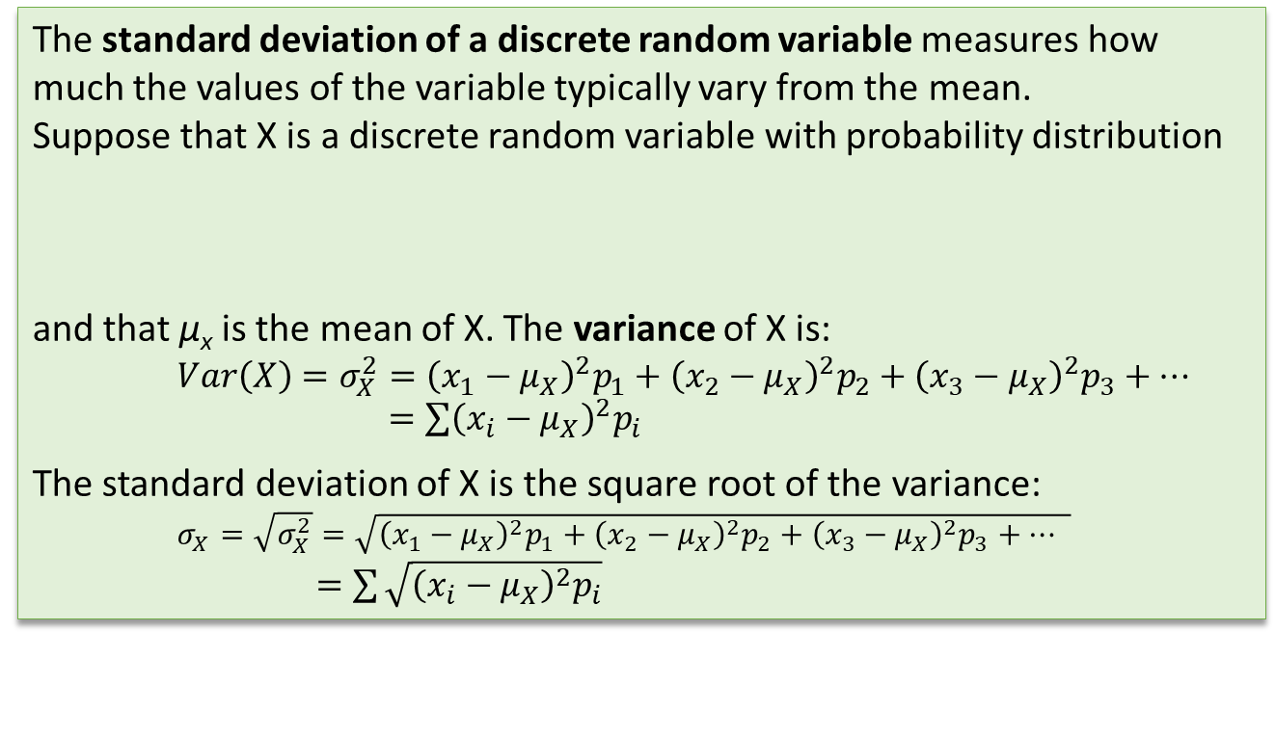
Measuring Variability: The Standard Deviation (and Variance) of a Discrete Random Variable
With the mean as our measure of center for a discrete random variable, it shouldn’t surprise you that we’ll use the standard deviation as our measure of variability.
The standard deviation of a discrete random variable measures how much the values of the variable typically vary from the mean.
Suppose that X is a discrete random variable with probability distribution
and that µ_{x} is the mean of X. The variance of X is:
$$Var\left(X\right)=σ_{X}^{2}={\left(x_{1}−μ_{X}\right)}^{2}p_{1}+{\left(x_{2}−μ_{X}\right)}^{2}p_{2}+{\left(x_{3}−μ_{X}\right)}^{2}p_{3}+⋯$$
$=\sum{{\left(x_{i}−μ_{X}\right)}^{2}p_{i}}$
The standard deviation of X is the square root of the variance:
$σ_{X}=\sqrt{σ_{X}^{2}}=\sqrt{{\left(x_{1}−μ_{X}\right)}^{2}p_{1}+{\left(x_{2}−μ_{X}\right)}^{2}p_{2}+{\left(x_{3}−μ_{X}\right)}^{2}p_{3}+⋯ }$
$=\sum{\sqrt{{\left(x_{i}−μ_{X}\right)}^{2}p_{i}}}$

Slide 30
Measuring Variability: The Standard Deviation (and Variance) of a Discrete Random Variable
Problem: Earlier, we defined the random variable X to be the Apgar score of a randomly selected newborn baby. The table gives the probability distribution of X once again. In the last example, we calculated the mean Apgar score of a randomly chosen newborn to be µ_{x} = 8.128.
Calculate and interpret the standard deviation of X.
susaro/iStock/Getty Images

Slide 31
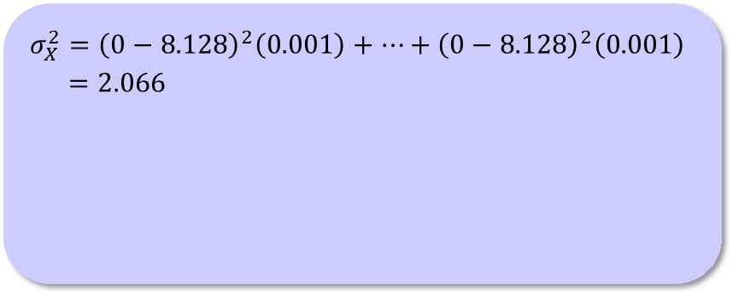
Measuring Variability: The Standard Deviation (and Variance) of a Discrete Random Variable
Problem: Earlier, we defined the random variable X to be the Apgar score of a randomly selected newborn baby. The table gives the probability distribution of X once again. In the last example, we calculated the mean Apgar score of a randomly chosen newborn to be µ_{x} = 8.128.
Calculate and interpret the standard deviation of X.
$$σ_{X}^{2}={\left(0−8.128\right)}^{2}\left(0.001\right)+⋯+{\left(0−8.128\right)}^{2}\left(0.001\right)$$
$=2.066$
susaro/iStock/Getty Images

Slide 32
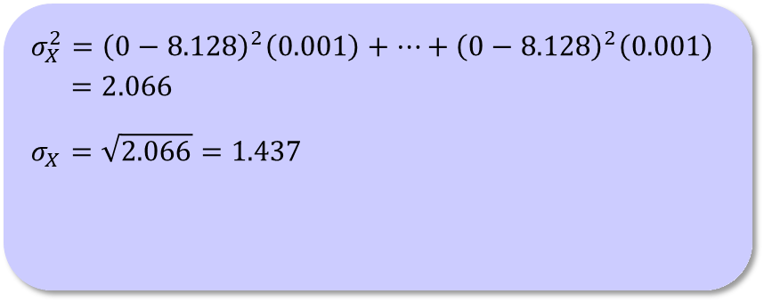
Measuring Variability: The Standard Deviation (and Variance) of a Discrete Random Variable
Problem: Earlier, we defined the random variable X to be the Apgar score of a randomly selected newborn baby. The table gives the probability distribution of X once again. In the last example, we calculated the mean Apgar score of a randomly chosen newborn to be µ_{x} = 8.128.
Calculate and interpret the standard deviation of X.
$$σ_{X}^{2}={\left(0−8.128\right)}^{2}\left(0.001\right)+⋯+{\left(0−8.128\right)}^{2}\left(0.001\right)$$
$=2.066$
$$σ_{X}=\sqrt{2.066}=1.437$$
susaro/iStock/Getty Images

Slide 33
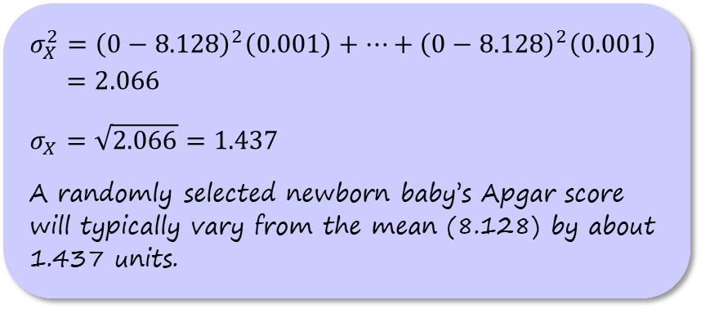
Measuring Variability: The Standard Deviation (and Variance) of a Discrete Random Variable
Problem: Earlier, we defined the random variable X to be the Apgar score of a randomly selected newborn baby. The table gives the probability distribution of X once again. In the last example, we calculated the mean Apgar score of a randomly chosen newborn to be µ_{x} = 8.128.
Calculate and interpret the standard deviation of X.
$$σ_{X}^{2}={\left(0−8.128\right)}^{2}\left(0.001\right)+⋯+{\left(0−8.128\right)}^{2}\left(0.001\right)$$
$=2.066$
$$σ_{X}=\sqrt{2.066}=1.437$$
A randomly selected newborn baby’s Apgar score will typically vary from the mean (8.128) by about 1.437 units.
susaro/iStock/Getty Images

Slide 34
Continuous Random Variables
A continuous random variable can take any value in an interval on the number line.

Slide 35
Continuous Random Variables
A continuous random variable can take any value in an interval on the number line.
How to Find Probabilities for a Continuous Random Variable
The probability of any event involving a continuous random variable is the
area under the density curve and directly above the values on the horizontal axis that make up the event.

Slide 36
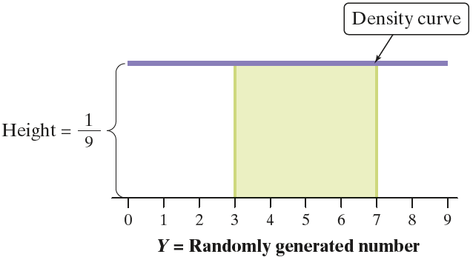
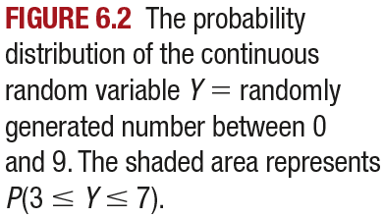
Continuous Random Variables
A continuous random variable can take any value in an interval on the number line.
How to Find Probabilities for a Continuous Random Variable
The probability of any event involving a continuous random variable is the
area under the density curve and directly above the values on the horizontal axis that make up the event.

Slide 37
Continuous Random Variables
Problem: Selena works at a bookstore in the Denver International Airport. She takes the airport train from the main terminal to get to work each day. The airport just opened a new walkway that would allow Selena to get from the main terminal to the bookstore in 4 minutes. She wonders if it will be faster to walk or take the train to work. Let Y = Selena’s journey time to work (in minutes) by train on a randomly selected day. The probability distribution of Y can be modeled by a uniform density curve on the interval from 2 to 5 minutes. Find the probability that it will be quicker for Selena to take the train than to walk that day.

Slide 38
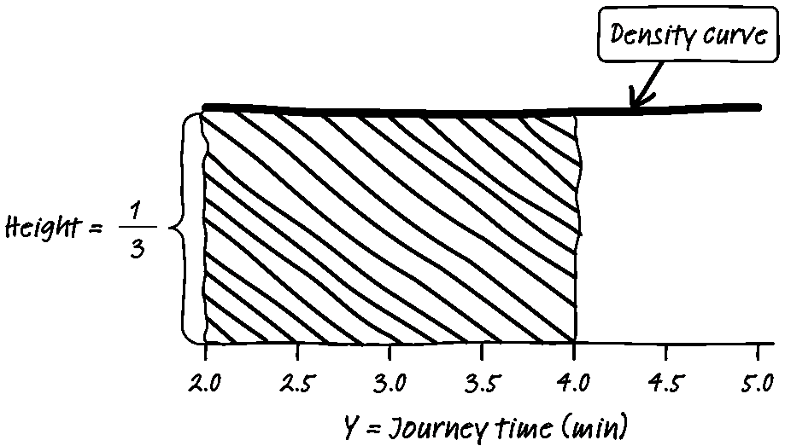
Continuous Random Variables
Problem: Selena works at a bookstore in the Denver International Airport. She takes the airport train from the main terminal to get to work each day. The airport just opened a new walkway that would allow Selena to get from the main terminal to the bookstore in 4 minutes. She wonders if it will be faster to walk or take the train to work. Let Y = Selena’s journey time to work (in minutes) by train on a randomly selected day. The probability distribution of Y can be modeled by a uniform density curve on the interval from 2 to 5 minutes. Find the probability that it will be quicker for Selena to take the train than to walk that day.

Slide 39
Continuous Random Variables
Problem: Selena works at a bookstore in the Denver International Airport. She takes the airport train from the main terminal to get to work each day. The airport just opened a new walkway that would allow Selena to get from the main terminal to the bookstore in 4 minutes. She wonders if it will be faster to walk or take the train to work. Let Y = Selena’s journey time to work (in minutes) by train on a randomly selected day. The probability distribution of Y can be modeled by a uniform density curve on the interval from 2 to 5 minutes. Find the probability that it will be quicker for Selena to take the train than to walk that day.
Shaded area = base × height
= 2 × 1/3
= 2/3

Slide 40
Continuous Random Variables
Problem: Selena works at a bookstore in the Denver International Airport. She takes the airport train from the main terminal to get to work each day. The airport just opened a new walkway that would allow Selena to get from the main terminal to the bookstore in 4 minutes. She wonders if it will be faster to walk or take the train to work. Let Y = Selena’s journey time to work (in minutes) by train on a randomly selected day. The probability distribution of Y can be modeled by a uniform density curve on the interval from 2 to 5 minutes. Find the probability that it will be quicker for Selena to take the train than to walk that day.
Shaded area = base × height
= 2 × 1/3
= 2/3
P(Y < 4) = 2/3 = 0.667

Slide 41
Continuous Random Variables
Problem: Selena works at a bookstore in the Denver International Airport. She takes the airport train from the main terminal to get to work each day. The airport just opened a new walkway that would allow Selena to get from the main terminal to the bookstore in 4 minutes. She wonders if it will be faster to walk or take the train to work. Let Y = Selena’s journey time to work (in minutes) by train on a randomly selected day. The probability distribution of Y can be modeled by a uniform density curve on the interval from 2 to 5 minutes. Find the probability that it will be quicker for Selena to take the train than to walk that day.
Shaded area = base × height
= 2 × 1/3
= 2/3
P(Y < 4) = 2/3 = 0.667
There is a 66.7% chance that it
will be quicker for Selena to take
the train to work on a randomly
selected day.

Slide 42
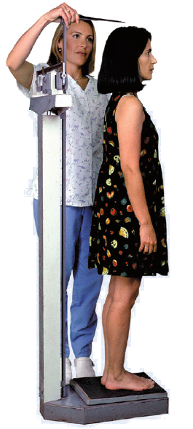
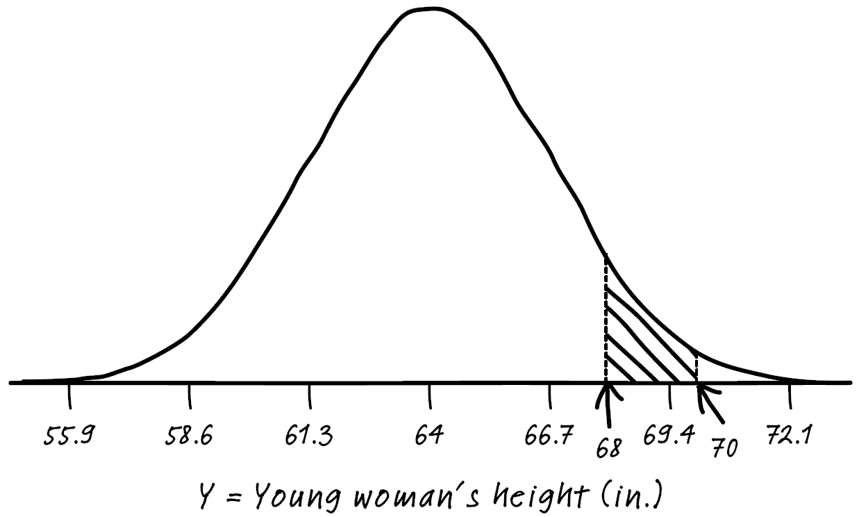
Continuous Random Variables
Problem: The heights of young women can be modeled by a Normal distribution
with mean µ = 64 inches and standard deviation σ = 2.7 inches. Suppose we choose a young woman at random and let Y = her height (in inches).
Find P(68 ≤ Y ≤ 70). Interpret this value.

Slide 43

Continuous Random Variables
Problem: The heights of young women can be modeled by a Normal distribution
with mean µ = 64 inches and standard deviation σ = 2.7 inches. Suppose we choose a young woman at random and let Y = her height (in inches).
Find P(68 ≤ Y ≤ 70). Interpret this value.
$z=\frac{68−64}{2.7}=1.48$
$z=\frac{70−64}{2.7}=2.22$

Slide 44

Continuous Random Variables
Problem: The heights of young women can be modeled by a Normal distribution
with mean µ = 64 inches and standard deviation σ = 2.7 inches. Suppose we choose a young woman at random and let Y = her height (in inches).
Find P(68 ≤ Y ≤ 70). Interpret this value.
$z=\frac{68−64}{2.7}=1.48$
$z=\frac{70−64}{2.7}=2.22$
  Using Table A:
  0.9868 – 0.9306
  = 0.0562

Slide 45

Continuous Random Variables
Problem: The heights of young women can be modeled by a Normal distribution
with mean µ = 64 inches and standard deviation σ = 2.7 inches. Suppose we choose a young woman at random and let Y = her height (in inches).
Find P(68 ≤ Y ≤ 70). Interpret this value.
$z=\frac{68−64}{2.7}=1.48$
$z=\frac{70−64}{2.7}=2.22$
  Using Table A:
  0.9868 – 0.9306
  = 0.0562
  Using technology:
  normalcdf(lower:1.48, upper:2.22, mean:0, SD:1)
  = 0.0562

Slide 46
Continuous Random Variables
Problem: The heights of young women can be modeled by a Normal distribution
with mean µ = 64 inches and standard deviation σ = 2.7 inches. Suppose we choose a young woman at random and let Y = her height (in inches).
Find P(68 ≤ Y ≤ 70). Interpret this value.
normalcdf(lower:68, upper:70, mean:64, SD:2.7)
= 0.0561

Slide 47
Continuous Random Variables
Problem: The heights of young women can be modeled by a Normal distribution
with mean µ = 64 inches and standard deviation σ = 2.7 inches. Suppose we choose a young woman at random and let Y = her height (in inches).
Find P(68 ≤ Y ≤ 70). Interpret this value.
The probability that a randomly selected young woman has a height between 68 and 70 inches is about 0.056.

Slide 48
Section Summary
USE the probability distribution of a discrete random variable to CALCULATE the probability of an event.
MAKE a histogram to display the probability distribution of a discrete random variable and DESCRIBE its shape.
CALCULATE and INTERPRET the mean (expected value) of a discrete random variable.
CALCULATE and INTERPRET the standard deviation of a discrete random variable.
USE the probability distribution of a continuous random variable (uniform or Normal) to CALCULATE the probability of an event.

