Slide 1


Chapter 6
Random Variables and Probability Distributions
Section 6.3
Binomial and Geometric
Random Variables

Slide 2
Binomial and Geometric Random Variables
DETERMINE whether the conditions for a binomial setting are met.
CALCULATE and INTERPRET probabilities involving binomial distributions.
CALCULATE the mean and standard deviation of a binomial random variable. INTERPRET these values.
When appropriate, USE the Normal approximation to the binomial distribution to CALCULATE probabilities.
CALCULATE and INTERPRET probabilities involving geometric random variables.
CALCULATE the mean and standard deviation of a geometric distribution. INTERPRET these values.

Slide 3
Binomial Settings and Binomial Random Variables
A binomial setting arises when we perform n independent trials of the same chance process and count the number of times that a particular outcome (called a “success”) occurs.
The four conditions for a binomial setting are
Binary? The possible outcomes of each trial can be classified as “success” or “failure.”
Independent? Trials must be independent. That is, knowing the outcome of one trial must not tell us anything about the outcome of any other trial.
Number? The number of trials n of the chance process must be fixed in advance.
Same probability? There is the same probability of success p on each trial.

Slide 4
Binomial Settings and Binomial Random Variables
A binomial setting arises when we perform n independent trials of the same chance process and count the number of times that a particular outcome (called a “success”) occurs.
The four conditions for a binomial setting are
Binary? The possible outcomes of each trial can be classified as “success” or “failure.”
Independent? Trials must be independent. That is, knowing the outcome of one trial must not tell us anything about the outcome of any other trial.
Number? The number of trials n of the chance process must be fixed in advance.
Same probability? There is the same probability of success p on each trial.
The circled letters give you a helpful way to remember the conditions for a binomial setting: just check the BINS!

Slide 5
Binomial Settings and Binomial Random Variables
Problem: Determine whether the given scenario describes a binomial
setting. Justify your answer.
(a) Genetics says that the genes children receive from their parents are independent from one child to another. Each child of a particular set of parents has probability 0.25 of having type O blood. Suppose these parents have 5 children. Count the number of children with type O blood.

Slide 6
Binomial Settings and Binomial Random Variables
Problem: Determine whether the given scenario describes a binomial
setting. Justify your answer.
(a) Genetics says that the genes children receive from their parents are independent from one child to another. Each child of a particular set of parents has probability 0.25 of having type O blood. Suppose these parents have 5 children. Count the number of children with type O blood.
(a)
Binary? “Success” 5 has type O blood. “Failure” 5 doesn’t have type O blood.
Independent? Knowing one child’s blood type tells you nothing about another child’s because they inherit genes independently from their parents.
Number? n = 5
Same probability? p = 0.25
This is a binomial setting.

Slide 7
Binomial Settings and Binomial Random Variables
Problem: Determine whether the given scenario describes a binomial
setting. Justify your answer.
(b) Shuffle a standard deck of 52 playing cards. Turn over the first 10 cards, one at a time. Record the number of aces you observe.

Slide 8
Binomial Settings and Binomial Random Variables
Problem: Determine whether the given scenario describes a binomial
setting. Justify your answer.
(b) Shuffle a standard deck of 52 playing cards. Turn over the first 10 cards, one at a time. Record the number of aces you observe.
(b)
Binary? “Success” 5 get an ace. “Failure” 5 don’t get an ace.
Independent? No. If the first card you turn over is an ace, then the next card is less likely to be an ace because you’re not replacing the top card in the deck. If the first card isn’t an ace, the second card is more likely to be an ace.
This is not a binomial setting because the independent condition is not met.

Slide 9
Binomial Settings and Binomial Random Variables
Problem: Determine whether the given scenario describes a binomial
setting. Justify your answer.
(c) Shuffle a deck of cards. Turn over the top card. Put the card back in the deck, and shuffle again. Repeat this process until you get an ace. Count the number of cards you had to turn over.

Slide 10
Binomial Settings and Binomial Random Variables
Problem: Determine whether the given scenario describes a binomial
setting. Justify your answer.
(c) Shuffle a deck of cards. Turn over the top card. Put the card back in the deck, and shuffle again. Repeat this process until you get an ace. Count the number of cards you had to turn over.
(c)
Binary? “Success” 5 get an ace. “Failure” 5 don’t get an ace.
Independent? Yes. Because you are replacing the card in the deck and shuffling each time, the result of one trial doesn’t tell you anything about the outcome of any other trial.
Number? No. The number of trials is not fixed in advance.
Because there is no fixed number of trials, this is not a binomial setting.

Slide 11
Binomial Settings and Binomial Random Variables
The blood type scenario in part (a) of the example is a binomial setting. If we let X = the number of children with type O blood, then X is a binomial random variable.

Slide 12
Binomial Settings and Binomial Random Variables
The blood type scenario in part (a) of the example is a binomial setting. If we let X = the number of children with type O blood, then X is a binomial random variable.
The probability distribution of X is called a binomial distribution.

Slide 13
Binomial Settings and Binomial Random Variables
The blood type scenario in part (a) of the example is a binomial setting. If we let X = the number of children with type O blood, then X is a binomial random variable.
The probability distribution of X is called a binomial distribution.
The count of successes X in a binomial setting is a binomial random variable.
The possible values of X are 0, 1, 2, …, n.
The probability distribution of X is a binomial distribution. Any binomial
distribution is completely specified by two numbers: the number of trials n of the chance process and the probability p of success on each trial.

Slide 14
Calculating Binomial Probabilities
Each child of a particular set of parents has probability 0.25 of having type O blood. Suppose these parents have 5 children.

Slide 15
Calculating Binomial Probabilities
Each child of a particular set of parents has probability 0.25 of having type O blood. Suppose these parents have 5 children.
What’s the probability that exactly one of the five children has type O blood?

Slide 16
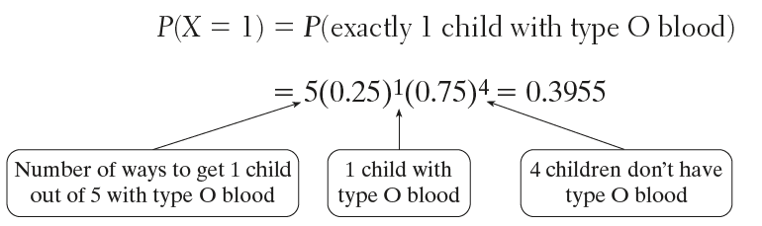
Calculating Binomial Probabilities
Each child of a particular set of parents has probability 0.25 of having type O blood. Suppose these parents have 5 children.
What’s the probability that exactly one of the five children has type O blood?

Slide 17
Calculating Binomial Probabilities
Each child of a particular set of parents has probability 0.25 of having type O blood. Suppose these parents have 5 children.
What’s the probability that exactly one of the five children has type O blood?
P(X = k) = (# of ways to get k successes in n trials) (success probability)^{k} (failure probability)^{n–k}

Slide 18
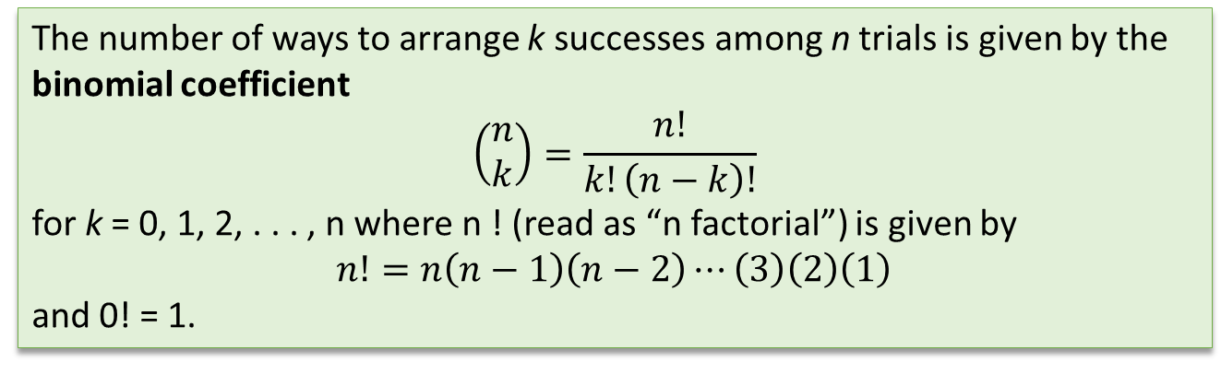
Calculating Binomial Probabilities
The number of ways to arrange k successes among n trials is given by the
binomial coefficient
$$\left(\begin{matrix}n \\ k\end{matrix}\right)=\frac{n!}{k!\left(n−k\right)!}$$
for k = 0, 1, 2, . . . , n where n ! (read as “n factorial”) is given by
$$n!=n\left(n−1\right)\left(n−2\right)⋯\left(3\right)\left(2\right)\left(1\right)$$
and 0! = 1.

Slide 19

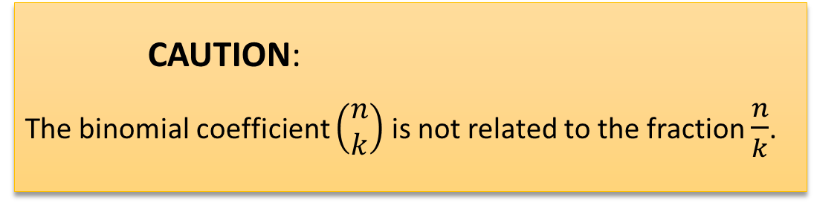
Calculating Binomial Probabilities
The number of ways to arrange k successes among n trials is given by the
binomial coefficient
$$\left(\begin{matrix}n \\ k\end{matrix}\right)=\frac{n!}{k!\left(n−k\right)!}$$
for k = 0, 1, 2, . . . , n where n ! (read as “n factorial”) is given by
$$n!=n\left(n−1\right)\left(n−2\right)⋯\left(3\right)\left(2\right)\left(1\right)$$
and 0! = 1.
CAUTION:
The binomial coefficient $\left(\begin{matrix}n \\ k\end{matrix}\right)$ is not related to the fraction $\frac{n}{k}$.

Slide 20
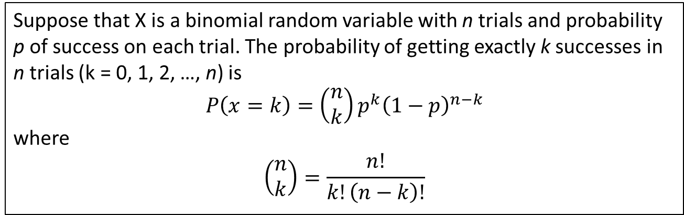
Calculating Binomial Probabilities
Binomial Probability Formula
Suppose that X is a binomial random variable with n trials and probability
p of success on each trial. The probability of getting exactly k successes in
n trials (k = 0, 1, 2, …, n) is
$$P\left(x=k\right)=\left(\begin{matrix}n \\ k\end{matrix}\right)p^{k}{\left(1−p\right)}^{n−k}$$
where
$$\left(\begin{matrix}n \\ k\end{matrix}\right)=\frac{n!}{k!\left(n−k\right)!}$$

Slide 21
Calculating Binomial Probabilities
Problem: Genetics says that the genes children receive from their parents are independent from one child to another. Each child of a particular set of parents has probability 0.25 of having type O blood. Suppose these parents have 5 children. Let X = the number of children with type O blood. Find P(X = 3). Interpret this value.

Slide 22
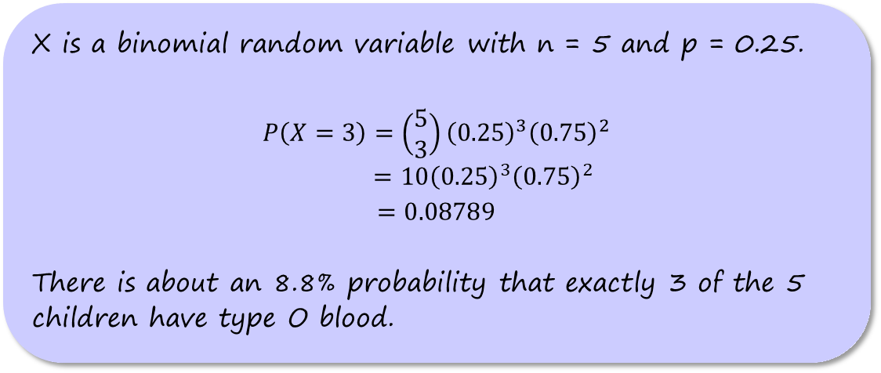
Calculating Binomial Probabilities
Problem: Genetics says that the genes children receive from their parents are independent from one child to another. Each child of a particular set of parents has probability 0.25 of having type O blood. Suppose these parents have 5 children. Let X = the number of children with type O blood. Find P(X = 3). Interpret this value.
X is a binomial random variable with n = 5 and p = 0.25.
$$P\left(X=3\right)=\left(\begin{matrix}5 \\ 3\end{matrix}\right){\left(0.25\right)}^{3}{\left(0.75\right)}^{2}$$
$=10{\left(0.25\right)}^{3}{\left(0.75\right)}^{2}$
$$=0.08789$$
There is about an 8.8% probability that exactly 3 of the 5 children have type O blood.

Slide 23
Calculating Binomial Probabilities
Problem: The preceding example tells us that each child of a particular set of parents has probability 0.25 of having type O blood. Suppose these parents have 5 children. Should the parents be surprised if more than 3 of their children have type O blood? Calculate an appropriate probability to support your answer.

Slide 24
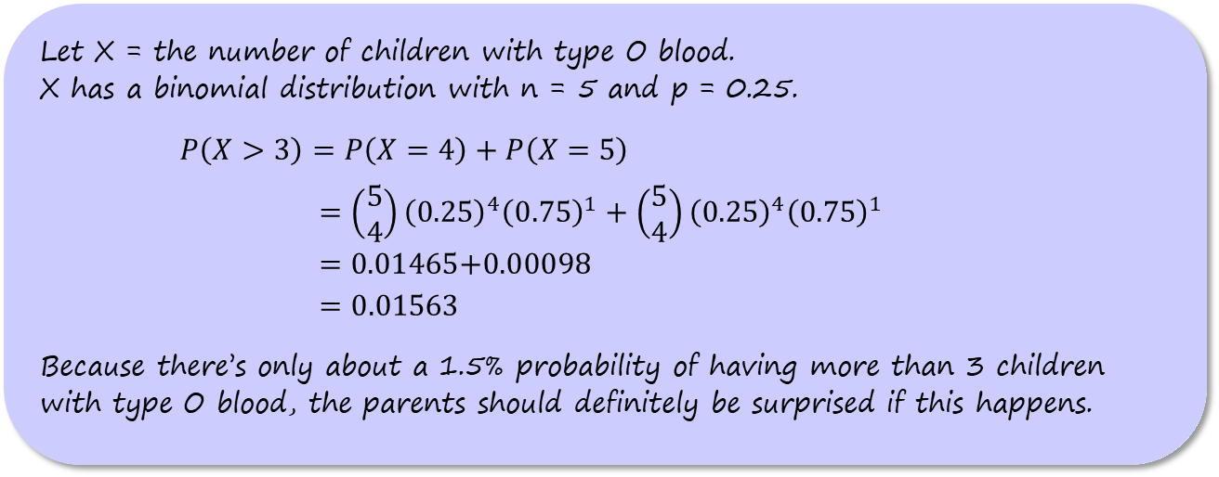
Calculating Binomial Probabilities
Problem: The preceding example tells us that each child of a particular set of parents has probability 0.25 of having type O blood. Suppose these parents have 5 children. Should the parents be surprised if more than 3 of their children have type O blood? Calculate an appropriate probability to support your answer.
Let X = the number of children with type O blood.
X has a binomial distribution with n = 5 and p = 0.25.
$P\left(X>3\right)=P\left(X=4\right)+P\left(X=5\right)$
$=\left(\begin{matrix}5 \\ 4\end{matrix}\right){\left(0.25\right)}^{4}{\left(0.75\right)}^{1}+\left(\begin{matrix}5 \\ 4\end{matrix}\right){\left(0.25\right)}^{4}{\left(0.75\right)}^{1}$
$=\text{0.01465}\text{+}\text{0.00098}$
$=0.01563$
Because there’s only about a 1.5% probability of having more than 3 children with type O blood, the parents should definitely be surprised if this happens.

Slide 25
Calculating Binomial Probabilities
To compute binomial probabilities on the TI-83/84 calculator:

Slide 26
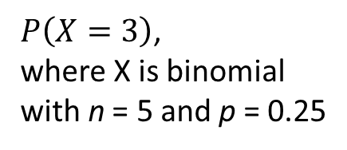
Calculating Binomial Probabilities
To compute binomial probabilities on the TI-83/84 calculator:
  binompdf (n,p,k) computes P(X = k)
$P\left(X=3\right)$,
where X is binomial
with n = 5 and p = 0.25

Slide 27
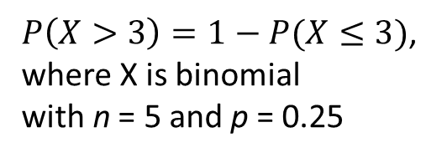
Calculating Binomial Probabilities
To compute binomial probabilities on the TI-83/84 calculator:
  binompdf (n,p,k) computes P(X = k)
  binomcdf (n,p,k) computes P(X ≤ k)
$P\left(X=3\right)$,
where X is binomial
with n = 5 and p = 0.25
$P\left(X>3\right)=1−P(X≤3)$,
where X is binomial
with n = 5 and p = 0.25

Slide 28
Calculating Binomial Probabilities
How to Find Binomial Probabilities
Step 1: state the distribution and the values of interest. Specify a binomial distribution with the number of trials n, success probability p, and the values of the variable clearly identified.

Slide 29
Calculating Binomial Probabilities
How to Find Binomial Probabilities
Step 1: state the distribution and the values of interest. Specify a binomial distribution with the number of trials n, success probability p, and the values of the variable clearly identified.
Step 2: Perform calculations—show your work! Do one of the following:
Use the binomial probability formula to fi nd the desired probability; or
Use the binompdf or binomcdf command and label each of the inputs.

Slide 30
Calculating Binomial Probabilities
How to Find Binomial Probabilities
Step 1: state the distribution and the values of interest. Specify a binomial distribution with the number of trials n, success probability p, and the values of the variable clearly identified.
Step 2: Perform calculations—show your work! Do one of the following:
Use the binomial probability formula to fi nd the desired probability; or
Use the binompdf or binomcdf command and label each of the inputs.
Be sure to answer the question that was asked.

Slide 31
Calculating Binomial Probabilities
Problem: A local fast-food restaurant is running a “Draw a three, get it free” lunch promotion. After each customer orders, a touchscreen display shows the message “Press here to win a free lunch.” A computer program then simulates one card being drawn from a standard deck. If the chosen card is a 3, the customer’s order is free. Otherwise, the customer must pay the bill.
(a) On the first day of the promotion, 250 customers place lunch orders. Find the probability that fewer than 10 of them win a free lunch.

Slide 32
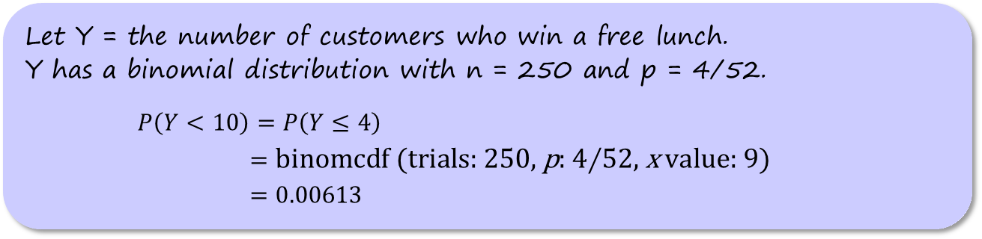
Calculating Binomial Probabilities
Problem: A local fast-food restaurant is running a “Draw a three, get it free” lunch promotion. After each customer orders, a touchscreen display shows the message “Press here to win a free lunch.” A computer program then simulates one card being drawn from a standard deck. If the chosen card is a 3, the customer’s order is free. Otherwise, the customer must pay the bill.
(a) On the first day of the promotion, 250 customers place lunch orders. Find the probability that fewer than 10 of them win a free lunch.
Let Y = the number of customers who win a free lunch.
Y has a binomial distribution with n = 250 and p = 4/52.
$P\left(Y<10\right)=P\left(Y≤4\right)$
$=\text{binomcdf}\text{ (}\text{trials}\text{: 250, }\text{p}\text{:} \text{4∕52, }\text{x} \text{value}\text{: 9)}$
$=0.00613$

Slide 33
Calculating Binomial Probabilities
Problem: A local fast-food restaurant is running a “Draw a three, get it free” lunch promotion. After each customer orders, a touchscreen display shows the message “Press here to win a free lunch.” A computer program then simulates one card being drawn from a standard deck. If the chosen card is a 3, the customer’s order is free. Otherwise, the customer must pay the bill.
(b) In fact, only 9 customers won a free lunch. Does this result give convincing evidence that the computer program is flawed?

Slide 34
Calculating Binomial Probabilities
Problem: A local fast-food restaurant is running a “Draw a three, get it free” lunch promotion. After each customer orders, a touchscreen display shows the message “Press here to win a free lunch.” A computer program then simulates one card being drawn from a standard deck. If the chosen card is a 3, the customer’s order is free. Otherwise, the customer must pay the bill.
(b) In fact, only 9 customers won a free lunch. Does this result give convincing evidence that the computer program is flawed?
There is only a 0.006 probability that fewer than 10 customers would win a free lunch if the computer program is working properly. Because only 9 customers won a free lunch on this day, we have convincing evidence that the computer program is flawed.

Slide 35

Describing a Binomial Distribution:
Shape, Center, and Variability
The table shows the possible values and corresponding probabilities for
X = the number of children with type O blood from previous examples. This is a binomial random variable with n = 5 and p = 0.25.

Slide 36
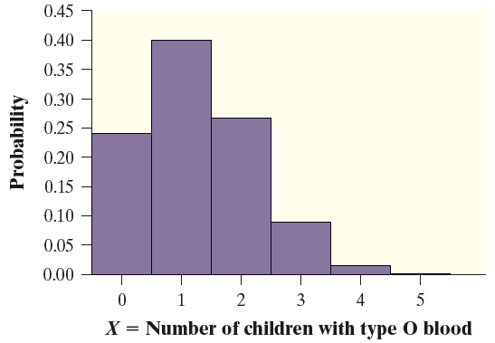
Describing a Binomial Distribution:
Shape, Center, and Variability
The table shows the possible values and corresponding probabilities for
X = the number of children with type O blood from previous examples. This is a binomial random variable with n = 5 and p = 0.25.
The binomial distribution with n = 5 and p = 0.25 is skewed to the right.

Slide 37
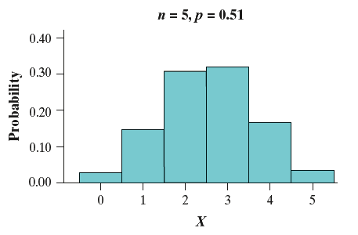
Describing a Binomial Distribution:
Shape, Center, and Variability
The binomial distribution with n = 5 and p = 0.51 is roughly symmetric.

Slide 38
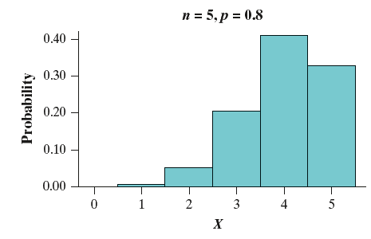
Describing a Binomial Distribution:
Shape, Center, and Variability
The binomial distribution with n = 5 and p = 0.51 is roughly symmetric.
The binomial distribution with n = 5 and p = 0.8 is skewed left.

Slide 39
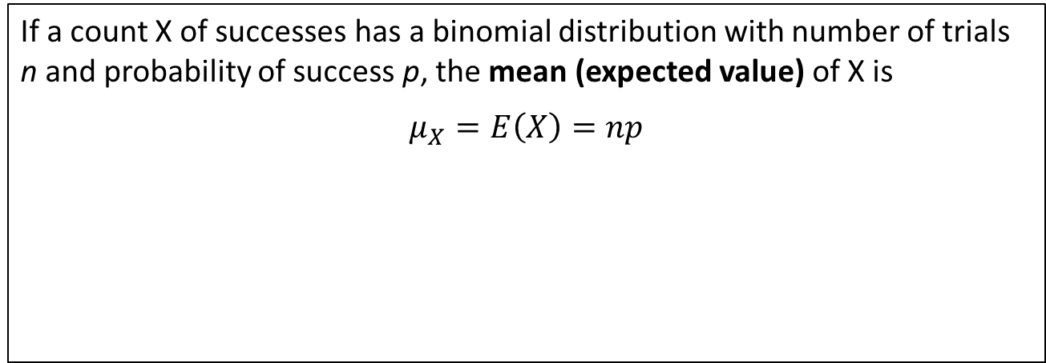
Describing a Binomial Distribution:
Shape, Center, and Variability
Mean and Standard Deviation of a Binomial Random Variable
If a count X of successes has a binomial distribution with number of trials n and probability of success p, the mean (expected value) of X is
$$μ_{X}=E\left(X\right)=np$$

Slide 40
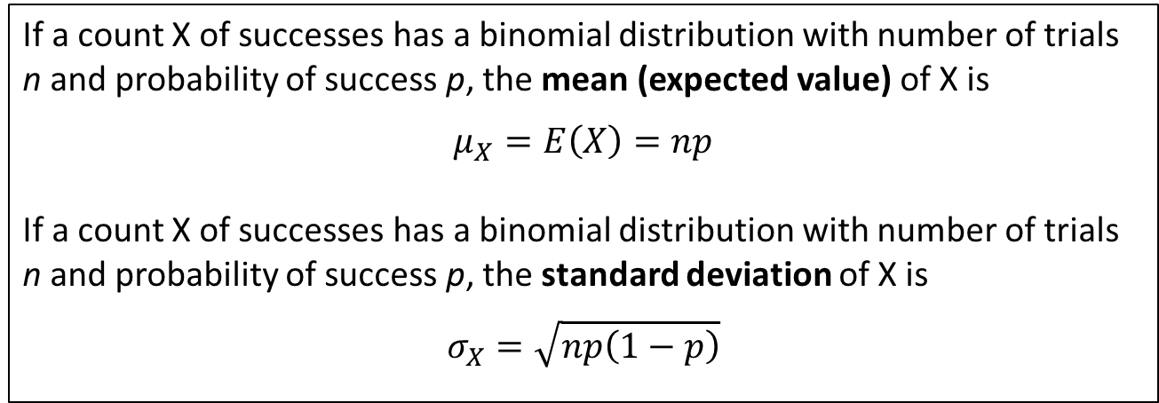
Describing a Binomial Distribution:
Shape, Center, and Variability
Mean and Standard Deviation of a Binomial Random Variable
If a count X of successes has a binomial distribution with number of trials n and probability of success p, the mean (expected value) of X is
$$μ_{X}=E\left(X\right)=np$$
If a count X of successes has a binomial distribution with number of trials n and probability of success p, the standard deviation of X is
$$σ_{X}=\sqrt{np\left(1−p\right)}$$

Slide 41
Describing a Binomial Distribution:
Shape, Center, and Variability
Mean and Standard Deviation of a Binomial Random Variable
If a count X of successes has a binomial distribution with number of trials n and probability of success p, the mean (expected value) of X is
$$μ_{X}=E\left(X\right)=np$$
If a count X of successes has a binomial distribution with number of trials n and probability of success p, the standard deviation of X is
$$σ_{X}=\sqrt{np\left(1−p\right)}$$
CAUTION:
Remember that these formulas for the mean and standard deviation work only for binomial distributions.

Slide 42
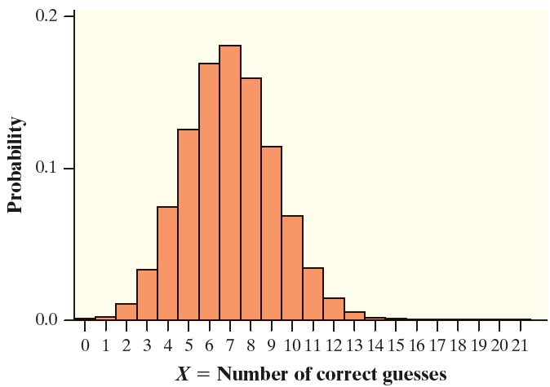
Describing a Binomial Distribution:
Shape, Center, and Variability
Problem: Assume that each of the 21 students in Mr. Hogarth’s AP® Statistics class who did the bottled water versus tap water activity was just guessing, so there was a 1/3 chance of each
student identifying the cup containing
bottled water correctly. Let X = the number
of students who make a correct
identification. At right is a histogram
of the probability distribution of X.
(a) Calculate and interpret the mean of X.

Slide 43
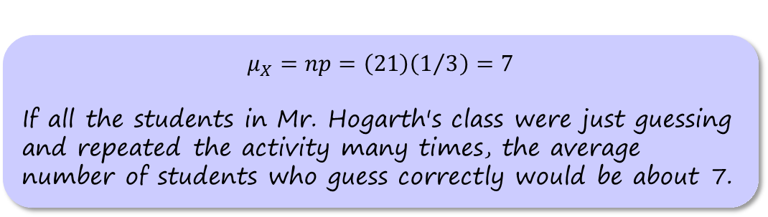
Describing a Binomial Distribution:
Shape, Center, and Variability
Problem: Assume that each of the 21 students in Mr. Hogarth’s AP® Statistics class who did the bottled water versus tap water activity was just guessing, so there was a 1/3 chance of each
student identifying the cup containing
bottled water correctly. Let X = the number
of students who make a correct
identification. At right is a histogram
of the probability distribution of X.
(a) Calculate and interpret the mean of X.
$$μ_{X}=np=\left(21\right)\left(1/3\right)=7$$
If all the students in Mr. Hogarth's class were just guessing and repeated the activity many times, the average number of students who guess correctly would be about 7.

Slide 44
Describing a Binomial Distribution:
Shape, Center, and Variability
Problem: Assume that each of the 21 students in Mr. Hogarth’s AP® Statistics class who did the bottled water versus tap water activity was just guessing, so there was a 1/3 chance of each
student identifying the cup containing
bottled water correctly. Let X = the number
of students who make a correct
identification. At right is a histogram
of the probability distribution of X.
(b) Calculate and interpret the standard
deviation of X.

Slide 45
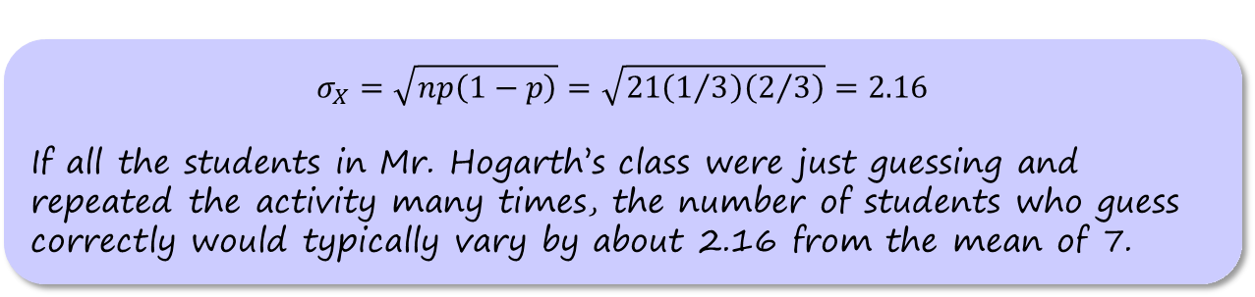
Describing a Binomial Distribution:
Shape, Center, and Variability
Problem: Assume that each of the 21 students in Mr. Hogarth’s AP® Statistics class who did the bottled water versus tap water activity was just guessing, so there was a 1/3 chance of each
student identifying the cup containing
bottled water correctly. Let X = the number
of students who make a correct
identification. At right is a histogram
of the probability distribution of X.
(b) Calculate and interpret the standard
deviation of X.
$$σ_{X}=\sqrt{np\left(1−p\right)}=\sqrt{21\left(1/3\right)\left(2/3\right)}=2.16$$
If all the students in Mr. Hogarth’s class were just guessing and repeated the activity many times, the number of students who guess correctly would typically vary by about 2.16 from the mean of 7.

Slide 46
Binomial Distributions in Statistical Sampling
Almost all real-world sampling, such as taking an SRS from a population of interest, is done without replacement.

Slide 47
Binomial Distributions in Statistical Sampling
Almost all real-world sampling, such as taking an SRS from a population of interest, is done without replacement.
Sampling without replacement leads to a violation of the Independent condition of the binomial setting.

Slide 48
Binomial Distributions in Statistical Sampling
Almost all real-world sampling, such as taking an SRS from a population of interest, is done without replacement.
Sampling without replacement leads to a violation of the Independent condition of the binomial setting.
But, when the population is much larger than the sample, a count of successes in an SRS of size n has an approximately binomial distribution.

Slide 49
Binomial Distributions in Statistical Sampling
Almost all real-world sampling, such as taking an SRS from a population of interest, is done without replacement.
Sampling without replacement leads to a violation of the Independent condition of the binomial setting.
But, when the population is much larger than the sample, a count of successes in an SRS of size n has an approximately binomial distribution.
When taking a random sample of size n from a population of size N, we can use a binomial distribution to model the count of successes in the sample as long as n < 0.10N. We refer to this as the 10% condition.

Slide 50
Binomial Distributions in Statistical Sampling
Problem: In a survey of 500 U.S. teenagers aged 14 to 18, subjects were asked a variety of questions about personal finance. One question asked whether teens had a debit card. Suppose that exactly 12% of teens
aged 14 to 18 have debit cards. Let X = the number of teens in a random sample of size 500 who have a debit card.
(a) Explain why X can be modeled by a binomial distribution even though the sample was selected without replacement.
(b) Use a binomial distribution to estimate the probability that 50 or fewer teens in the sample have debit cards.

Slide 51
Binomial Distributions in Statistical Sampling
Problem: In a survey of 500 U.S. teenagers aged 14 to 18, subjects were asked a variety of questions about personal finance. One question asked whether teens had a debit card. Suppose that exactly 12% of teens
aged 14 to 18 have debit cards. Let X = the number of teens in a random sample of size 500 who have a debit card.
(a) Explain why X can be modeled by a binomial distribution even though the sample was selected without replacement.
(b) Use a binomial distribution to estimate the probability that 50 or fewer teens in the sample have debit cards.
500 is less than 10% of all U.S. teenagers aged 14 to 18.

Slide 52
Binomial Distributions in Statistical Sampling
Problem: In a survey of 500 U.S. teenagers aged 14 to 18, subjects were asked a variety of questions about personal finance. One question asked whether teens had a debit card. Suppose that exactly 12% of teens
aged 14 to 18 have debit cards. Let X = the number of teens in a random sample of size 500 who have a debit card.
(a) Explain why X can be modeled by a binomial distribution even though the sample was selected without replacement.
(b) Use a binomial distribution to estimate the probability that 50 or fewer teens in the sample have debit cards.
500 is less than 10% of all U.S. teenagers aged 14 to 18.
(b) X is approximately binomial with n = 500 and p = 0.12.
P(X ≤ 50) = binomcdf(trials:500, p:0.12, x value: 50)
= 0.0932

Slide 53
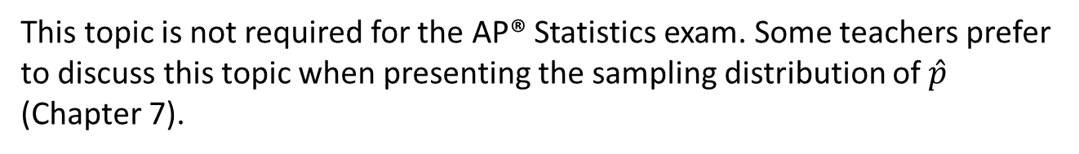
The Normal Approximation to Binomial Distributions
This topic is not required for the AP® Statistics exam. Some teachers prefer to discuss this topic when presenting the sampling distribution of $\hat{p}$ (Chapter 7).

Slide 54
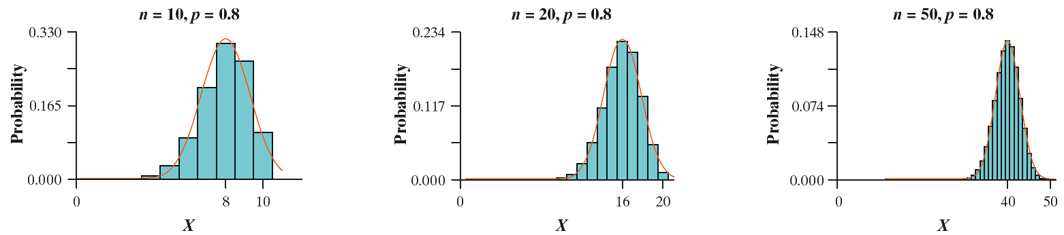
The Normal Approximation to Binomial Distributions
This topic is not required for the AP® Statistics exam. Some teachers prefer to discuss this topic when presenting the sampling distribution of $\hat{p}$ (Chapter 7).
As the number of observations n becomes larger, the binomial distribution gets close to a Normal distribution.

Slide 55
The Normal Approximation to Binomial Distributions
When n is large, we can use Normal probability calculations to approximate binomial probabilities.

Slide 56
The Normal Approximation to Binomial Distributions
When n is large, we can use Normal probability calculations to approximate binomial probabilities.
Suppose that a count X of successes has the binomial distribution with n trials and success probability p. The Large Counts condition says that the probability distribution of X is approximately Normal if
np ≥ 10 and n(1 – p) ≥ 10
That is, the expected numbers (counts) of successes and failures are both at least 10.

Slide 57
The Normal Approximation to Binomial Distributions
When n is large, we can use Normal probability calculations to approximate binomial probabilities.
Suppose that a count X of successes has the binomial distribution with n trials and success probability p. The Large Counts condition says that the probability distribution of X is approximately Normal if
np ≥ 10 and n(1 – p) ≥ 10
That is, the expected numbers (counts) of successes and failures are both at least 10.
This condition is called “large counts” because np is the expected (mean) count of successes and n(1 – p) is the expected (mean) count of failures in a binomial setting.

Slide 58
The Normal Approximation to Binomial Distributions
Problem: In a survey of 500 U.S. teenagers aged 14 to 18, subjects were asked a variety of questions about personal finance. One question asked whether teens had a debit card. Suppose that exactly 12% of teens aged
14 to 18 have debit cards. Let X = the number of teens in a random sample of size 500 who have a debit card.
(a) Justify why X can be approximated by a Normal distribution.
(b) Use a Normal distribution to estimate the probability that 50 or fewer teens in the sample have debit cards.

Slide 59
The Normal Approximation to Binomial Distributions
Problem: In a survey of 500 U.S. teenagers aged 14 to 18, subjects were asked a variety of questions about personal finance. One question asked whether teens had a debit card. Suppose that exactly 12% of teens aged
14 to 18 have debit cards. Let X = the number of teens in a random sample of size 500 who have a debit card.
(a) Justify why X can be approximated by a Normal distribution.
(b) Use a Normal distribution to estimate the probability that 50 or fewer teens in the sample have debit cards.
X is approximately binomial with n = 500 and p = 0.12.
Because np = 500(0.12) = 60 ≥ 10
and n(1 – p) = 500(0.88) = 440 ≥ 10,
we can approximate X with a Normal distribution.

Slide 60
The Normal Approximation to Binomial Distributions
Problem: In a survey of 500 U.S. teenagers aged 14 to 18, subjects were asked a variety of questions about personal finance. One question asked whether teens had a debit card. Suppose that exactly 12% of teens aged
14 to 18 have debit cards. Let X = the number of teens in a random sample of size 500 who have a debit card.
(a) Justify why X can be approximated by a Normal distribution.
(b) Use a Normal distribution to estimate the probability that 50 or fewer teens in the sample have debit cards.

Slide 61
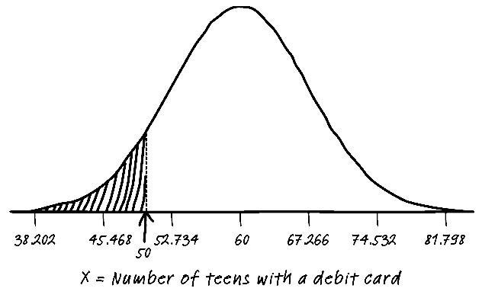
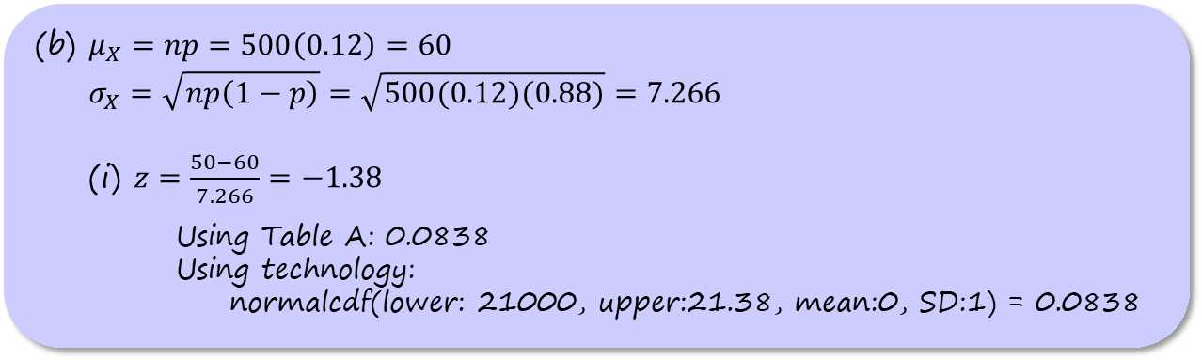
The Normal Approximation to Binomial Distributions
Problem: In a survey of 500 U.S. teenagers aged 14 to 18, subjects were asked a variety of questions about personal finance. One question asked whether teens had a debit card. Suppose that exactly 12% of teens aged
14 to 18 have debit cards. Let X = the number of teens in a random sample of size 500 who have a debit card.
(a) Justify why X can be approximated by a Normal distribution.
(b) Use a Normal distribution to estimate the probability that 50 or fewer teens in the sample have debit cards.
(b) $μ_{X}=np=500\left(0.12\right)=60$
$$σ_{X}=\sqrt{np\left(1−p\right)}=\sqrt{500(0.12)(0.88)}=7.266$$
(i) $z=\frac{50−60}{7.266}=−1.38$
    Using Table A: 0.0838
    Using technology:
    normalcdf(lower: 21000, upper:21.38, mean:0, SD:1) = 0.0838

Slide 62
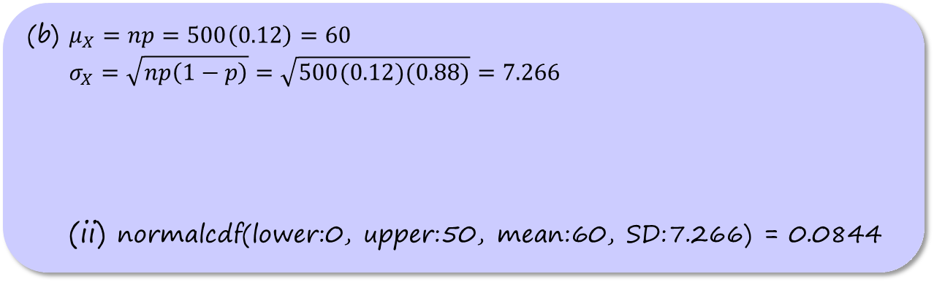
The Normal Approximation to Binomial Distributions
Problem: In a survey of 500 U.S. teenagers aged 14 to 18, subjects were asked a variety of questions about personal finance. One question asked whether teens had a debit card. Suppose that exactly 12% of teens aged
14 to 18 have debit cards. Let X = the number of teens in a random sample of size 500 who have a debit card.
(a) Justify why X can be approximated by a Normal distribution.
(b) Use a Normal distribution to estimate the probability that 50 or fewer teens in the sample have debit cards.
(b) $μ_{X}=np=500\left(0.12\right)=60$
$$σ_{X}=\sqrt{np\left(1−p\right)}=\sqrt{500(0.12)(0.88)}=7.266$$
(ii) normalcdf(lower:0, upper:50, mean:60, SD:7.266) = 0.0844

Slide 63
Geometric Random Variables
A geometric setting arises when we perform independent trials of the same chance process and record the number of trials it takes to get one success. On each trial, the probability p of success must be the same.

Slide 64
Geometric Random Variables
A geometric setting arises when we perform independent trials of the same chance process and record the number of trials it takes to get one success. On each trial, the probability p of success must be the same.
The number of trials Y that it takes to get a success in a geometric setting is a geometric random variable. The probability distribution of Y is a geometric distribution with probability p of success on any trial.
The possible values of Y are 1, 2, 3, . . . .

Slide 65
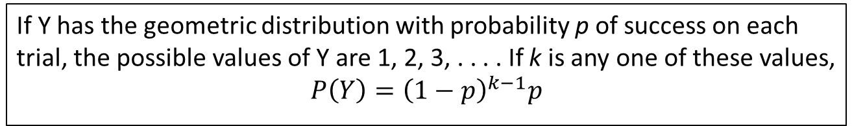
Geometric Random Variables
A geometric setting arises when we perform independent trials of the same chance process and record the number of trials it takes to get one success. On each trial, the probability p of success must be the same.
The number of trials Y that it takes to get a success in a geometric setting is a geometric random variable. The probability distribution of Y is a geometric distribution with probability p of success on any trial.
The possible values of Y are 1, 2, 3, . . . .
Geometric Probability Formula
If Y has the geometric distribution with probability p of success on each trial, the possible values of Y are 1, 2, 3, . . . . If k is any one of these values,
$$P\left(Y\right)={\left(1−p\right)}^{k−1}p$$

Slide 66
Geometric Random Variables
Problem: Mr. Lochel’s class decides to play the Lucky Day game. A student
will be selected at random from your class and asked to pick a day of the week (e.g., Thursday). Then your teacher will use technology to randomly choose a day of the week as the “lucky day.” If the student picks the correct day, the class will have only one homework problem. If the student picks the wrong day, your teacher will select another student from the class at random and repeat the process. The game continues until a student correctly picks the lucky day. Let Y = the number of homework problems that the class receives.
(a) Find the probability that the class receives exactly 10 homework problems as a result of playing the Lucky Day game.

Slide 67
Geometric Random Variables
Problem: Mr. Lochel’s class decides to play the Lucky Day game. A student
will be selected at random from your class and asked to pick a day of the week (e.g., Thursday). Then your teacher will use technology to randomly choose a day of the week as the “lucky day.” If the student picks the correct day, the class will have only one homework problem. If the student picks the wrong day, your teacher will select another student from the class at random and repeat the process. The game continues until a student correctly picks the lucky day. Let Y = the number of homework problems that the class receives.
(a) Find the probability that the class receives exactly 10 homework problems as a result of playing the Lucky Day game.
X is approximately binomial with n = 500 and p = 0.12.
Because np = 500(0.12) = 60 ≥ 10
and n(1 – p) = 500(0.88) = 440 ≥ 10,
we can approximate X with a Normal distribution.

Slide 68
Geometric Random Variables
Problem: Mr. Lochel’s class decides to play the Lucky Day game. A student
will be selected at random from your class and asked to pick a day of the week (e.g., Thursday). Then your teacher will use technology to randomly choose a day of the week as the “lucky day.” If the student picks the correct day, the class will have only one homework problem. If the student picks the wrong day, your teacher will select another student from the class at random and repeat the process. The game continues until a student correctly picks the lucky day. Let Y = the number of homework problems that the class receives.
(b) Find P(Y < 10) and interpret this value.

Slide 69
Geometric Random Variables
Problem: Mr. Lochel’s class decides to play the Lucky Day game. A student
will be selected at random from your class and asked to pick a day of the week (e.g., Thursday). Then your teacher will use technology to randomly choose a day of the week as the “lucky day.” If the student picks the correct day, the class will have only one homework problem. If the student picks the wrong day, your teacher will select another student from the class at random and repeat the process. The game continues until a student correctly picks the lucky day. Let Y = the number of homework problems that the class receives.
(b) Find P(Y < 10) and interpret this value.
(Y < 10) = P(Y = 1) + P(Y = 2) + P(Y = 3) + ··· + P(Y = 9)
= (1/7) + (6/7)(1/7) + (6/7)²(1/7) + ··· + (6/7)⁸(1/7)
=0.7503
There’s about a 75% probability that the class will get fewer than 10 homework problems by playing the Lucky Day game.

Slide 70
Geometric Random Variables
To compute geometric probabilities on the TI-83/84 calculator:

Slide 71
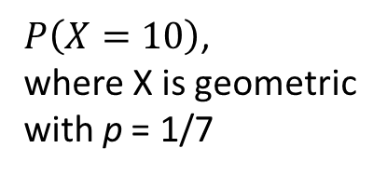
Geometric Random Variables
To compute geometric probabilities on the TI-83/84 calculator:
  geometpdf (p,k) computes P(X = k)
$P\left(X=10\right)$,
where X is geometric
with p = 1/7

Slide 72
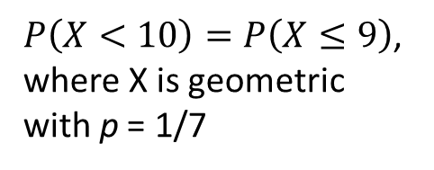
Geometric Random Variables
To compute geometric probabilities on the TI-83/84 calculator:
  geometpdf (p,k) computes P(X = k)
  geometcdf (p,k) computes P(X ≤ k)
$P\left(X=10\right)$,
where X is geometric
with p = 1/7
$P\left(X<10\right)=P\left(X≤9\right)$,
where X is geometric
with p = 1/7

Slide 73
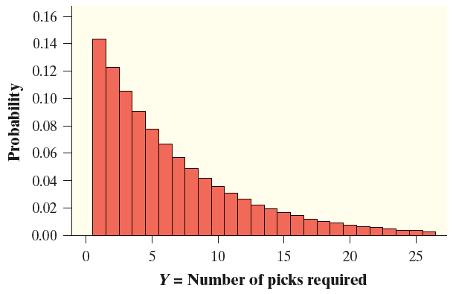
Describing a Geometric Distribution: Shape, Center, Variability
The table and histogram show part of the probability distribution of Y = the number of picks it takes to match the lucky day. We can’t show the entire distribution because the number of trials it takes to get the first success could be a very large number.

Slide 74
Describing a Geometric Distribution: Shape, Center, Variability
The table and histogram show part of the probability distribution of Y = the number of picks it takes to match the lucky day. We can’t show the entire distribution because the number of trials it takes to get the first success could be a very large number.
Shape: Skewed to the right. Every geometric distribution has this shape.

Slide 75
Describing a Geometric Distribution: Shape, Center, Variability
The table and histogram show part of the probability distribution of Y = the number of picks it takes to match the lucky day. We can’t show the entire distribution because the number of trials it takes to get the first success could be a very large number.
Shape: Skewed to the right. Every geometric distribution has this shape.
Center: The mean (expected value) of X is μX = 7. If the class played the Lucky Day game many times, they would receive an average of 7 homework problems.

Slide 76
Describing a Geometric Distribution: Shape, Center, Variability
The table and histogram show part of the probability distribution of Y = the number of picks it takes to match the lucky day. We can’t show the entire distribution because the number of trials it takes to get the first success could be a very large number.
Shape: Skewed to the right. Every geometric distribution has this shape.
Center: The mean (expected value) of X is μX = 7. If the class played the Lucky Day game many times, they would receive an average of 7 homework problems.
Variability: The standard deviation of X is σX = 6.48. If the class played the Lucky Day game many times, the number of homework problems they receive would typically vary by about 6.5 problems from the mean of 7.

Slide 77
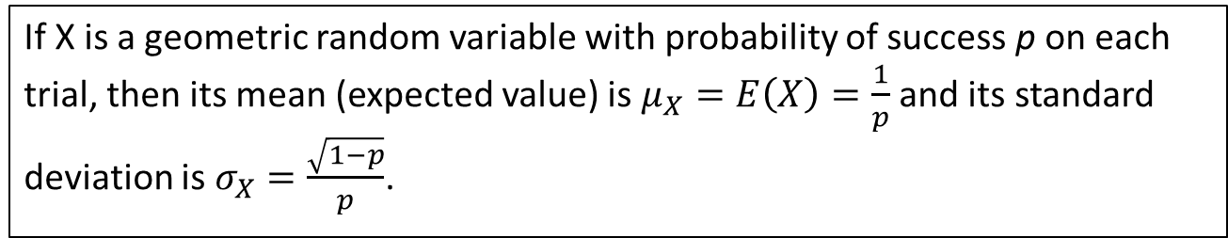
Describing a Geometric Distribution: Shape, Center, Variability
Mean (Expected Value) and Standard Deviation
of a Geometric Random Variable
If X is a geometric random variable with probability of success p on each
trial, then its mean (expected value) is $μ_{X}=E\left(X\right)=\frac{1}{p}$ and its standard deviation is $σ_{X}=\frac{\sqrt{1−p}}{p}$.

Slide 78
Describing a Geometric Distribution: Shape, Center, Variability
Problem: A local fast-food restaurant is running a “Draw a three, get it free” lunch promotion. After each customer orders, a touchscreen display shows the message “Press here to win a free lunch.” A computer program then simulates one card being drawn from a standard deck. If the chosen card is a 3, the customer’s
order is free. Otherwise, the customer must pay the bill. Let X = the number of customers it takes to get the first free order on a given day.
(a) Calculate and interpret the mean of X.

Slide 79
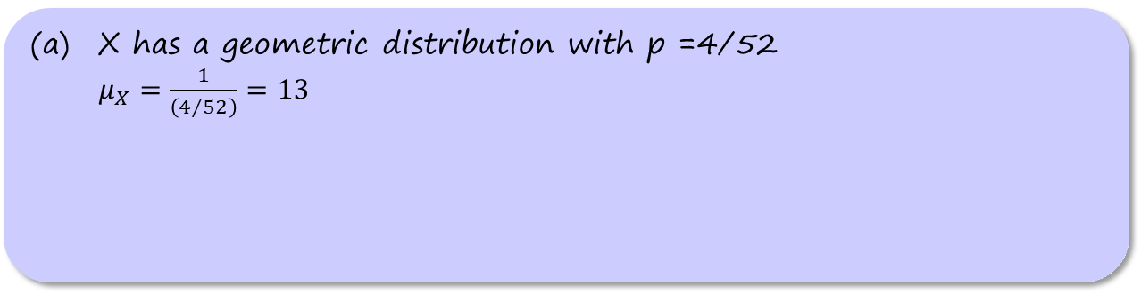
Describing a Geometric Distribution: Shape, Center, Variability
Problem: A local fast-food restaurant is running a “Draw a three, get it free” lunch promotion. After each customer orders, a touchscreen display shows the message “Press here to win a free lunch.” A computer program then simulates one card being drawn from a standard deck. If the chosen card is a 3, the customer’s
order is free. Otherwise, the customer must pay the bill. Let X = the number of customers it takes to get the first free order on a given day.
(a) Calculate and interpret the mean of X.
X has a geometric distribution with p =4/52
$μ_{X}=\frac{1}{\left(4/{52}\right)}=13$

Slide 80
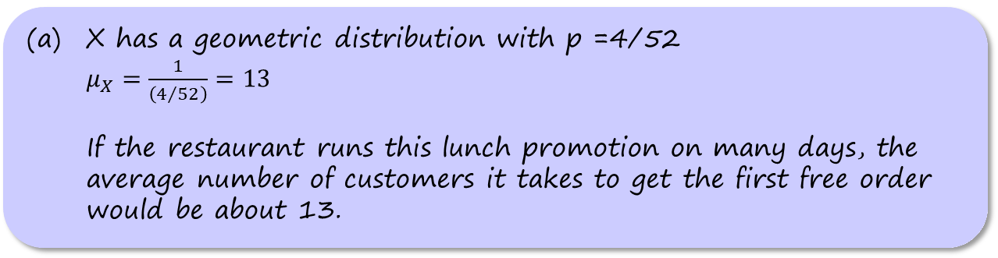
Describing a Geometric Distribution: Shape, Center, Variability
Problem: A local fast-food restaurant is running a “Draw a three, get it free” lunch promotion. After each customer orders, a touchscreen display shows the message “Press here to win a free lunch.” A computer program then simulates one card being drawn from a standard deck. If the chosen card is a 3, the customer’s
order is free. Otherwise, the customer must pay the bill. Let X = the number of customers it takes to get the first free order on a given day.
(a) Calculate and interpret the mean of X.
X has a geometric distribution with p =4/52
$μ_{X}=\frac{1}{\left(4/{52}\right)}=13$
If the restaurant runs this lunch promotion on many days, the average number of customers it takes to get the first free order would be about 13.

Slide 81
Describing a Geometric Distribution: Shape, Center, Variability
Problem: A local fast-food restaurant is running a “Draw a three, get it free” lunch promotion. After each customer orders, a touchscreen display shows the message “Press here to win a free lunch.” A computer program then simulates one card being drawn from a standard deck. If the chosen card is a 3, the customer’s
order is free. Otherwise, the customer must pay the bill. Let X = the number of customers it takes to get the first free order on a given day.
(a) Calculate and interpret the mean of X.
(b) Calculate and interpret the standard deviation of X.

Slide 82
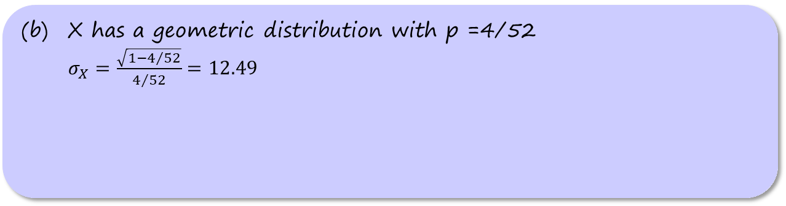
Describing a Geometric Distribution: Shape, Center, Variability
Problem: A local fast-food restaurant is running a “Draw a three, get it free” lunch promotion. After each customer orders, a touchscreen display shows the message “Press here to win a free lunch.” A computer program then simulates one card being drawn from a standard deck. If the chosen card is a 3, the customer’s
order is free. Otherwise, the customer must pay the bill. Let X = the number of customers it takes to get the first free order on a given day.
(a) Calculate and interpret the mean of X.
(b) Calculate and interpret the standard deviation of X.
X has a geometric distribution with p =4/52
$σ_{X}=\frac{\sqrt{1−4/{52}}}{4/{52}}=12.49$

Slide 83
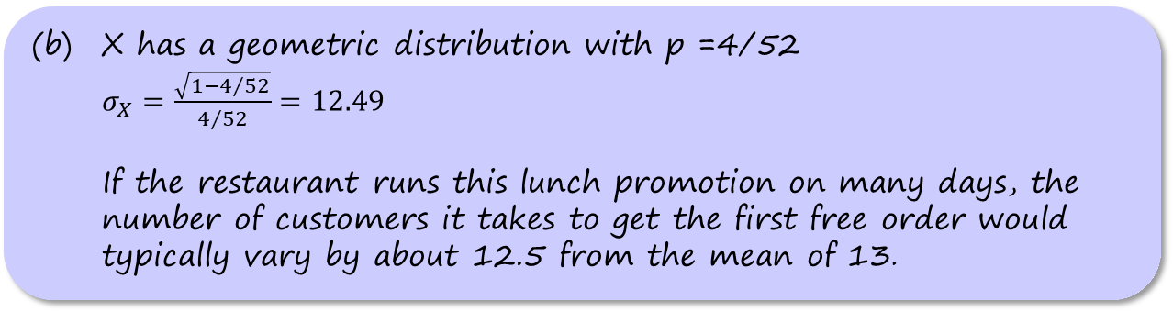
Describing a Geometric Distribution: Shape, Center, Variability
Problem: A local fast-food restaurant is running a “Draw a three, get it free” lunch promotion. After each customer orders, a touchscreen display shows the message “Press here to win a free lunch.” A computer program then simulates one card being drawn from a standard deck. If the chosen card is a 3, the customer’s
order is free. Otherwise, the customer must pay the bill. Let X = the number of customers it takes to get the first free order on a given day.
(a) Calculate and interpret the mean of X.
(b) Calculate and interpret the standard deviation of X.
X has a geometric distribution with p =4/52
$σ_{X}=\frac{\sqrt{1−4/{52}}}{4/{52}}=12.49$
If the restaurant runs this lunch promotion on many days, the number of customers it takes to get the first free order would typically vary by about 12.5 from the mean of 13.

Slide 84
Section Summary
DETERMINE whether the conditions for a binomial setting are met.
CALCULATE and INTERPRET probabilities involving binomial distributions.
CALCULATE the mean and standard deviation of a binomial random variable. INTERPRET these values.
When appropriate, USE the Normal approximation to the binomial distribution to CALCULATE probabilities.
CALCULATE and INTERPRET probabilities involving geometric random variables.
CALCULATE the mean and standard deviation of a geometric distribution. INTERPRET these values.

